Slide 1
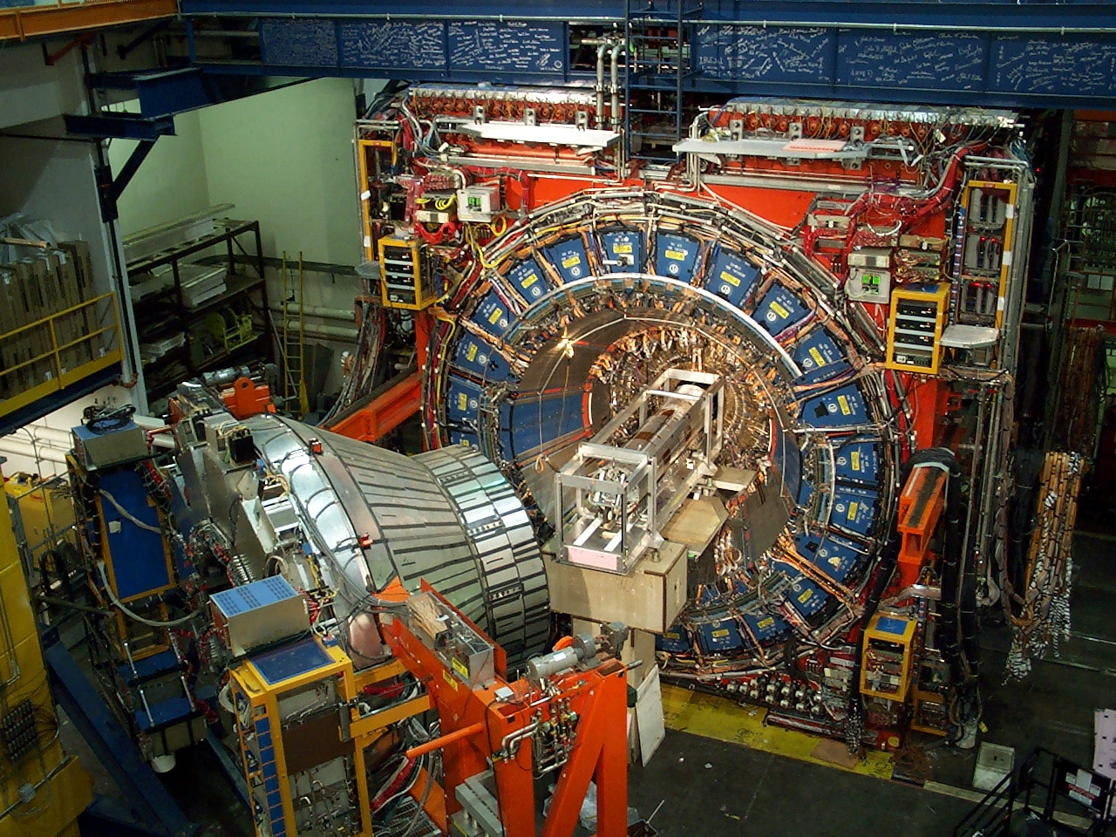

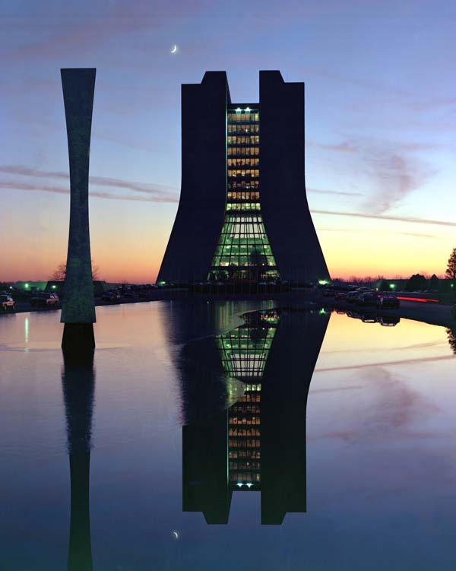

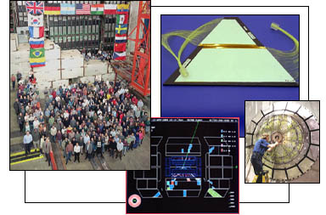
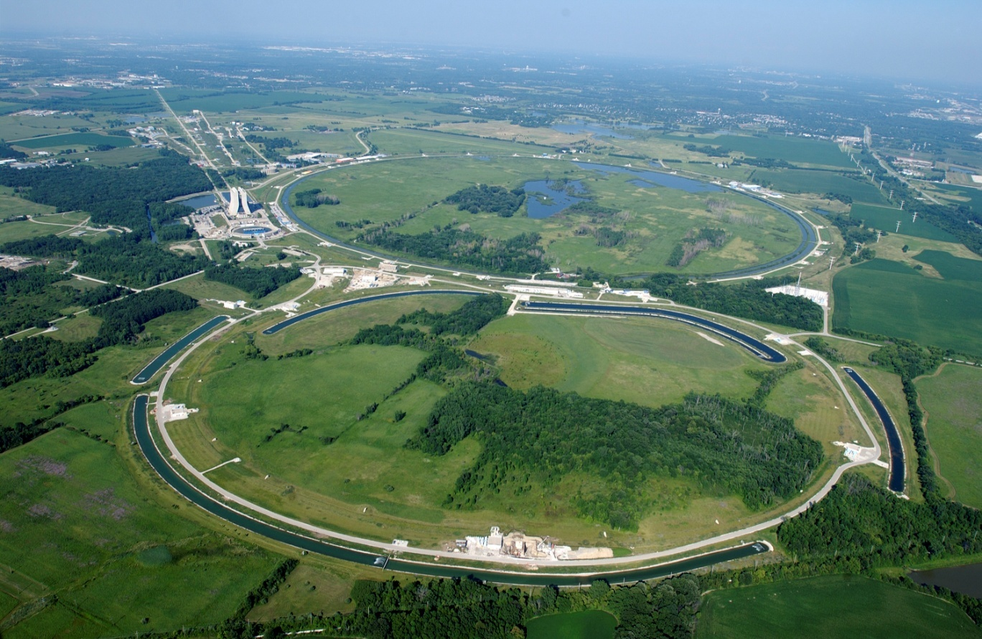

Tevatron Results on SM Higgs Search
  Dr. Richard St. Denis
  Glasgow University
  Edinburgh, October 28, 2010
Outline
Search Foundation and Higgs detection modes
Low Mass Higgs
High Mass Higgs
Results, implications, next steps, Retro

Slide 2
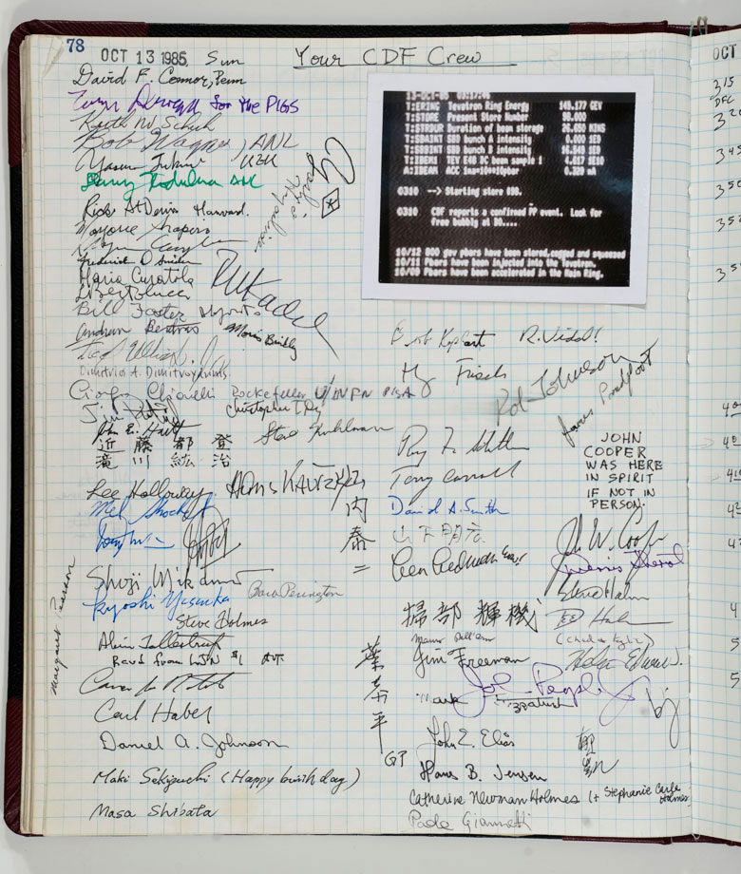
25th Anniversary:
First Collisions: Oct 13, 1985

Slide 3

Tevatron Lumi

Slide 4
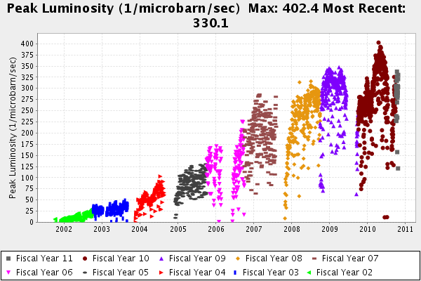
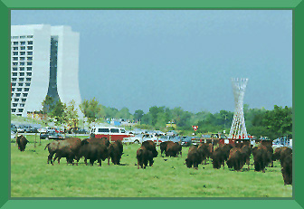
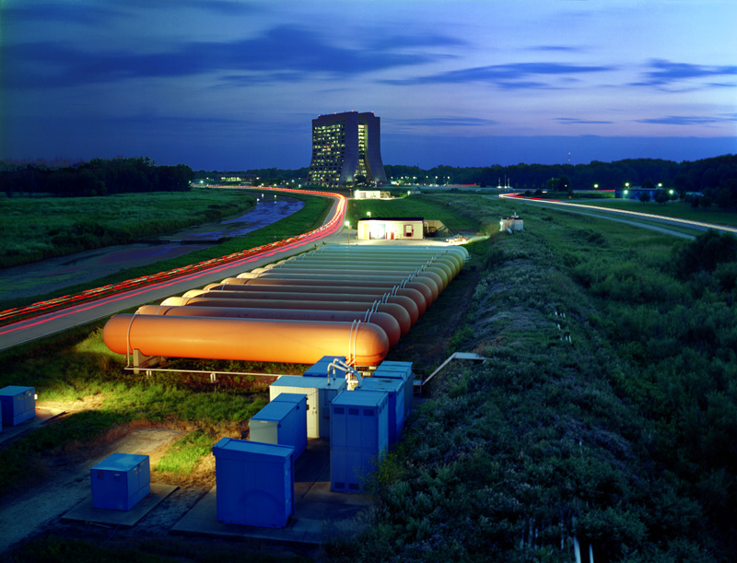
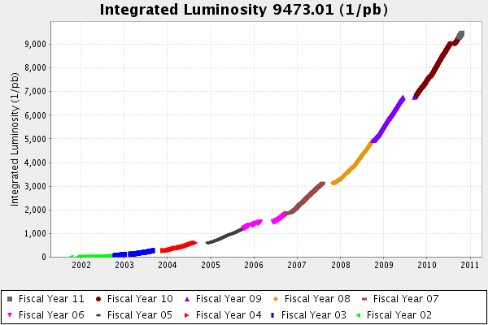
Max:0.4 x 10³³
09
07
05
03
9.5 fb⁻¹ Delivered
Last talk

Slide 5
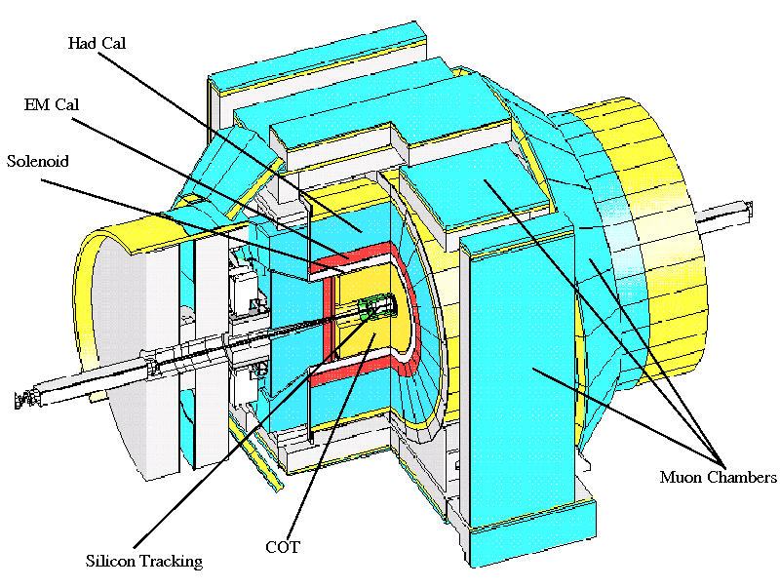
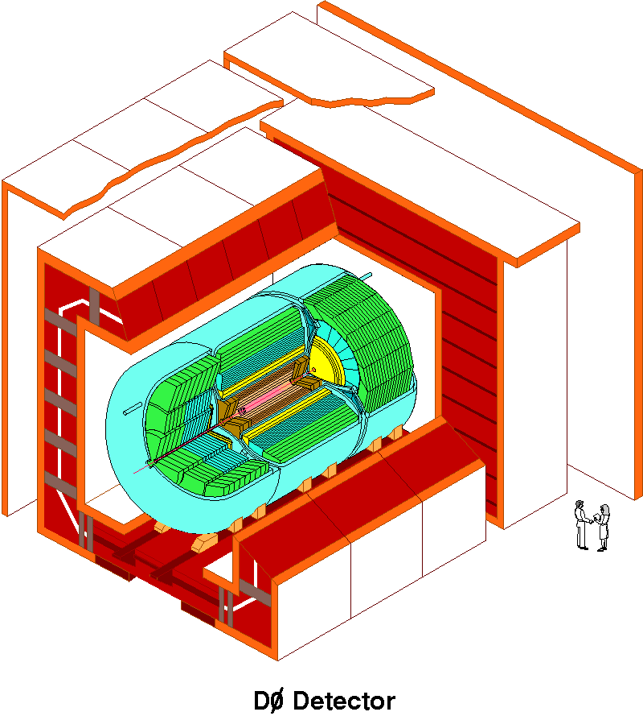
D0 and CDF Detectors
Silicon Tracking
Fibre Tracker
L Ar Calo. |η|<4
Muon: |η|<2
Silicon Tracking
Open drift Cell Tracker
Scintillator Calo. |η|<3.2
Muon coverage |η|<1.5
Results for 2-5.4 fb⁻¹

Slide 6
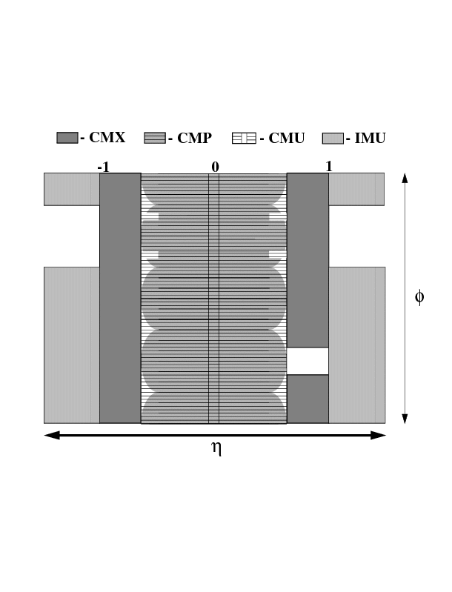

Slide 7
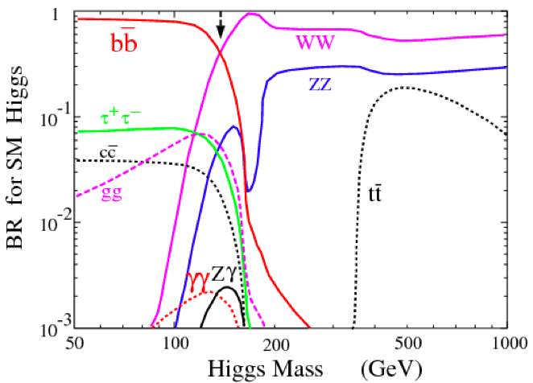
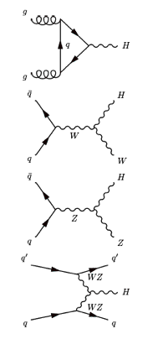
SM Higgs Production and Decay
Low Mass
High Mass
Gluon Fusion
(dominates)
Trigger: Met, 1 High Pt e or μ
Focus on llbb,lnbb,nnbb
Event Selection: High Pt Leptons, 2 jets, Missing E_{T,} BTag
Associated production
Vector Boson Fusion

Slide 8
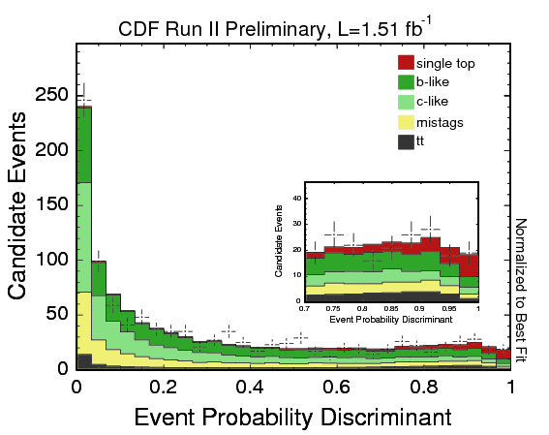
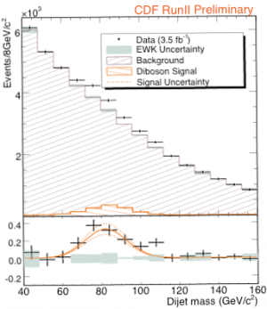
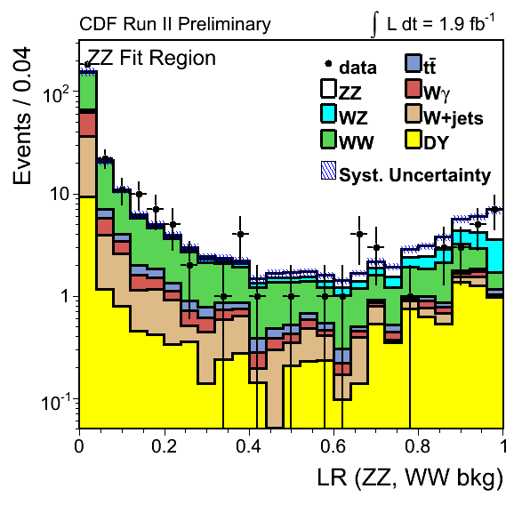
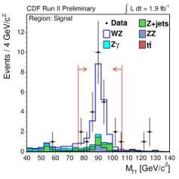
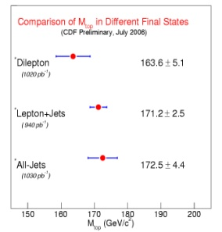
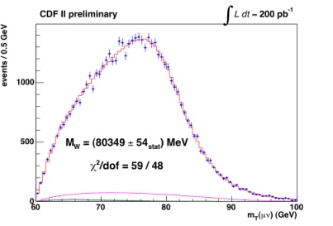
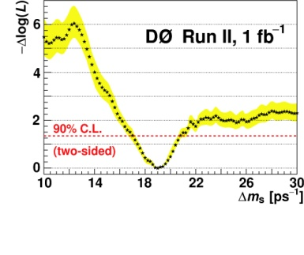
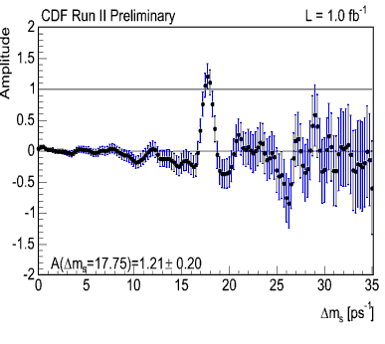
Higher Physics Reach
Susy
New
hadronic
Single Top
Higgs
ZZ
WW,WZ,ZZ
M
t
Top (t)
WZ
M
w
Top(ttbar)
WZ
Δm_{s}=17.77 ± 0.10 ± 0.07
Bottom
Jets
Build on mountain of measurements

Slide 9
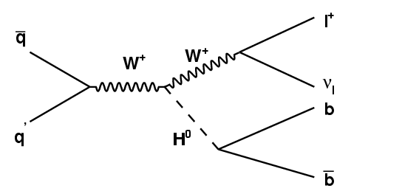
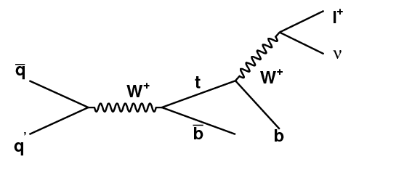
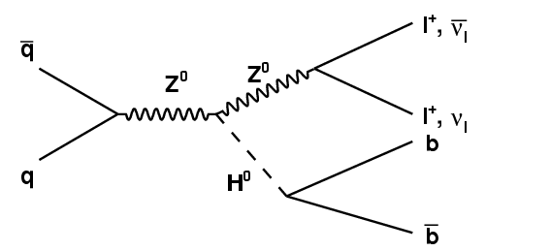
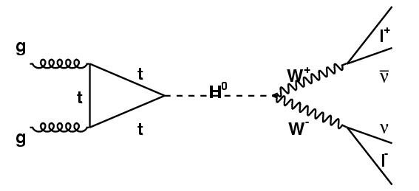
Messengers
+
+
W
l
q
ν
l
0
b
q
Z
b
0
+
0
l
Z
Z
q
-
l
0
b
q
Z
b
0
‘+
Z
l
q
‘-
l
0
ν
q
Z
l
ν
l

Slide 10

Look at W/Zbb

Slide 11
Must Have Events to Detect Them
WH(lνbb)
WW to 120ish
Total
ZH(ννbb)
Small VBF
ZH(llbb)
gg-WW
Before
Selection!
(ε∼2-7%)
VBF
WH-WWW

Slide 12
Associated Production: Z/W bb
Topology
& Trigger
Background
Control
Worst
Systematic
Requires Multiple Channels
20
Track-based
MET
B tag modelling
35
20
B tag modelling
20
20
NN Input
Z+jets

Slide 13
Analysis Map
Trigger and Selection
B tagging
Multivariate Analysis

Slide 14
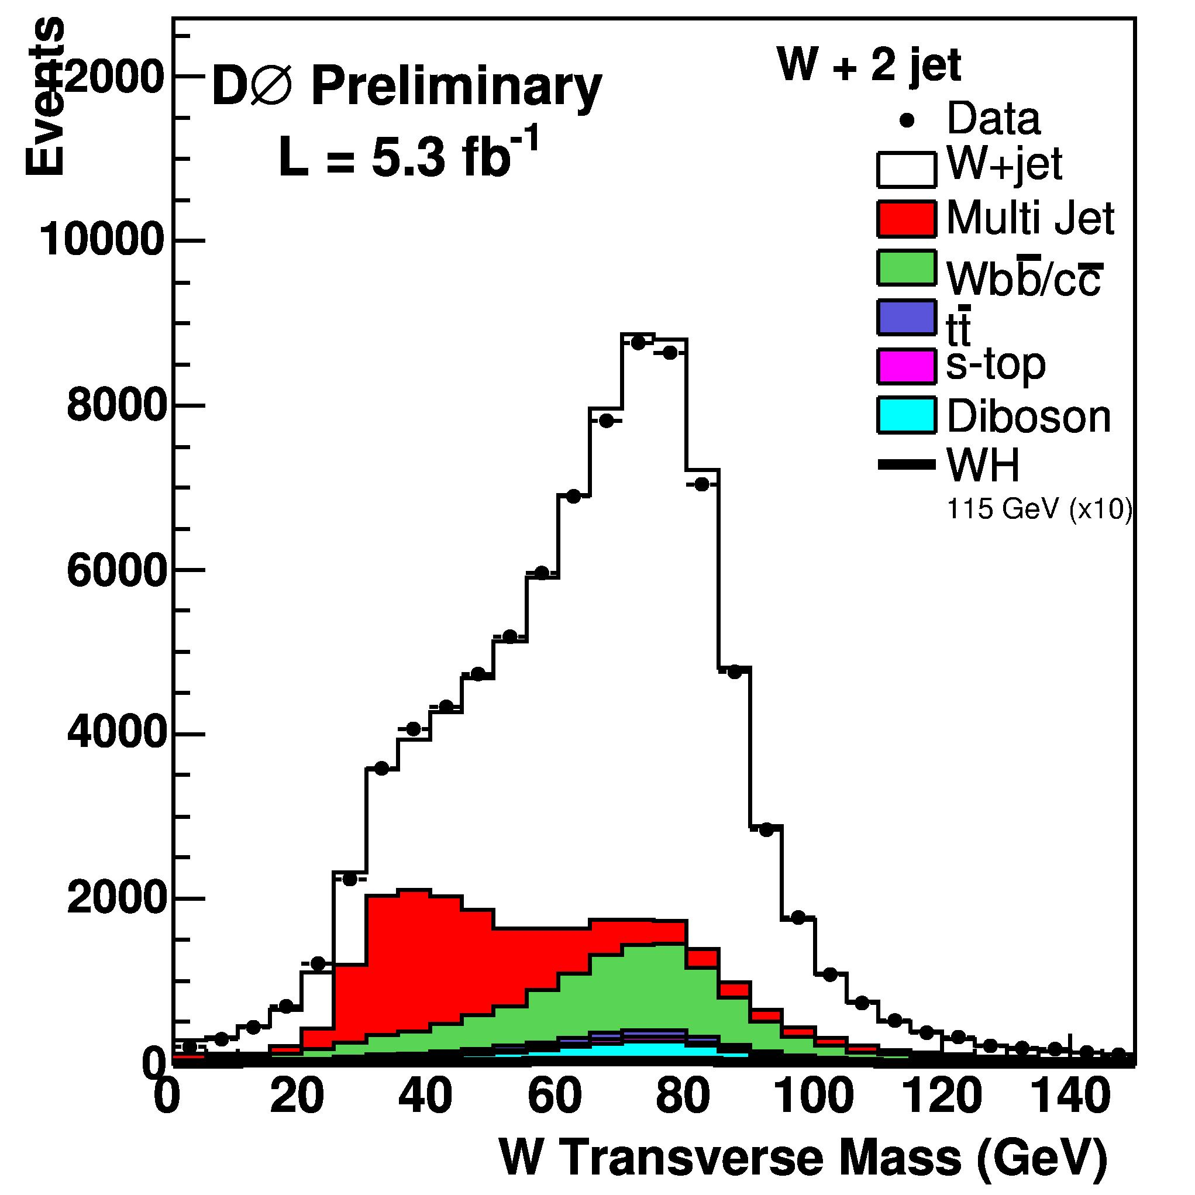
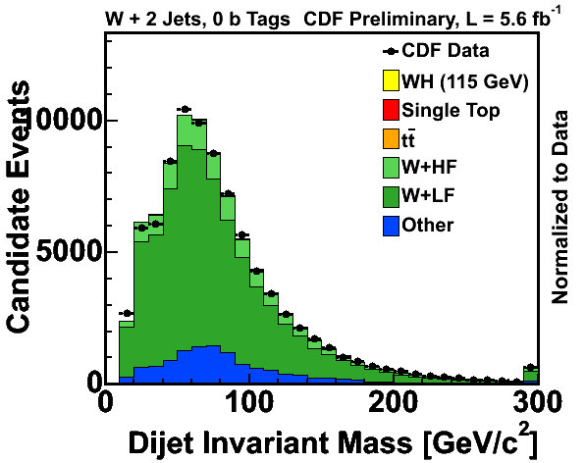

WH>lνbb
Trigger and Selection
A W + Jets analysis
Trigger on MET or a high pt (>15,20 GeV) lepton
Select events with 2 or 3 jets

Slide 15
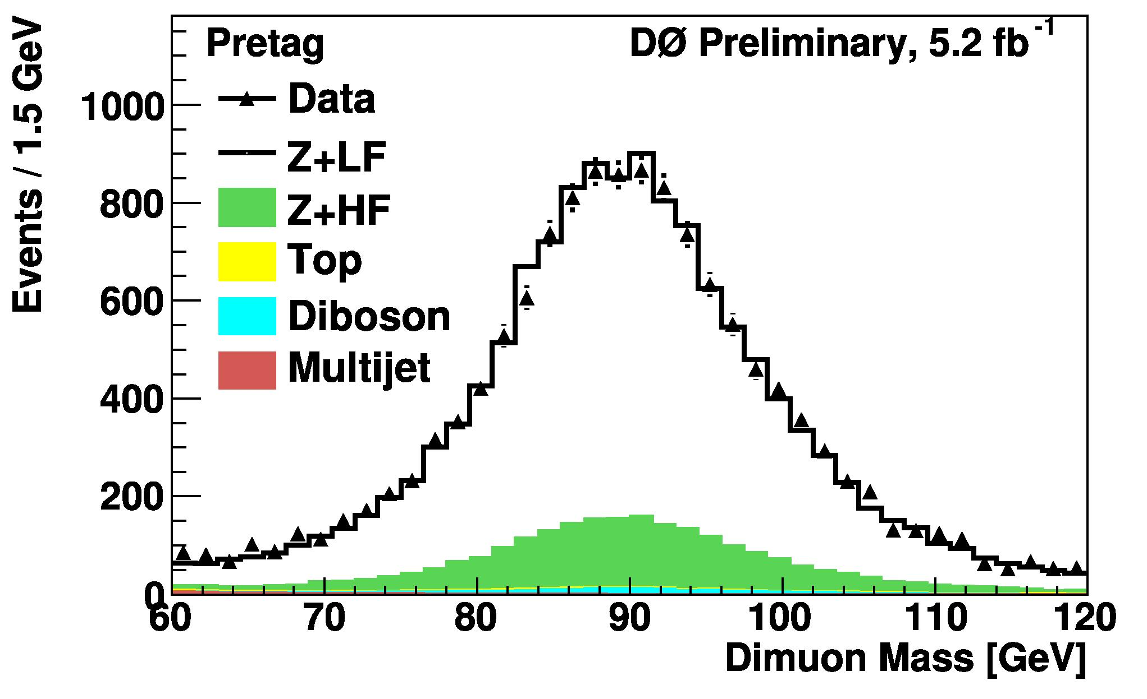
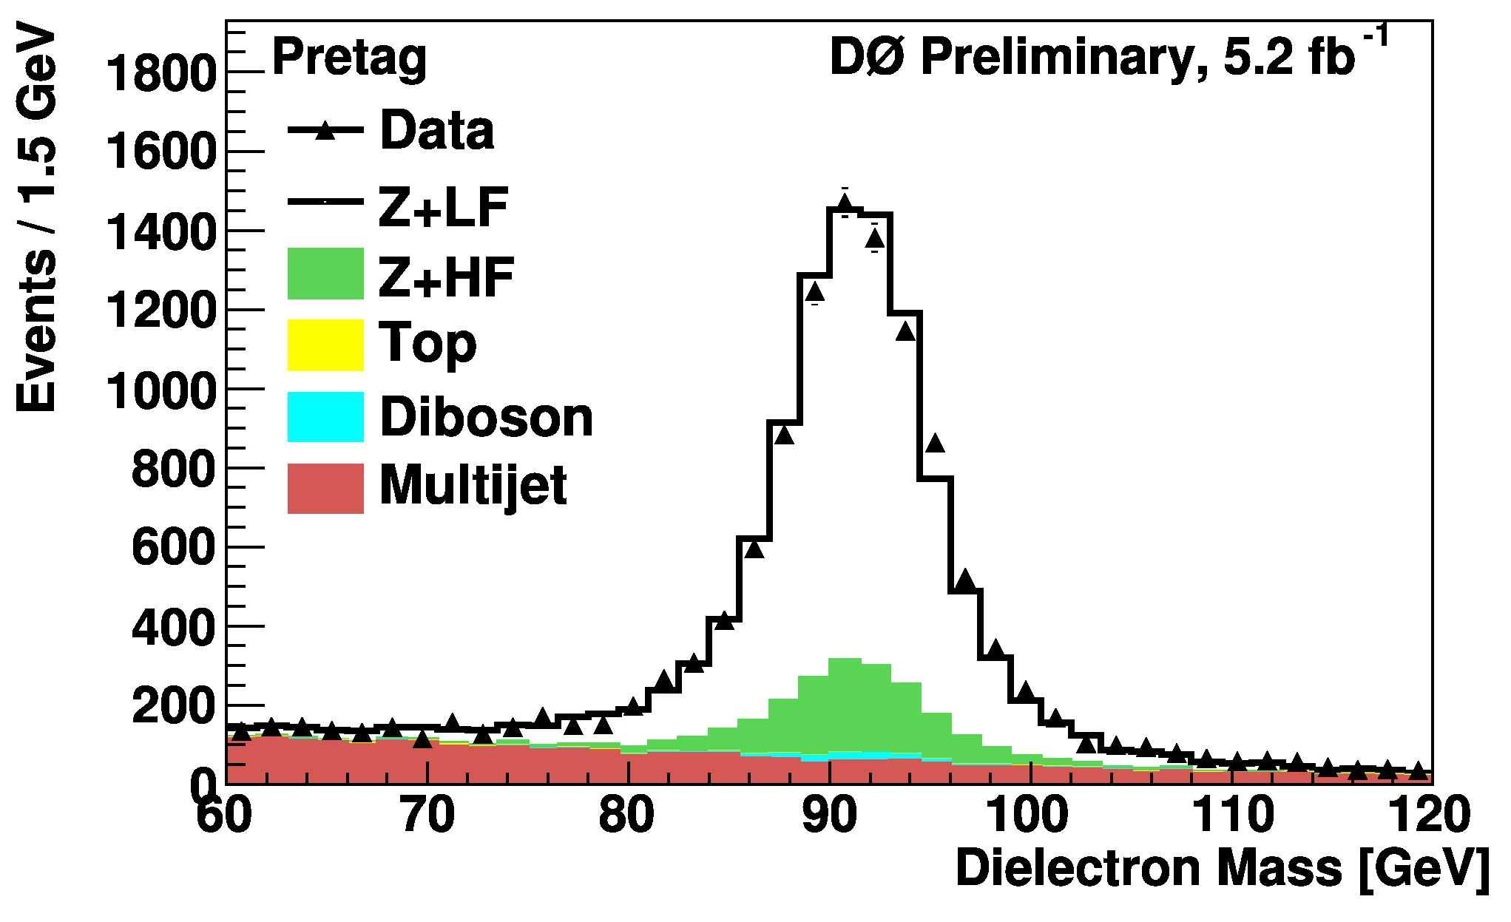
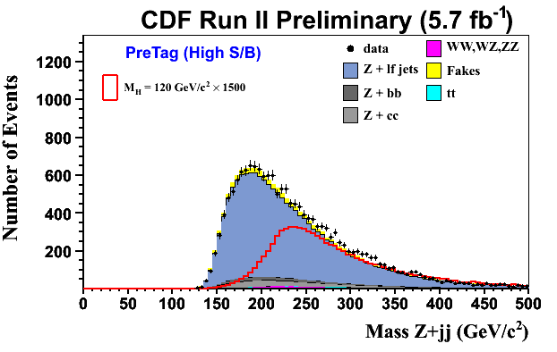
ZH->llbb
Trigger and Selection
A Z + Jets analysis
Trigger a high pt (>15,20 GeV) lepton
Select events with 2nd lepton pt>20, M_{z} mass
Select at least 2 jets
μμ
ee
ee+μμ

Slide 16
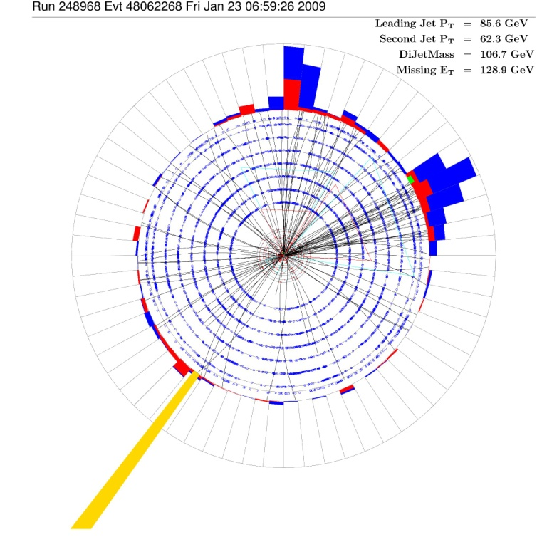
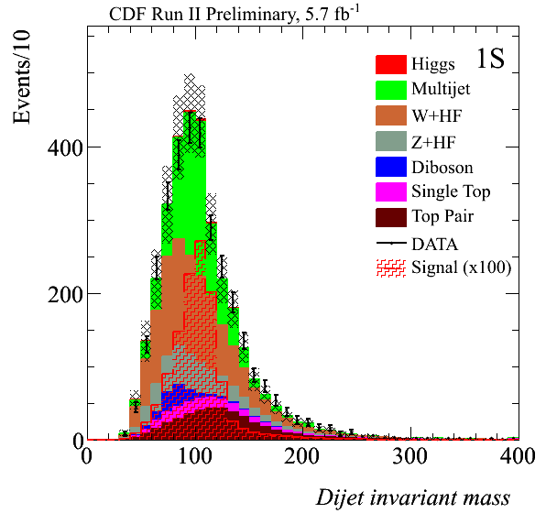
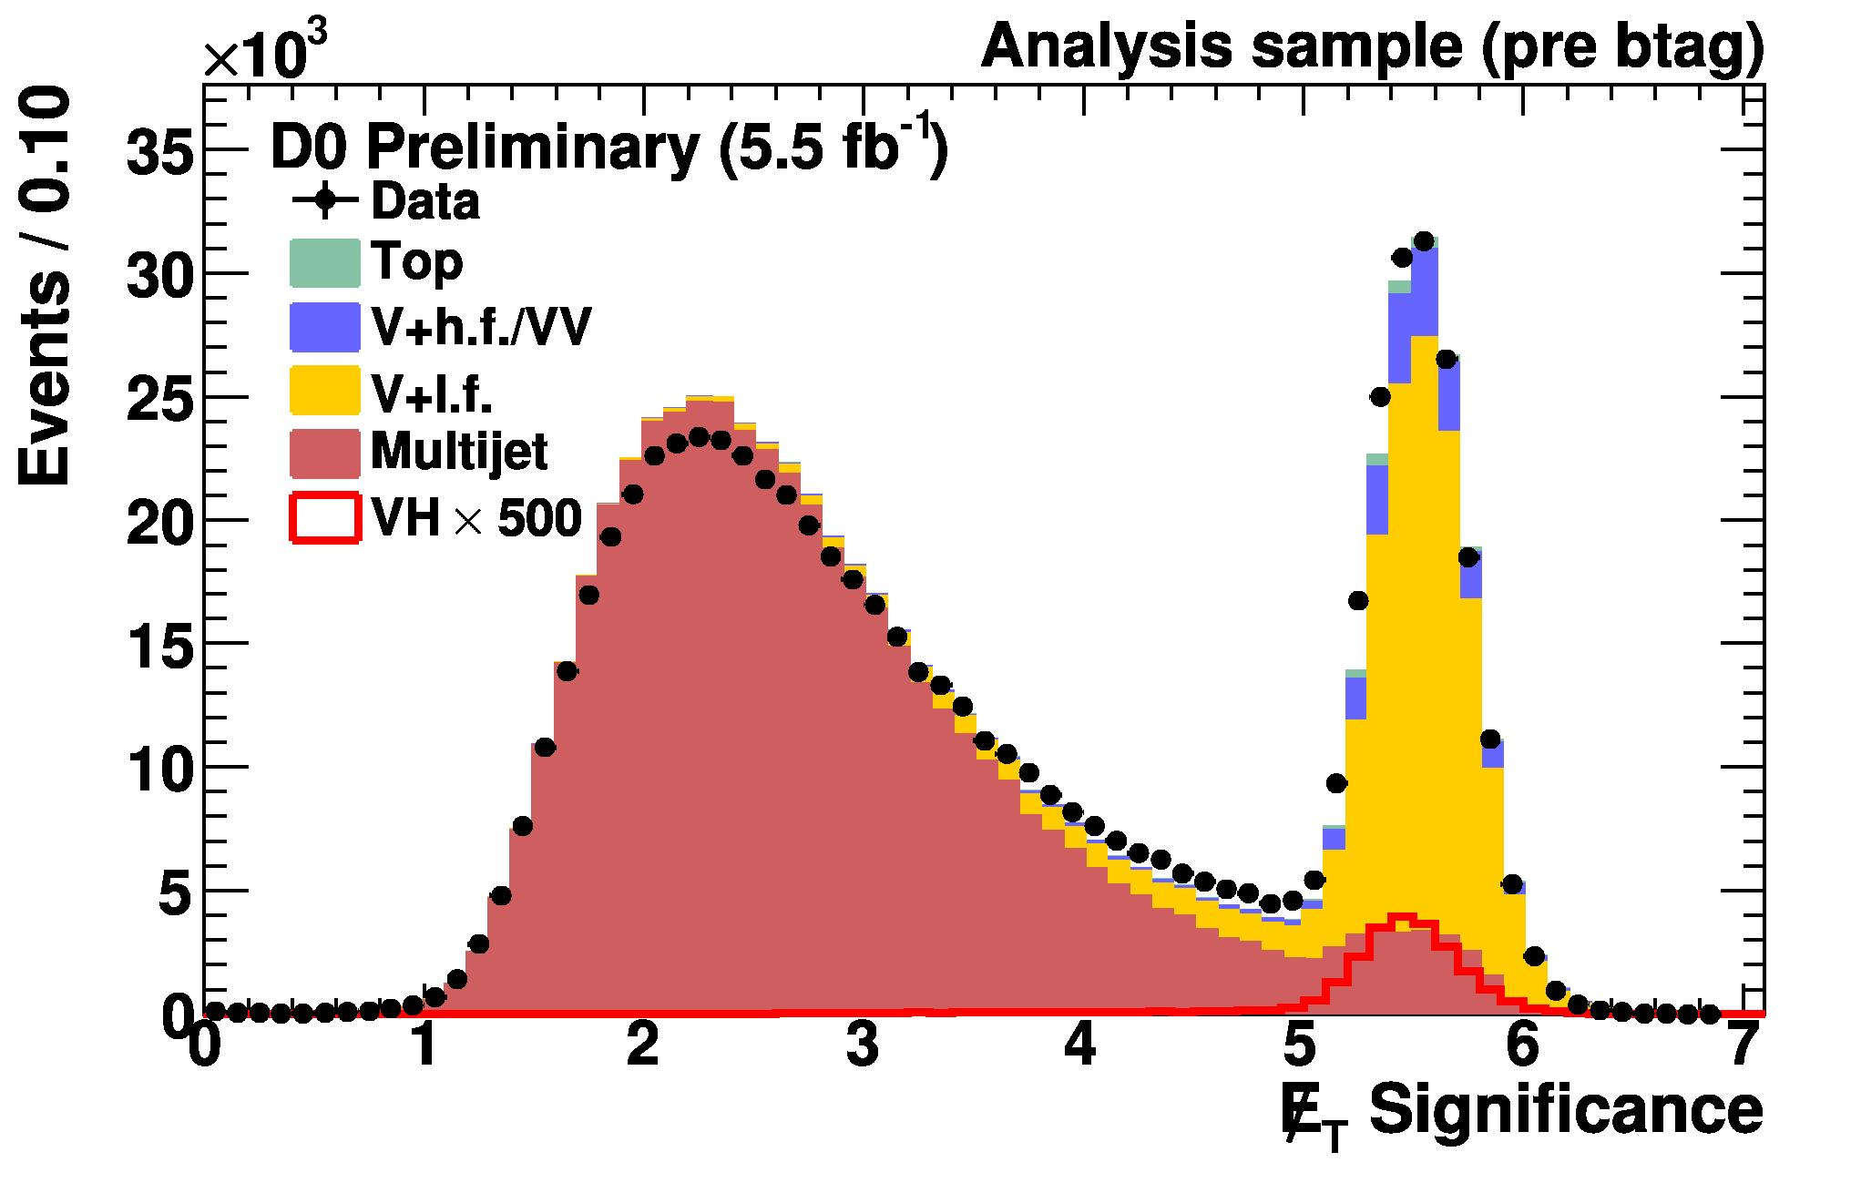
ZH->ννbb
WH->(l)νbb
Met + 2 jet, veto leptons
Background
  Physics: Z,W+jet, tt,WZ,ZZ
  Instrumental: Mismeasured QCD

Slide 17
Analysis Map
Trigger and Selection
B tagging
Multivariate Analysis

Slide 18
Purity
Jet
Tight Secondary vertex reconstructed?
displaced tracks
decay lifetime
Loose Secondary vertex reconstructed?
Lxy
primary vertex
M_{tag}
d0
Jet Probability?
prompt tracks
NN Tagger?
B tagging
Tag Efficiency: 50-70% b, 0.5-5% light quark
Orthogonal event samples
Form matrix for 2 jet: Tight-Tight, Tight-Loose… Single Tag.
Tight Secondary vertex reconstructed?
Loose Secondary vertex reconstructed?
Jet Probability?
NN Tagger?
No Tag

Slide 19
Explosion of Channels (CDF)!
WH→lνbb
Tag | Lepton | Jet
SecStx+SecVtx | Tight | 2
SecVtx+JP | Tight | 2
SecVtx+Nntagger | Tight | 2
SecVtx Single | Tight | 2
SecStx+SecVtx | IsoTrk | 2
SecVtx+JP | IsoTrk | 2
SecVtx+Nntagger | IsoTrk | 2
SecVtx Single | IsoTrk | 2
SecStx+SecVtx | Forward | 2
LooseSecVtx+JP | Forward | 2
SecVtx+Nntagger | Forward | 2
SecVtx Single | Forward | 3
SecStx+SecVtx | Tight | 3
LooseSecVtx+JP | Tight | 3
SecVtx Single | Tight | 3
SecStx+SecVtx | Extend-μ | 3
ooseSecVtx+JP | Extend-μ | 3
SecVtx Single | Extend-μ | 3
METbb: WH→(l)νbb: ZH→ννbb
Tag
SecStx+SecVtx
SecVtx+JP
SecVtx Single
ZH→llbb
Tag | Leptons
SecStx+SecVtx | High S/B
SecVtx+JP | High S/B
SecVtx Single | High S/B
SecStx+SecVtx | Low S/B
SecVtx+JP | Low S/B
SecVtx Single | Low S/B
W/ZH→jjbb
Tag
SecStx+SecVtx

Slide 20
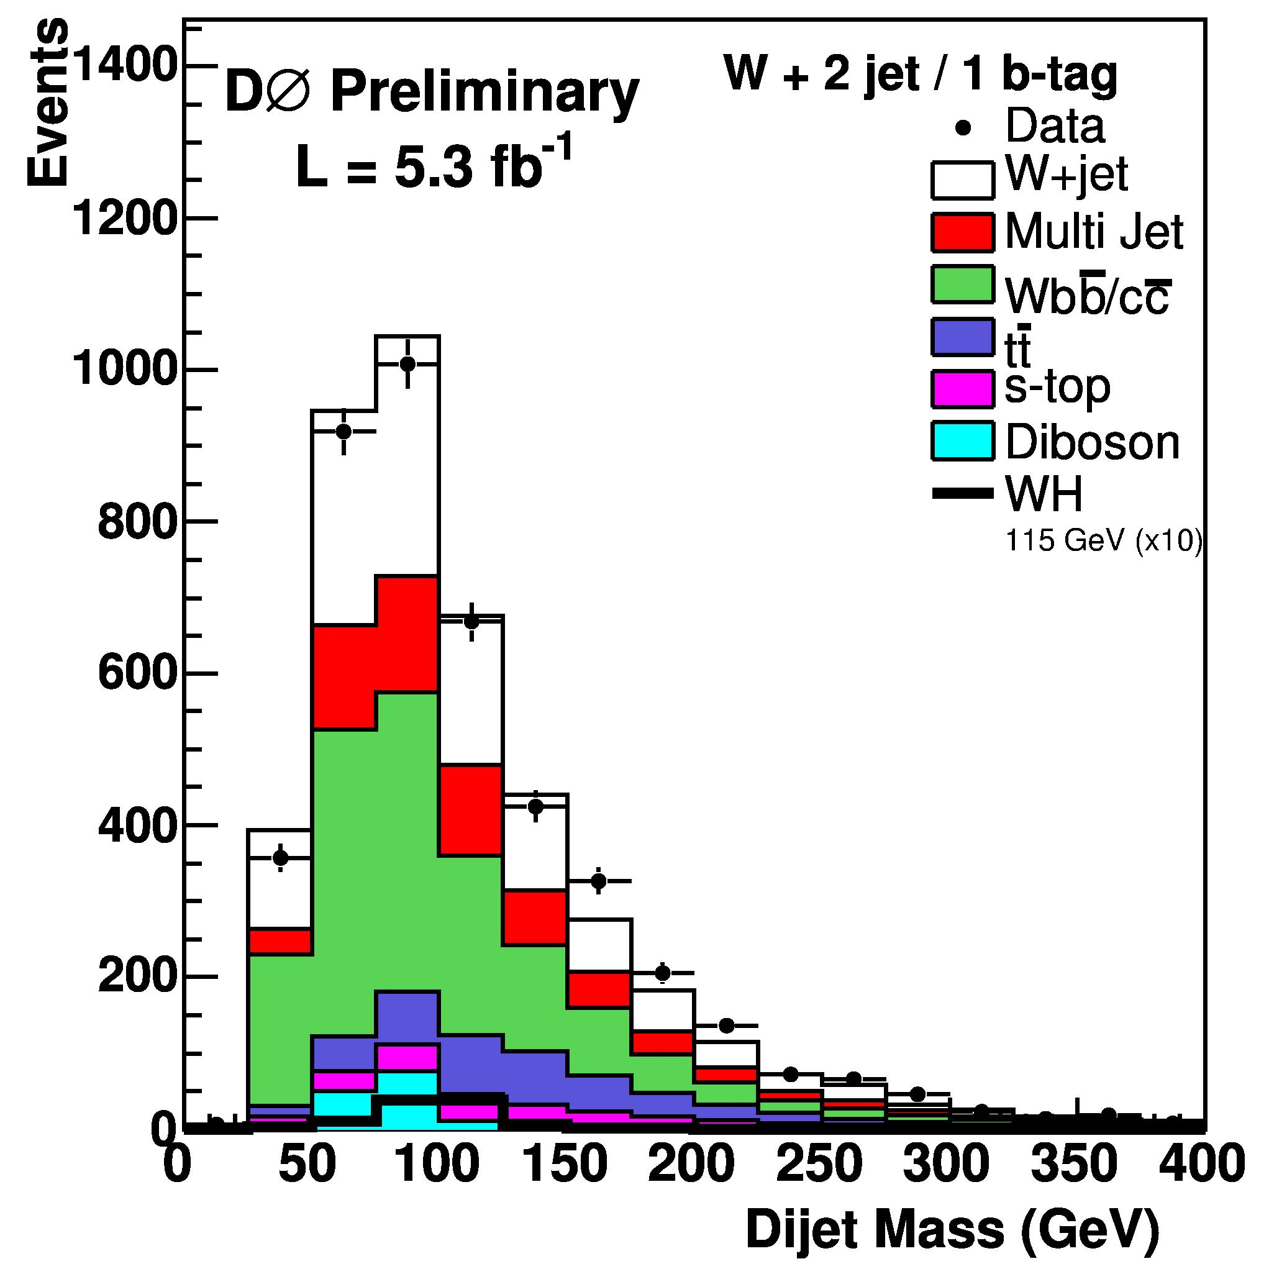
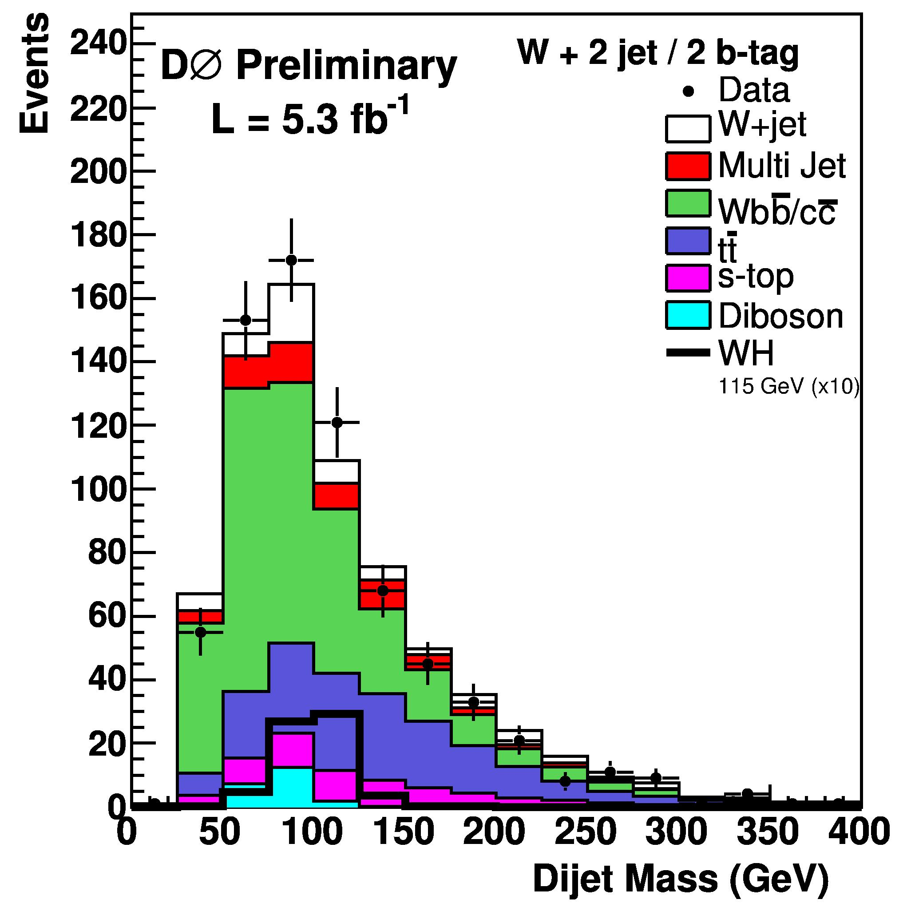
B tagging
1 tagged Jet
2 tagged Jets

Slide 21
Analysis Map
Trigger and Selection
B tagging
Multivariate Analysis

Slide 22
Look at Multivariate Analysis

Slide 23
Overview of Analyses
Cut-based analysis
Angles and M_{h} = M_{bb}
Extend sensitivity
Boosted Decision Tree:
Cut-based in disguise
Neural net approach
Matrix element approach
score
var1
NN
dσ ∝ ∫ Σ ƒª(x,Q²) ƒ^{b}(x,Q²) |M^{ab}(Φ₄;α)|² …
var2
0 1
var n
Notes:
nn - 1/fb, march ; me 1.X/fb, aug

Slide 24

Matrix element method
♦ Use LO matrix element (MCFM) to compute event probability
x_{obs}:
p_{x}
p_{y}
p_{z}
LO |M|² :
p_{x}
p_{y}
p_{z}
H→WW→lνlν
WW→lνlν
ZZ→llνν
W+parton→lν+jet
Wγ→lν+γ
lep1
lep2
E_{x} , E_{y}
parton →lepton fake rate
γ conversion rate
(with true values y)
E_{T} model
lepton energy resn
♦ Compute likelihood ratio discriminator
P_{s}
P_{s} + Σk_{b}^{i}P_{b}^{i}
^{i}
R =
k_{b} is relative fraction of expected background contrib.
P_{s} computed for each m_{H}
♦ Fit R distribution

Slide 25
A single Neuron
Input
I-1
y
I-1
1
w
1j
Output
I-1
y
I-1
1
.. .
y
2
w
2j
Σ
j
I-1
w
I-1
nj
y
n

Slide 26
1
w
2
11
y
2
x
1
1
1
w
y
11
1
1
w
12
2
y
1
2
x
y
3
y
y
2
2
1
ANN
2
y
3
2
x
1
y
1
w
3
3
w
41
34
2
y
4
1
2
Bias
1
w
04
w
01
Bias
1

Slide 27
Random Values for Weights
.33
2
y
R
1
1
.71
y
ll
1
.41
2
y
.37
.37
2
H
1
3
y
.61
y
y
t
2
.71
.77
.30
1
ANN
2
.29
y
.37
.28
3
.99
E
1
0.82
y
.14
94
3
.52
lep1
2
y
4
Higgs
Bias
1
.82
.29
Bias
1

Slide 28
Random Values for Weights
.33
2
y
R
1
1
.71
y
ll
1
.41
2
y
.37
.37
2
H
1
3
y
.61
y
y
t
2
.71
.77
.30
1
ANN
2
.29
y
.37
.28
3
.99
E
1
0.55
y
.14
94
3
.52
lep1
2
y
4
WW
Bias
1
.82
.29
Bias
1

Slide 29
Minimize Difference From expected and actual, adjust weights
signal
R
1-Y
ll
NN
Η
bkg
t
Y
E
Lep1
“Error”
Adjust Weights

Slide 30
Neural network method
Control Numeric
(the Net),
Change alg
Check Input
High NN
No Data
score
var1
NN
var2
var n
Check Input
For Low NN
Score (with Data)
Control Input
Various: ie. R,Mll…

Slide 31
Matrix Element Method
Numerics:
Vegas
score
ME
WW
var1
score
ME
Higgs
var2
var n
Control Input:
(E,p),Met
Combine with NN
Put into NN

Slide 32
Example for ME
Example: Breit-Wigner
Know that the invariant mass of the products is the right physics.
If you give it a 4-vector combination that is not at resonant mass, the cross section is tiny: it is not signal-like.
If you had a number of resonances, you could compare them to see which 4-vectors were correct.

Slide 33

Analysis Evolution
Start with Separate Analyses and compare
Neural Net
BDT
Neural Net
ME
Combine outputs to NN: Look for *no* improvement!
Liklihood

Slide 34
Complimentarity of multivariate Techniques
NN,BDT: Know precisely what variables are used but don’t know if it is a complete description
ME: Know it is a complete description to some order of computation, don’t know what the important “products” of variables are in the numerical computation.
Example: Breit-Wigner
Know that the invariant mass of the products is the right physics. The individual 4-vector components are not what you examine.
In fact the Z in llbb tells us to use M_{ll} anything else is suboptimal
Hence if ME has no impact, we understand the right variable combination and most importantly the distributions to examine for the NN input.

Slide 35
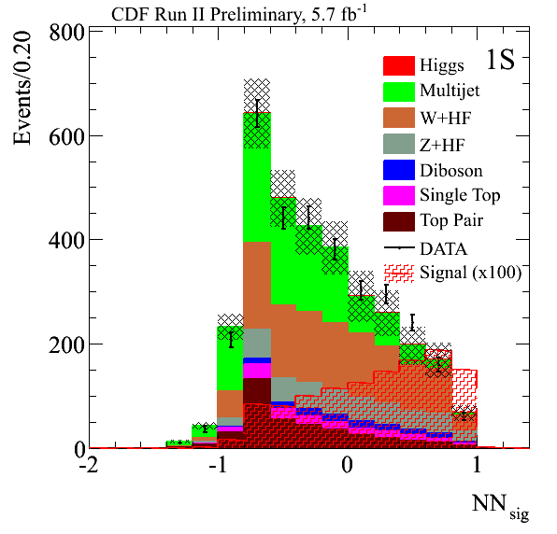
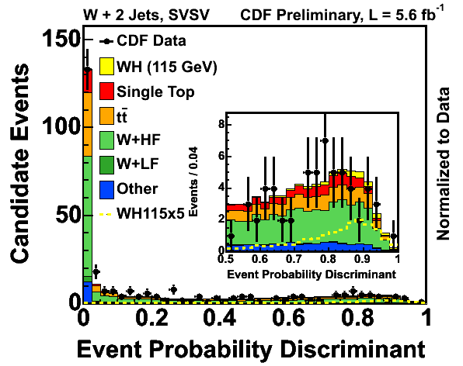
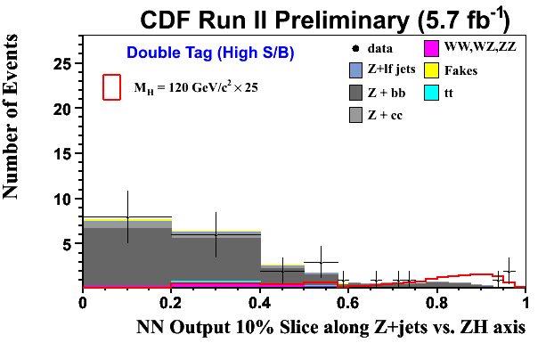
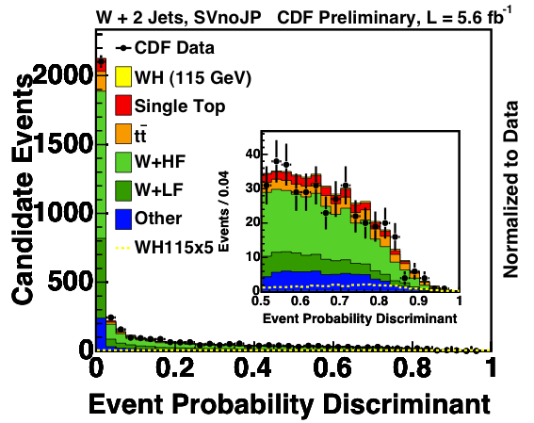
Multivariate Analysis
ZH->ννbb
WH->lνbb
WH->lνbb
ZH->llbb

Slide 36
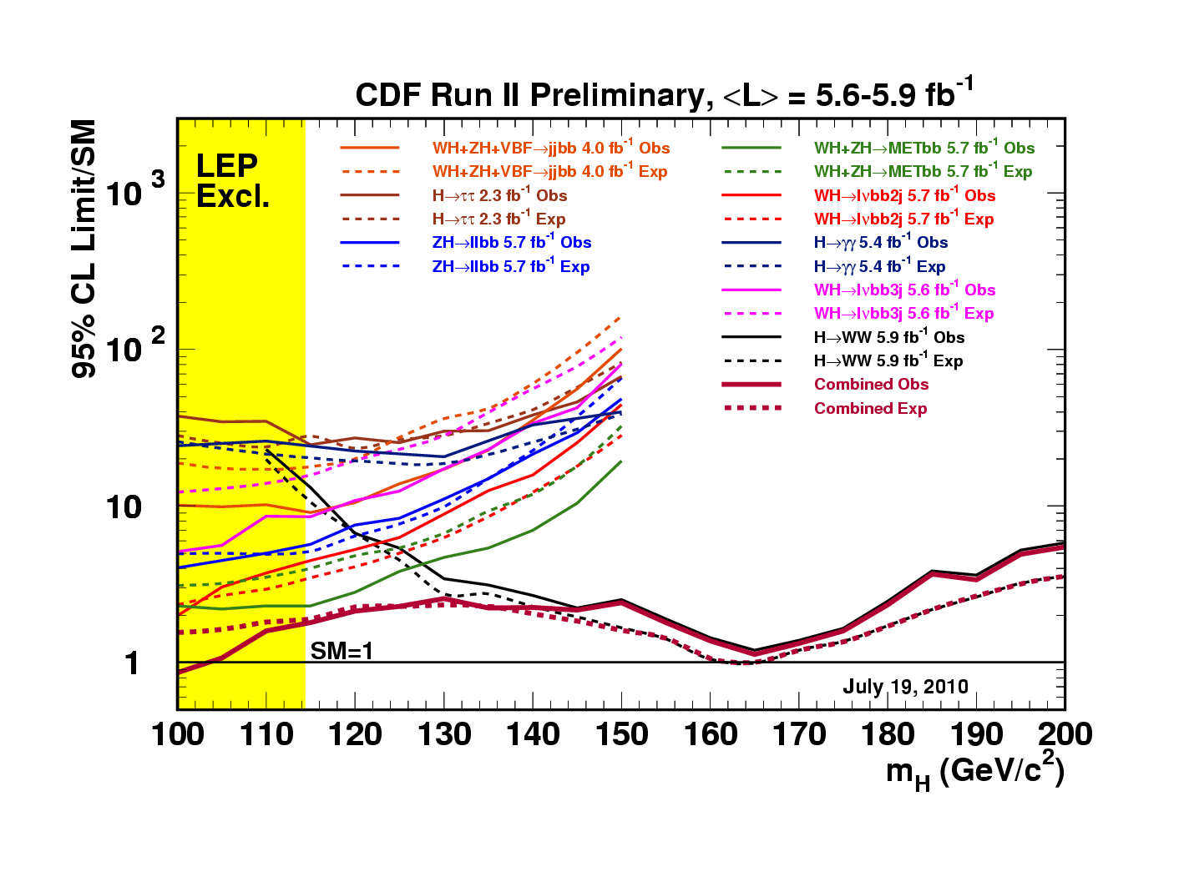
Many Contributions!
ZH→llbb(NN)
Tag | Leptons
SecStx+SecVtx | High S/B
SecVtx+JP | High S/B
SecVtx Single | High S/B
SecStx+SecVtx | Low S/B
SecVtx+JP | Low S/B
SecVtx Single | Low S/B
METbb(NN) WH→(l)νbb: ZH→ννbb
Tag
SecStx+SecVtx
SecVtx+JP
SecVtx Single
WH→lνbb(ME)
Tag
SecStx+SecVtx
SecVtx+JP
SecVtx Single
SecStx+SecVtx
SecVtx+JP
SecVtx Single
WH→lνbb(NN)
Tag | Lepton | Jet
SecStx+SecVtx | Tight | 2
SecVtx+JP | Tight | 2
SecVtx+Nntagger | Tight | 2
SecVtx Single | Tight | 2
SecStx+SecVtx | IsoTrk | 2
SecVtx+JP | IsoTrk | 2
SecVtx+Nntagger | IsoTrk | 2
SecVtx Single | IsoTrk | 2
SecStx+SecVtx | Forward | 2
LooseSecVtx+JP | Forward | 2
SecVtx+Nntagger | Forward | 2
SecVtx Single | Forward | 3
SecStx+SecVtx | Tight | 3
LooseSecVtx+JP | Tight | 3
SecVtx Single | Tight | 3
SecStx+SecVtx | Extend-μ | 3
LooseSecVtx+JP | Extend-μ | 3
SecVtx Single | Extend-μ | 3
W/ZH→jjbb(NN)
Tag
SecStx+SecVtx

Slide 37
Look at HWW

Slide 38
HWW/VBF
W Decay: 33% e,μ,τ
Dilepton: 5%
Backgrounds
W⁺W⁻
Drell-Yan: Z/γ∗
W + Jets (jet fakes e,μ)
W+ γ

Slide 39
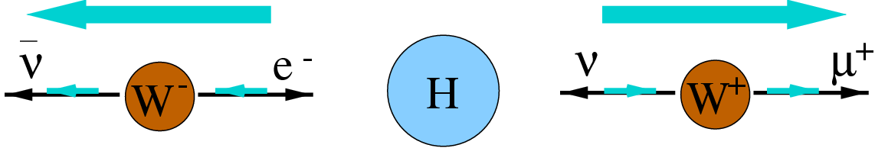
HWW Production Features
ν_{μ}
High Pt Leptons not back to back
Spin 0 Higgs correlates spins of leptons: charged leptons (low Δφ _{ll}), two neutrinos (High MET) tend to be closely aligned with one another.
g
W⁺
μ⁺
H⁰
g
W⁻
e⁻
ν_{e}
ww
Δφ _{ll}
Δφ _{ll}
Z/γ
Backgrounds

Slide 40

High Pt e,μ
Isolation
Met,M_{ll}
Discr. Ana
M
ll
(CDF)
Δφ,ΔR,Ht…
Lo
Wγ
B
<2Jet
Wγ
H
H
Hi
t
>1Jet
t
H
Z/γ
H
Z/γ
Z/γ
WW
t
t
WW
1Jet
Z/γ
H
WW
WW
H
WW
H
H
WW
0jet
H
Heavy
Flavor
H
DrellYan
WW/Wγ/top
H-Enhanced

Slide 41
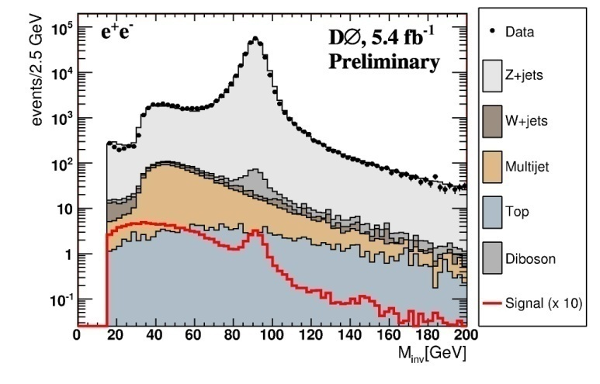
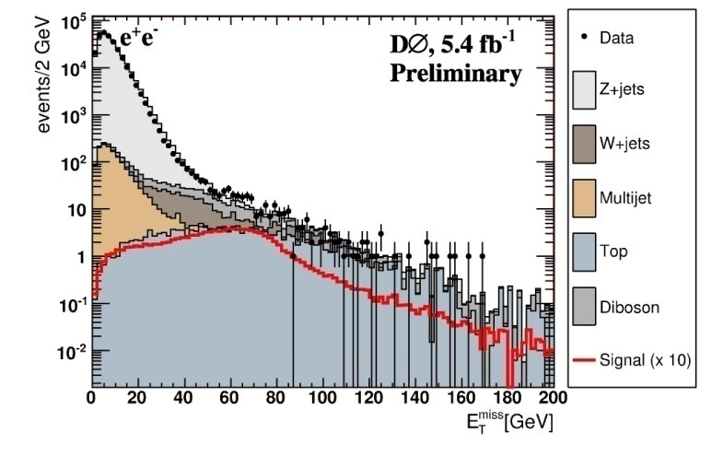
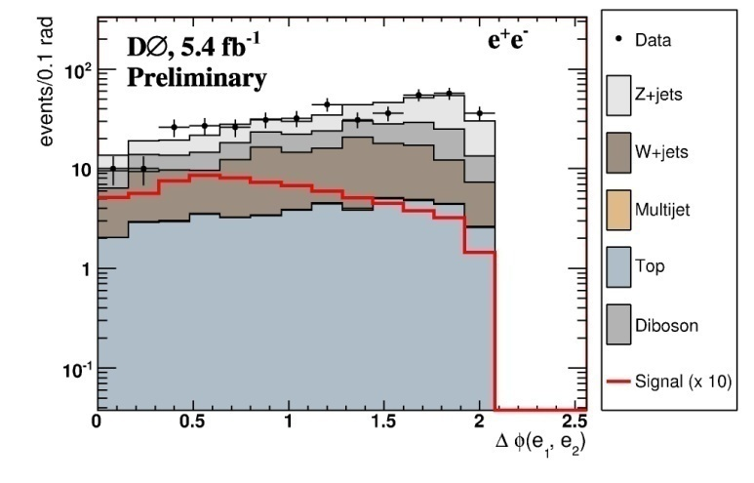
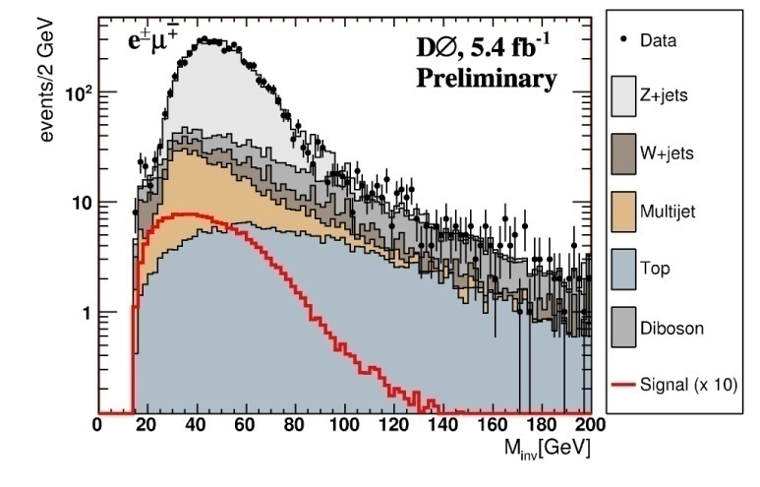
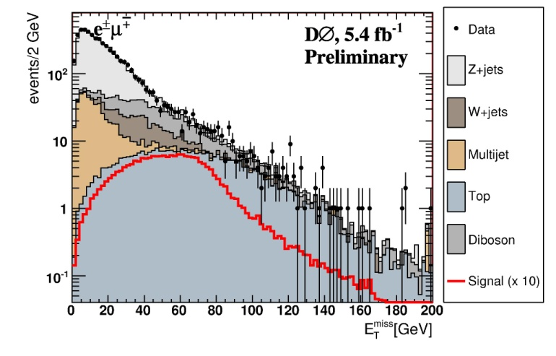
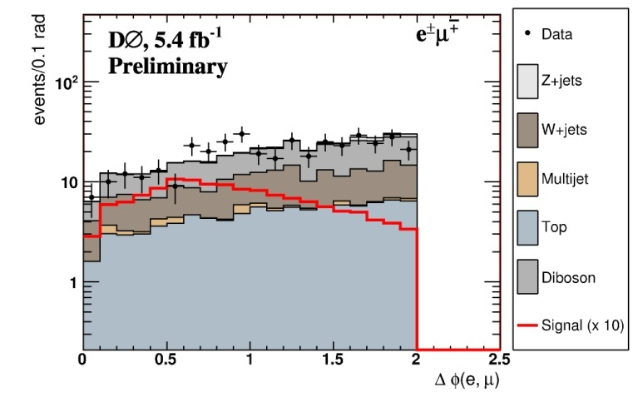
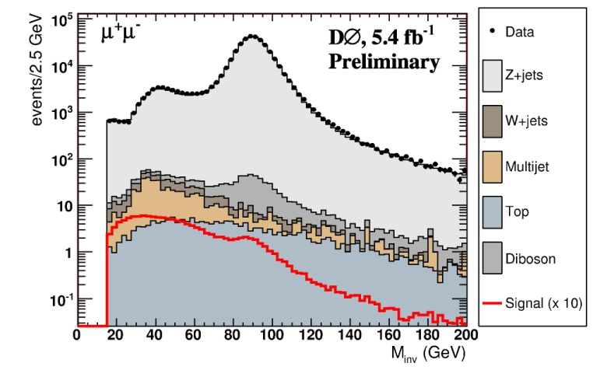
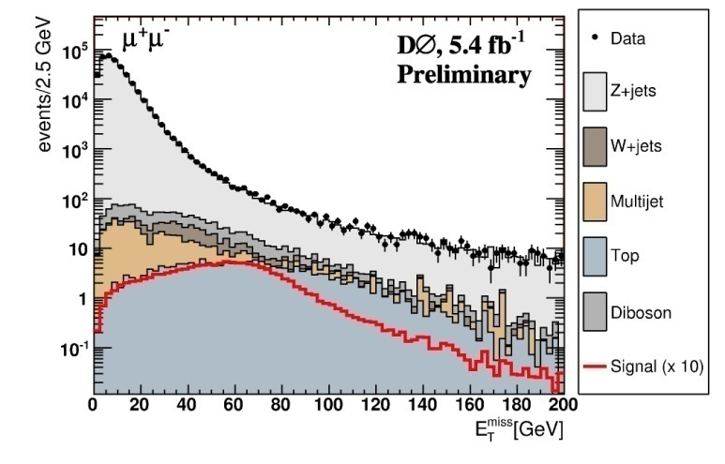

Dileptons,Iso p_{t}>15,10GeV/c
Met>20,30
GeV/c²
Discr:
Δφ_{ll}
M_{ll}
Z/γ
Z/γ
Z/γ
ee
Z/γ
WW
eμ
Z/γ
Z/γ
Z/γ
μμ

Slide 42




WW
Hx10
Expect 35 Signal Events
Z/γ
Bkg Uncertainty does not wash out signal

Slide 43




CDF 5.9 fb⁻¹
Expect 30 Signal Events
→Total W/D0: 65
0J
>1 J
WW
tt
Hx10
Fit Background
Search H
1J
Wγ
0,1 J,
M_{ll}<16
WW
WW
Hx15

Slide 44




WW→eτνν,μτνν
Control Region: Determine systematics, measure background rates → Proper W+jet fake modelling
M_{τl} >20 GeV
MET < 20 GeV
Δφ_{l,MET} <.5
z→ττ
Control Region
Mττ: invariant mass
W+jet (fake τ)
τ property
eτ_{h}
μτ_{h}
Sum track pt in τ cone
Expected Signal:1.6

Slide 45



WW→jj+eν,μν

Slide 46

Same sign Dileptons(CDF/D0), Trileptons(CDF)
No Rate? Too Low? No!
l⁺
Same Sign dileptons:
  WH: W(jj)W*(lν)W(lν),
  ll(l) ννν
  ZH: Z(jj)llνν,W(jj)ll(l) νν,…
Trileptons:
  WH:lllννν
  ZH:Z(ll)W(qq)W(l) ν
W⁺
ν_{l}
q
W⁺
H⁰
l⁻
q
W⁻
ν_{l}
q
W⁺
l⁺
q
ν_{l}
q
q
q
W⁺
H⁰
l⁻
Z⁰
Different Channel Different Systematics
W⁻
ν_{l}
No Channel Left Behind
l⁺
q
Z⁰
l⁻

Slide 47





Same Sign
Dilepton
S:2.1
S:0.41
S:0.6
3.6fb⁻¹
Hx10
Different Background(WZ)
Trileptons
S:0.8
Hx10
S:0.2
WH
ZH
No Bkg: Linear gain with Lumi

Slide 48



arXiv: 1001.4468
CDF5.9 fb⁻¹
@165: Expected
1.14
@165:
Expected
1.00
Observed
1.08
Observed
1.03
D0 6.1 fb⁻¹
SM Sensitivity:
156-173 GeV/c²!
+
SM Exclusion:
158-175 GeV/c²!
arXiv: 1007.4587.

Slide 49


Improvements Over Publication
New
4.8→5.9 fb⁻¹: 11% better
Optimized e⁻ selection
Add Trileptons, Low M_{ll} , VH, VBF for 0 Jet
All together: 20% better!
Improvements continue (Aim for 56% by Mar 11)
WW only
For M_{H}=165 GeV/c² | Expected | Observed
CDF New | 1.00 | 1.08
CDF Pub | 1.20 | 1.29

Slide 50

The picture for the end of Run II Tevatron limits

Slide 51


Next:Extend sensitivity
WW ONLY
146-183
136-190

Slide 52


Improvements Essential

Slide 53

Exclusion/Discovery:Mh<185
2x
5σ
4σ
Run IIe…
End RunII
3σ
Now
2σ

Slide 54
Summary
“No channel too small” strategy successful: different, backgrounds, systematics, S/B and many channels.
At the one sigma level now – should get to 2 sigma in the next year, possibly evidence by end of RunIIUpdated
Combined Tevatron results exclude the Standard Model Higgs at 95% CL for 158≤ M_{H} ≤ 175 GeV/c².
CDF results: sensitivity at to 95% CL exclusion for M_{H}=165 GeV/c².
The High mass sensitivity will be expanded: 2xCDF gives 146-183 GeV/c² if no improvements, 136-190 GeV/c² with improvements.
Both experiments have 9.5 fb⁻¹ delivered!
These are remarkable times. Rapid changes in data collected and analysis continue.

Slide 55
Edinburgh Epilog… from Feb 2006

Slide 56

CDF Limits: (WW:360 pb⁻¹)
X 12
Jet Resolution

Slide 59
July 2005

Slide 60
Oct 2005

Slide 61

Integrated Lumi Projections

Slide 62
Instantaneous Lumi Needed
Current Peak Luminosity

Slide 63

Rolandi: LP2005
2007
Pilot: 300pb⁻¹
Objectives for the Pilot RUN
Reach a Luminosity of 10³²
Low Luminosity run at 25 ns separation
Difficult to speculate further on what the performance
might be in the first year. As always, CERN accelerators departments will do their best !
Lyn Evans
2008
1
2009
10
2010
2011
30

Slide 64

14 vs 1.860 TeV
1fb⁻¹ LHC >= 8fb-1 Tevatron (Table from Fabioa Gionatti, LP2005)

Slide 65

ATLAS Channels
Exclude/
deviation
5σ
Mtop,
Mw
M_{H}(GeV)
Exclude/Evidence for from CDF (if b jet resolution)

Slide 66
Scenario
ATLAS 2007: Pilot Run, Z,W calib? 200pb⁻¹
ATLAS 2008: Physics, 1fb⁻¹
CDF 2007: 4fb⁻¹ : HWW 4x3: at SM limit in the 140-170 range. TOP and W Mass improved as well, so SM fit limits narrower.
    Deviations building from expected limit: we focus on this range for ATLAS 2008. Perhaps SM fit narrowing on this range.
    Higgs is 130-150 OR 170-185. Perhaps SM Fit excludes upper range.
CDF 2009: 3σ at 120: ATLAS 2011? For discovery. CDF Keeps running!?
ATLAS 2010: 10fb⁻¹ : Discover it for > 130.

Slide 67

Tevatron Projections
2009
2007

Slide 68


Slide 69
Backup

Slide 70




SUSY
Lxy
MSSM neutral scalars h/H/A
  “down” fermion couplings enhanced by tan²β
  radiated from b’s, decay to b or τ
Event Selection:
  L1: 2 jets, , E_{t} > 5 GeV, 2 tracks p_{t}>2 GeV
  L2: d₀ > 100 μm ;
  L3: 2 jets, E_{t} > 20 GeV, 2 tracks p_{t}>2 GeV, d₀ > 100 μm
  Offline: 3 jets, E_{t} > 20 GeV, all tight secondary vertices
Backgrounds: h.f. multi-jets
  Essentially all bbb, bbq, bcb, bqb
  model with double tagged data
    Subtract non-bb component from bkgds
Fit data to 4 component bkg + signal in
  m₁₂ = mass of two leading jets: “m_{Higgs}”
  x_{tags} = 1D rep of m₁+m₂ vs m₃ (tag masses)
d0
m_{tag}≡m_{i}
φ
6 | 7 | 8
3 | 4 | 5
0 | 1 | 2
m₁+m₂
m₃
j
2.5fb⁻¹
Most significant excess @ 140 GeV/c²
9306
events
  0.9% p-value, 5.7%
  including trials factor

Slide 71
Neural network method
Various versions. Current:
Apply preselection (eg E_{T} to remove Drell-Yan)
Train on {all backgrounds / WW} against Higgs
m_{H}=110,120…160…200 { possibly separate ee,eμ,μμ }
score
var1
NN
E_{T}
ΣE_{T}
m_{ll}
E^{lep1}
E^{lep2}
E_{T}sig
E_{T}^{jet1}
ΔR_{leptons}
Δφ_{leptons}
Δφ E_{T lep or jet}
E_{T}^{jet2}
N_{jets}
var2
x10
0 1
var n
Background Higgs
Pass signal/all backgrounds through net
Form templates
Data
HWW
WW
DY
Wg
WZ
ZZ
t t
fakes
Most recent CDF
“combined ME/NN”
analysis also uses
ME LRs as NN input
variables
NN
0 1
♦ Pass templates and data to fitter

Slide 72
Analyzed Lumi in CDF Combo
Channel | Int. Lumi (fb⁻¹)
WH→lνbb(trigger lepton+isotrack) (2 jets) | 4.3
WH→lνbb(trigger lepton+extended muons) (3 jets) | 4.3
ZH→ννbb | 3.6
ZH→llbb | 4.1
H→ττ | 2.0
WH+ZH→jjbb | 2.0

Slide 73
Primary Vertex Facts
Linear fit of (x_{v},y_{v}) vs z_{v} yields beamline each 30s
σ_{z}=29cm
Cross section of beam is circular with width of 30 μm at z=0 and 50-60 μm at |z|=40cm with slopes of 5.0(1.7) μm/cm in the horizontal(vertical) plane.
Parameters stable,varying by nor more than 20% during data taking periods.

Slide 74
SecVTX: Primary Vertex Fit
Use lepton or vertex with highest scalar sum of track pt as primary vertex (PV). For non-lepton, fit tracks to vertex using a 1cm window in z.
  Fit all tracks with |d₀/σ_{d0}|<3, σ_{d0} both track and PV errors.
  Prune: remove tracks contributing χ²>10 or track with largest χ² if χ²/ndf>5.
  If no tracks survive, use beamline profile

Slide 75
SecVTX:Secondary Vertex Fit
Consider tracks in a jet cone only
Reject tracks based on cuts in p_{t} , number of silicon hits, quality of Si hits, χ²/ndf.
Require at least 2 good tracks. Jet is “taggable” if it has 2 good tracks.
Two passes:
  For p_{t}>0.5 GeV/c and |d₀/σ_{d0}|>2.5, use ≥ 3 tracks, one with p_{t}>1.0 GeV/c to form a common vertex.
  If first unsuccessful, require p_{t}> 1 GeV/c and |d₀/σ_{d0}|>3 but only for 2 tracks, one with p_{t}>1.5 GeV/c.

Slide 76
Compute 2D decay length L_{2D} relative to jet direction, projected in r- φ. Sign: + for φ<90º , − for φ>90º
Good Secondary vertex: L_{2D} /σ_{L2d} >3 (positive tag) or <-3 (negative tag). σ_{L2d} is typically 190μm.
Negative tags used to compute false positive tags.
“Tagged jet” has a good secondary vertex
Algorithm finds at most one good vertex per jet.

Slide 77
Measuring Tagging efficiency
Sample of events with known HF content: low-p_{t} electron data enriched in semileptonic decays. p_{t}>7 GeV/c, |η|<1.3
Require a second tagged jet in the event to reduce charm: bottom dominates sample.
Compare to MC and use MC to get dependence on energy and geometrical acceptance.
Electron jet: E_{T}>15, within ΔR<0.4 of electron. Away Jet: E_{T}>15, |η|<1.5, Δφ_{e-away-jet}>2

Slide 78
Determine F_{b}, fraction of e-jets from b. Use two methods:
  Reconstruct D⁰→K⁻π⁺ and use sidebands to subtract background. F_{b}=0.139±0.021
  Use same sign muons to find cascade c decays. F_{b}=0.228±0.037.
Inflate weighted average by 2.09 to get F_{b}=0.161±0.038.
Determine F_{c}, fraction of e-jets from c. by fitting the invariant mass spectrum of tracks to MC template for b,c, light flavor. F_{c}^{tag}/ F_{b}^{tag} =0.118±0.017, error dominated by systematic on light flavor template.

Slide 79
Multiply by ratio of tagging efficiencies, ε_{b}/ε_{c}=5.2 ±0.4 from MC to get F_{c} / F_{b c}=0.61±0.10
Apply to get F_{HF}=F_{b} + F_{c} = 0.259 ±0.064.
Use double tag to get tagging efficiency: require away jet is tagged by SecVtx.
N_{a+} and N_{a+} are positive and negative tagged away jets, N^{e+}_{a+} is number of events where both electron and away jet are positively tagged. Fª_{HF}is fraction of tagged away jets containing heavy flavor.

Slide 80
A correction to Fª_{HF} is applied for conversions.
Systematic due to mistag estimate taken by making it zero or multiplying by 2.

Slide 81
Mistag Rate Measurement: The Mistag Matrix
Caused by random overlap of tracks as well as K_{s} and Λ decays and nuclear interactions in material.
Use negative tag rate.
Subtract negative tags in HF and lifetime of interactions: a 20% effect.
Measured in inclusive jets as a function of jet E_{t}, track multiplicity, η and φ and of the scalar sum E_{t} of all jets in an event.
Use Jet 20,50,70, 100 to get syserr :11%

Slide 82
Jet Probability Tagger
A distribution of d₀/σ_{d0} can be sampled as a probability distribution function for a single track to have lifetime.
A jet probability is formed from the individual track probabilities, P_{i}:
Where Π=P₁P₂…P_{N}

Slide 83
Loose and Tight SecSVX
Loose and Tight SVX |  | Loose |  | Tight
 |  | Pass1 | Pass2 | Pass1 | Pass2
SVX layers | > | 2 | 3 | 3
Track-d₀ Sign | > | 2.0 | 3.0 | 2.0 | 3.5
Attachment cut d₀ Sig. | < | 6.0 | - | 3.0 | -
Track prune χ² | > | 90 | 1000 | 45 | 30
Vertex fit χ² | < | 120 | 2000 | 50
Lxy significance | > | 6.0 |  | 7.5
Material Removal |  | no |  | yes

Slide 84
Trigger: 2 jets, E_{t}>15 Gev, 2 tracks pt>2 and d₀>100 μm
Offline 3 tagged jets E_{t}>20 Gev |η|<2
Auxiliary sample for background: third jet not tagged. Background: QCD multijet: 2 b jets+ mistag or c-tag or b-tag. Flavor content: XXY (lead two jets and third).
Real b jets: bbb,(bbc,bbq)≡bbx, bcb, bqb.

