Slide 1
High Pressure Thermodynamics (How not to break the laws)
https://www2.ph.ed.ac.uk/~gja/thermo/
https://bookboon.com/en/an-inverted-textbook-on-thermodynamics-part-ii-ebook
Graeme Ackland

Slide 2
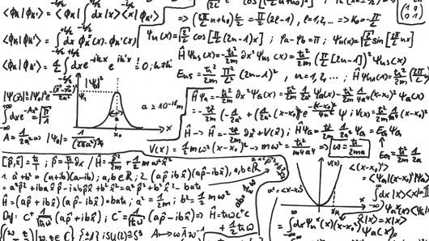
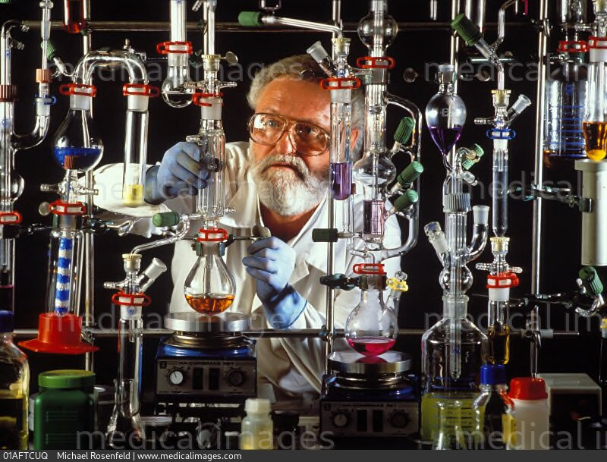
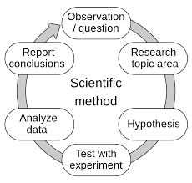
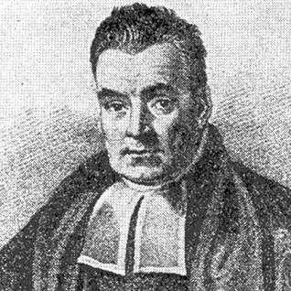
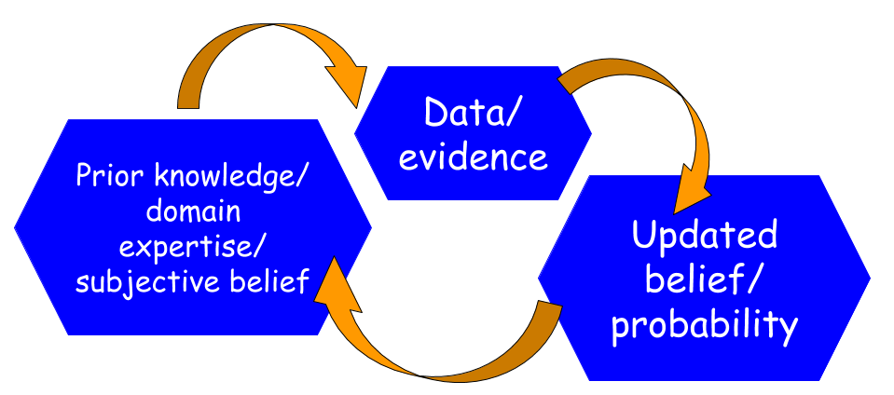
Theorists and Experimentalists
Experiment: What is the hypothesis?
Theorist: What counts as falsification?
All experiments are based in theory, often outdated.
Useful theories are about measurable quantities.
Thomas Bayes
UoE 1719-22

Slide 3
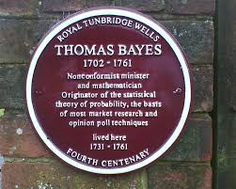
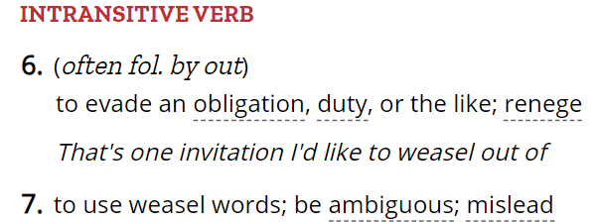
Theory always comes first
e.g. in a diffraction experiment a scientist* will typically
Science or religion?
1. Hypothesis: we have a crystal with a space group
2. Assume Braggs Law (no peaks – falsify 1)
3. Observe patterns – falsify most space groups
(Ockhams razor => structure has the highest symmetry compatible with data?)
Apply Ockham’s Razor.
“Simple” => Does not violate accepted physics
Sample obeys thermodynamics
Free energy is minimised
(e.g. Atoms aren’t on top of each other)
(e.g. Structure is stable in Density Functional Theory within error)
and finally, interpret measurements on the basis of all this theory
*This distinguishes scientists from lab technician
see also theorist vs computationalist

Slide 4
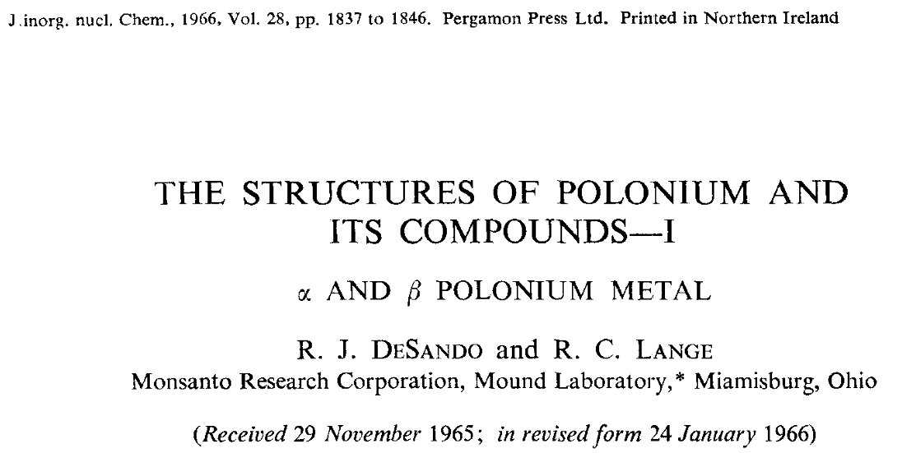
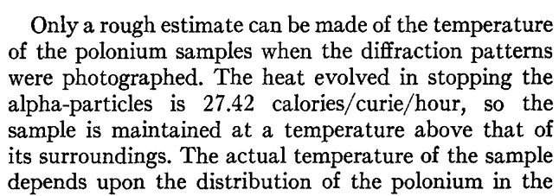
Experiment – what are you testing? – what did you falsify? - alternative explanations Theory – what does your theory say will be measured?
Theorists – proof by assertion.

Slide 5
Zeroth Law of Thermodynamics
If two systems are in thermal equilibrium with a third system, then they are in thermal equilibrium with each other.
“Thermodynamic equilibrium exists”
Temperature and pressure exist (only at equilibrium)
Without the zeroth law, experiments are impossible to reproducible.
There is no test that an experiment has reached equilibrium.
Various well-defined non-equilibrium states also exist (some have P,T)

Slide 6
First and Second Laws of Thermodynamics
1. Energy of the universe is conserved
2. Entropy of the universe increases
Combined, these tell us that
Any system at fixed (P,T) will change to adopt the minimum Gibbs Free Energy:
G = U + PV -TS
Any system at fixed (P,T) obeys the Gibbs Phase rule
Number of phases = 2 + C – F
C = non-reacting components, F=independent, intensive variables e.g. P,T.
Questions: Is your experiment at fixed P,T? Did you calculate G?

Slide 7
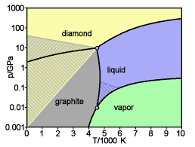
Third Law of thermodynamics
The entropy of a system at absolute zero is zero.
(Some wriggle room with degenerate ground states)
Heat capacity goes to zero at T=0
(Because, it takes finite energy to excite to the first quantum state)
Phase lines on P,T diagram are vertical at T=0
wikipedia

Slide 8
What is high pressure thermodynamics?
Gibbs free energy G = U-TS+PV
High pressure – volume/density is important
Favour structures with high density rather than low energy. e.g.
Favours efficient packing of objects
Disfavour covalent bonds, networks
Disfavour “free” electrons vs “localised” states

Slide 9
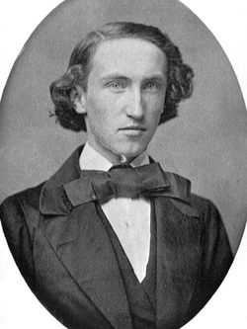
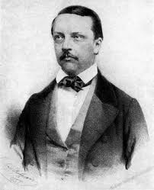
Who is your favourite thermodynamicist?

Slide 10
The Gibbs Free Energy G = U +PV -TS
Second Law: Entropy increases.
Split universe into System and Surroundings.
Allow heat and work to flow between them (fixed P,T)
Increasing Entropy of the Universe
Means Reducing Gsys .
dG = PdV - SdT
μ = G/N. G is the chemical potential
Two coexisting phases => same μ
Two coexisting compounds => same μ

Slide 11
Thermodynamics in high pressure physics
Experiment
Theory
DAC: Fixed volume, temperature
DAC: Measure pressure, temperature
DAC: All components have the same chemical potential (specific Gibbs)
Gibbs free energy – G=U+PV-TS
Calculate:
U+PV Density functional theory
TS from vibrations (also zero point)
Simulate:
Stability: Molecular dynamics
Melts: Phase coexistence, Z-method

Slide 12
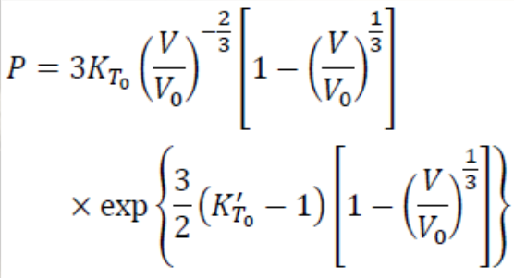
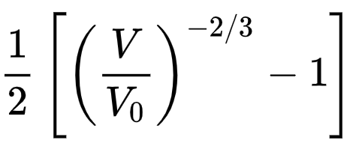
Isothermal Equations of State
Birch Murnaghan
Comes from linear strain:
G=
Vinet Rose
Comes from finding best function of strain to fit DFT calculations (!)
G=

Slide 13
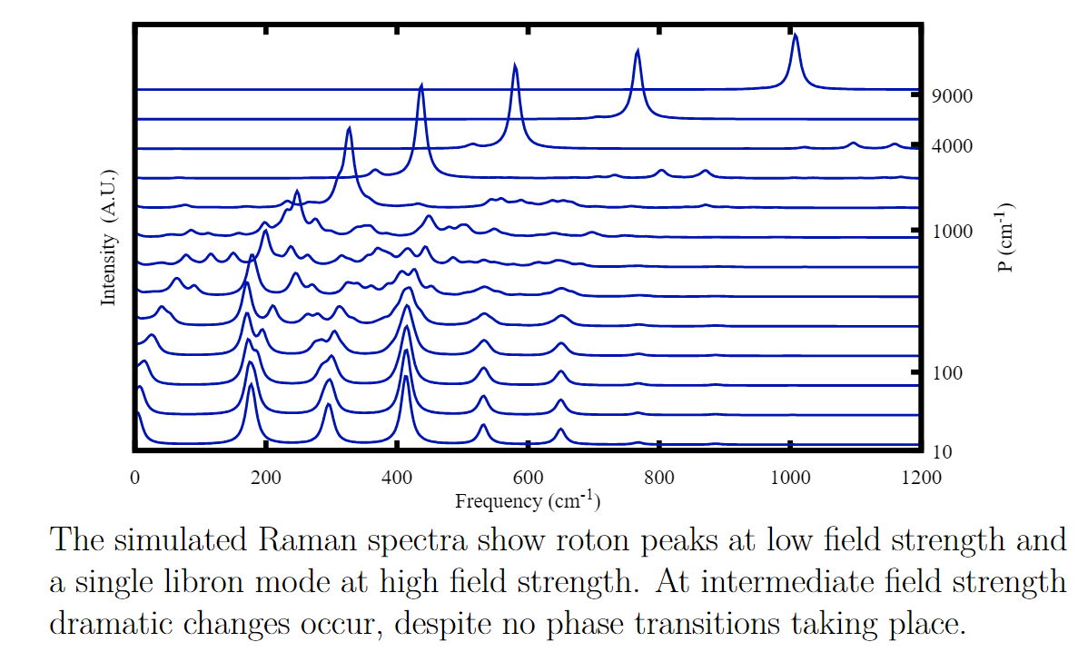
How many phase transitions?

Slide 14
What is a phase transition?
Elementary Tasseography
Theory (Ehrenfest), a Phase Transition is…
A discontinuity in thermodynamic properties vs T, P (board)
Very difficult to show experimentally…
Calculated Raman signal for H2 in a slowly increasing potential
V=P cos2θ
Obviously no phase transition

Slide 15
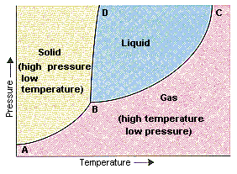
Walk around a single component phase diagram.
Line should be horizontal
All angles less than 180 degrees
Critical point – gas and liquid indistinguishable
Positive slope – liquid has higher entropy & volume
(dG = PdV-TdS = 0 on line)
E. No phase coexistence 2 + C – F = 2 + 1 -2 =1
n.b. Phase coexistence occurs only on the phase boundary.
Experiments tend to “stick” at phase boundary – requires a lot of energy to be supplied or removed to cross.

Slide 16
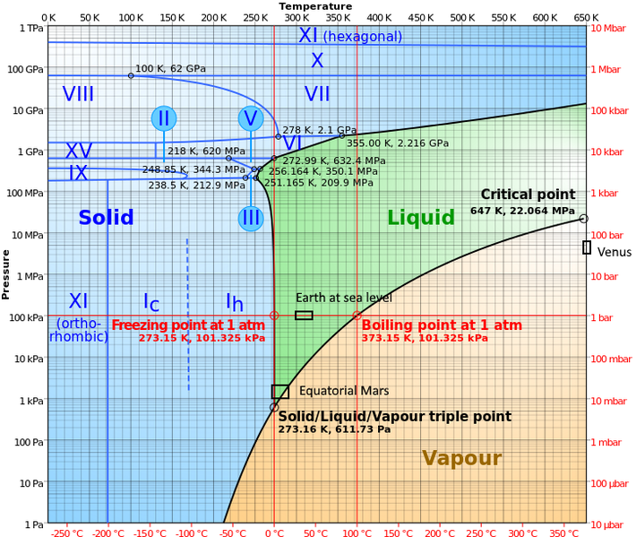
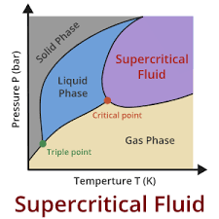
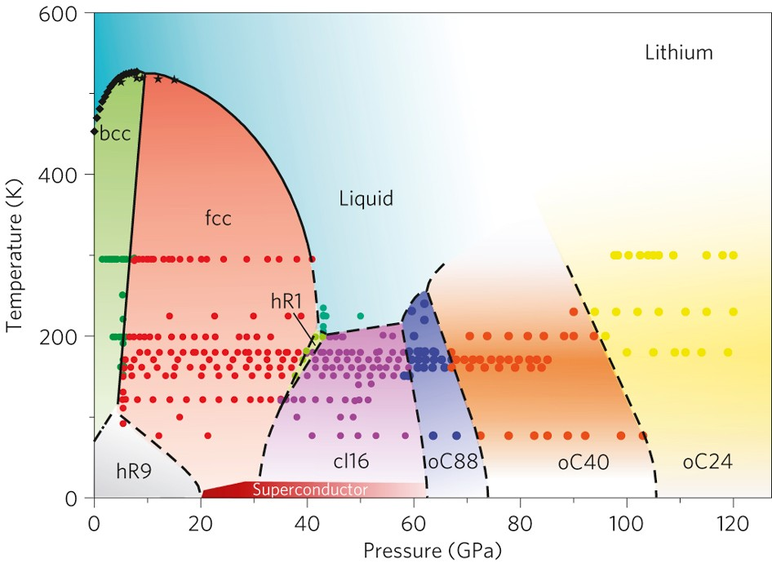
Who broke the Law?

Slide 17
Authors: explain WHY and well as WHAT - you know more than readers do! - readers know your data is noisy “The structure was solved” (but we’re not showing the data) “The sample was heated” Does it mean “investigated at high temperature” or “ Processed to equilibrium, by increasing reaction rates”
Weasel

Slide 18
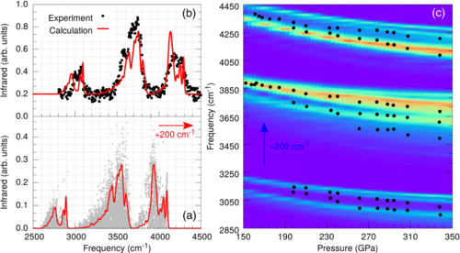
“Seven peaks were observed” Assumption 1 – the signal is made up of peaks Assumption 2 – the peaks/shoulders can be resolved
Weasel

Slide 19
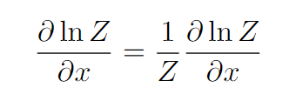
The Partition Function
All you need to do is calculate everything that can possibly happen!
But, many properties are derivatives of ln Z. We can use
So if we have a representative fraction of Z, that’s often enough (except for S).

Slide 20
How to calculate the partition function
Static free energy = Enthalpy H+PV.
Density functional theory
Vibrational free energy = zero point - TS
Lattice dynamics
Molecular dynamics
Monte Carlo
Details from Miguel and Andreas on Friday
The partition function tells us everything, but there are simpler ways to G

Slide 21
How to avoid calculating the partition function I
Gibbs Helmholtz equation:
RHS – stuff that can be easily calculated
LHS – differences in G/T
- once we know G somewhere, can calculate it everywhere
- other similar relations exist to do “thermodynamic integration” from one state to another
Problem, can’t use T=0 as our “somewhere”. Need a reference state.

Slide 22
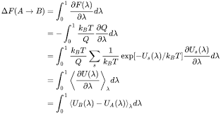
Choice of reference state
“Thermodynamic Integration”: Reference state is Einstein Crystal. This has a known free energy.
Lattice Switch Monte Carlo : Reference state is one crystal phase
Phase coexistence : Reference state is liquid (may be supercooled)
Frenkel - Ladd
Free energy difference between system B and an Einstein crystal A
λ =0 for Einstein, λ=1 for system B.
Write as a partition function F=kT ln Q
Need to calculate with MC/MD system moving partly (1- λ) under Einstein crystal forces and partly λ under system B forces (e.g. DFT)
In practice, do a series of calculations with different λ and integrate.

Slide 23
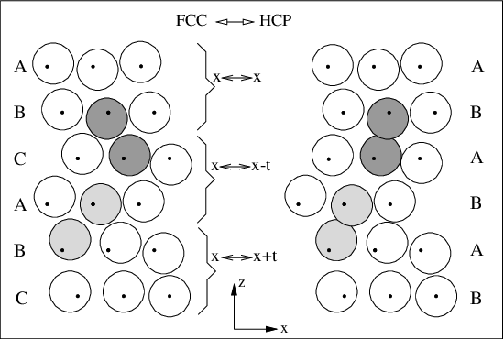
How to avoid calculating the partition function II
Lattice Switch Monte Carlo
Two phases in the same MC calculation
Switch-move between fcc box and hcp box
Free energy difference is just ratio of time spent in each phase (fix T,V).
Phase Coexistence Molecular Dynamics
Two phases in contact in MD (constant energy)
Must have the same G
Therefore, P,T in simulation lies on phase boundary.
Can extend phase boundary
by integration

Slide 24
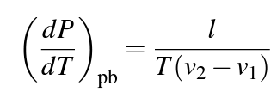
How to avoid calculating partition function III
Start with a free energy difference
e.g. Difference between solid and liquid:
ΔG = ΔU + P ΔV - T ΔS
Phase line ΔG=0 (Derive Clausius Clapeyron)
Questions
Which has higher U ?
Which has higher V
Which has higher S
If ΔU, ΔV, ΔS are constant, how does phase diagram look?
(Did we break the law)

Slide 25
The Gibbs Free Energy G = U +PV -TS
Second Law: Entropy increases.
Split universe into System and Surroundings.
Allow heat and work to flow between them (fixed P,T)
Increasing Entropy of the Universe
Means Reducing Gsys .
dG = PdV - SdT
μ = G/N. G is the chemical potential
Two coexisting phases => same μ
Two coexisting compounds => same μ

Slide 26
The Gibbs Free Energy G = U +PV -TS
Second Law: Entropy increases.
Split universe into System and Surroundings.
Allow heat and work to flow between them (fixed P,T)
Increasing Entropy of the Universe
Means Reducing Gsys .
dG = PdV - SdT
μ = G/N. G is the chemical potential
Two coexisting phases => same μ
Two coexisting compounds => same μ

Slide 27
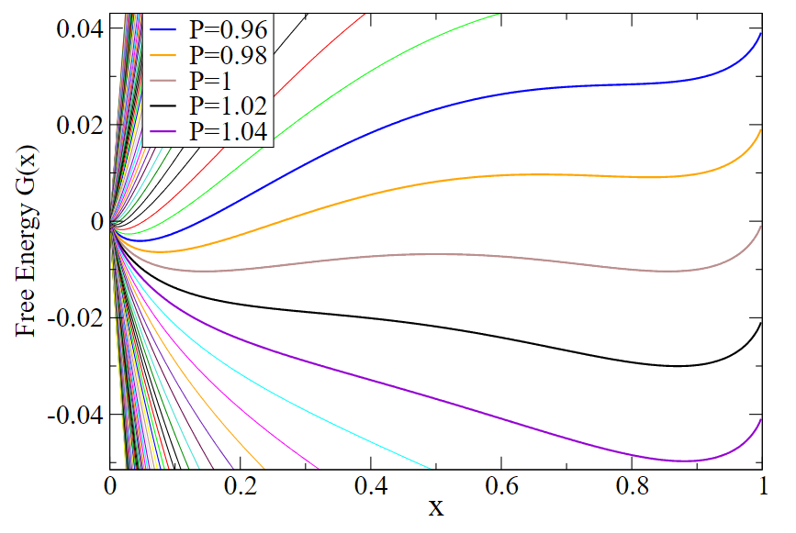
Fitting a 2-state model to thermodynamics
Assume each atom can be in one either of two states.
x in state A, 1-x in state B
Stable state has (1st/2nd law):
Therefore, (meta)stable state:
Need a model for G(x,P,T)
Interesting case will have two minima in x –
stable and metastable state

Slide 28
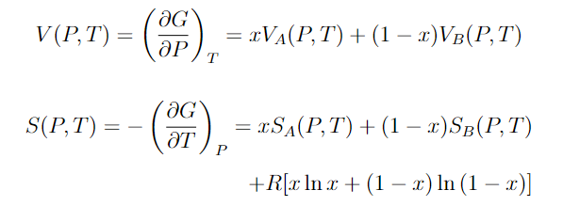
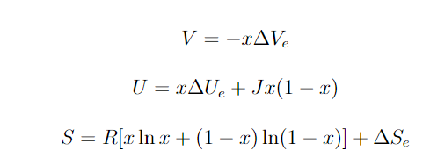
Simple linear model- ingredients
States have different sizes
States have different energies
States have different entropies
+ Entropy of mixing
Assume these differences are independent of P,T. And extract the x dependent part

Slide 29
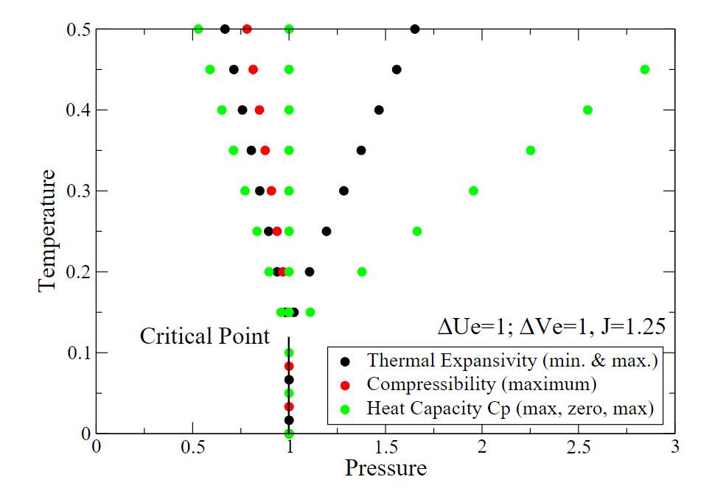
Model for liquid OR solid
Gibbs free energy relative to state B
Equilibrium will be A-rich or B-rich.
May have a critical point
What is the…
High pressure state?
High Temperature state?

Slide 30
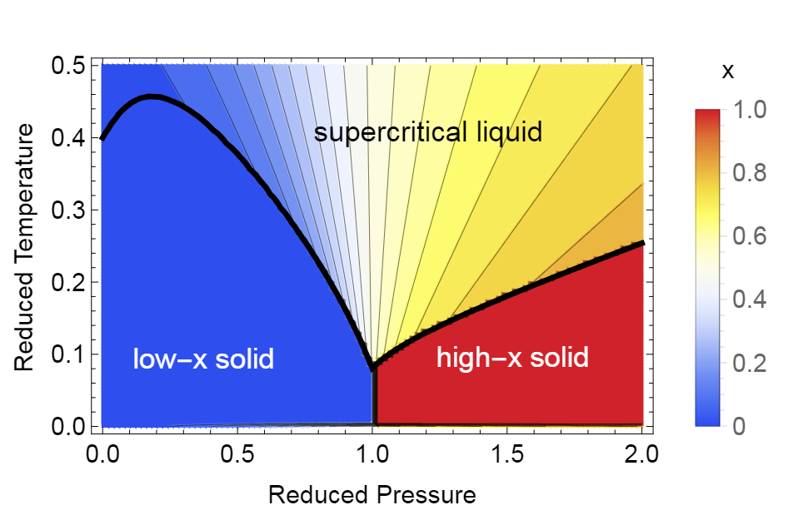
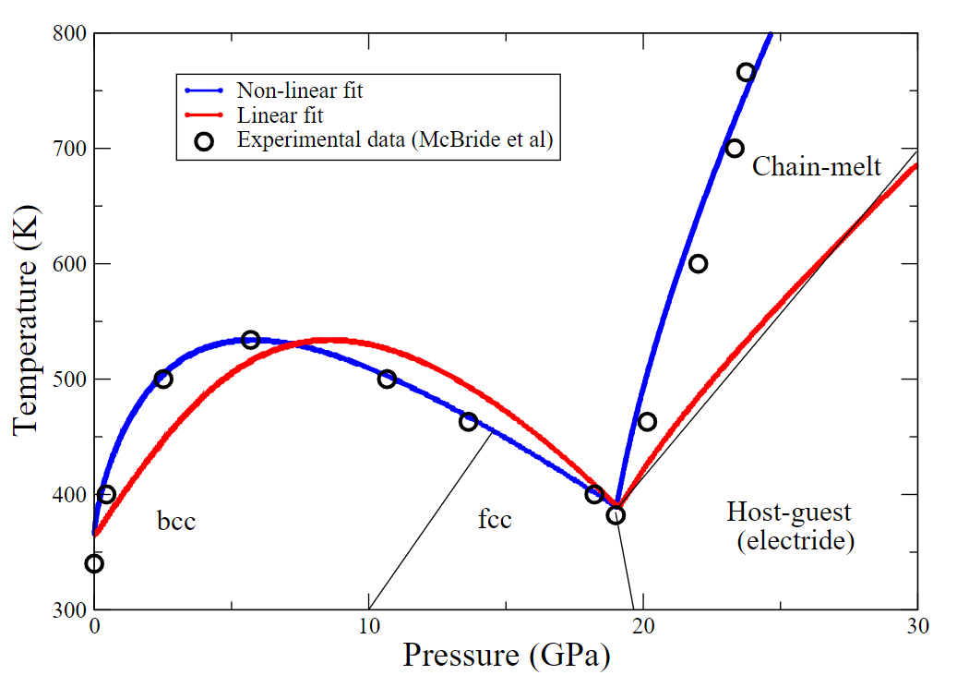
Model for liquid AND solid
Add to previous model a term distinguishing liquid and solid.
Fit to high pressure potassium (x=electride)
X-related Difference: Liquid can relax more easily to accommodate a smaller object.

