Slide 1
Advanced Implantation Detector Array (AIDA)
HISPEC/DESPEC meeting 25 February 2019
presented by
Tom Davinson
on behalf of the AIDA collaboration
(Edinburgh – Liverpool – STFC DL & RAL)
Tom Davinson
School of Physics & Astronomy
The University of Edinburgh

Slide 2
Done
1x MSL type BB18(DS)-1000 installed
1x Plastic scintillator installed
DSSSD+Plastic Scintillator operate together OK with γ-ray sources
AIDA FEE64 firmware updated
now supports 1GHz, 64 bit White Rabbit timestamp

Slide 3
To Do
Plastic scintillator – mechanical issues identified
extant design OK for upstream detector
increase transverse dimensions for downstream detector
Plastic scintillator – AIDA DSSSD interactions for high energy ions?
effect of high energy signals?
no scintillator wrapping – light?
crosstalk?
Reduce AIDA snout length by 5cm to accommodate length of plastic
scintillator cables
White Rabbit compatible AIDA ( ‘Mark 2’ ) merger
Occasional timewarps and other format issues observed
Under investigation by Vic Pucknell, STFC DL
Forward AIDA data to MBS
Obtain AIDA+FATIMA data with pulser and sources

Slide 4
Acknowledgements
AIDA collaboration
http://www2.ph.ed.ac.uk/~td/AIDA/welcome.html
Edinburgh
Corrigan Appleton, Peter Black, Carlo Bruno, Oscar Hall
UKRI STFC Daresbury Laboratory
Ian Burrows, Mike Cordwell, Alan Grant
GSI
Juergen Gerl, Magda Gorska, Nic Hubbard, Nik Kurz,
Henning Schaffner, Arici Tugba

Slide 5
AIDA Support Stand – the plan
AIDA support stand
8cm x 8cm & 8cm x 24cm DSSSDs
Overhead services routing
ac mains power
2x Gbit Ethernet
cooling water
White Rabbit
etc
Temperature controlled cooling water
+20 ºC
https://www2.ph.ed.ac.uk/~td/AIDA/Information/information.html

Slide 6
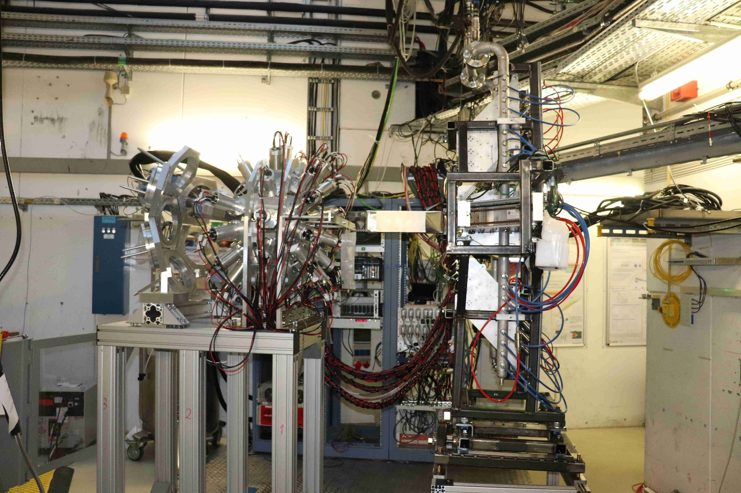
S4: AIDA + FATIMA

Slide 7
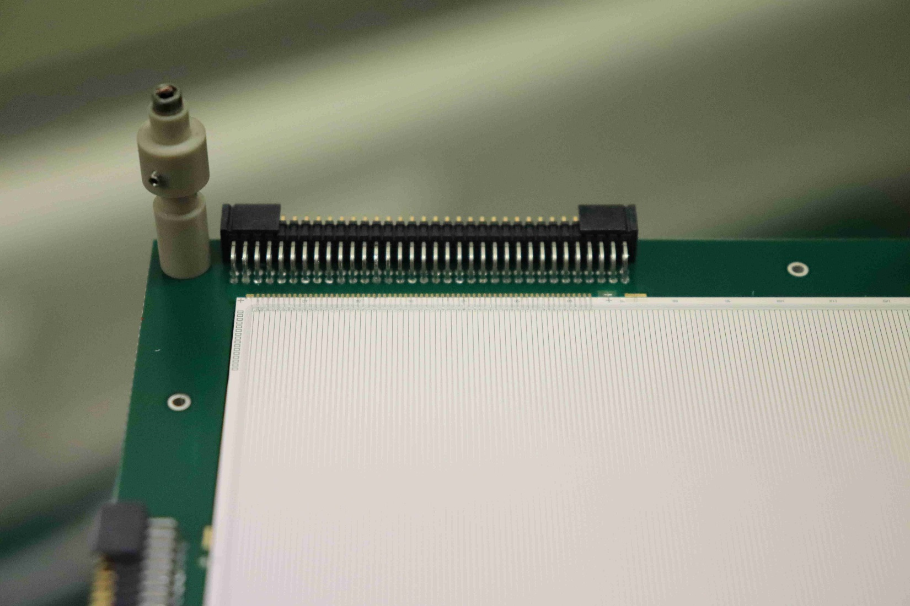
AIDA DSSSD: MSL type BB18(DS)-1000
Detail – 1 (of 4) connectors, strips, bond wires, bias ring, multi-guard ring,
field plate etc

Slide 8
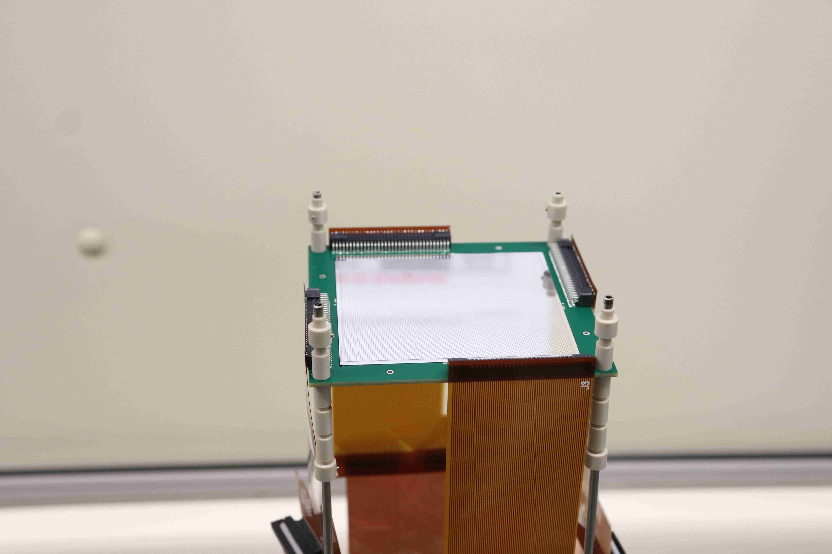
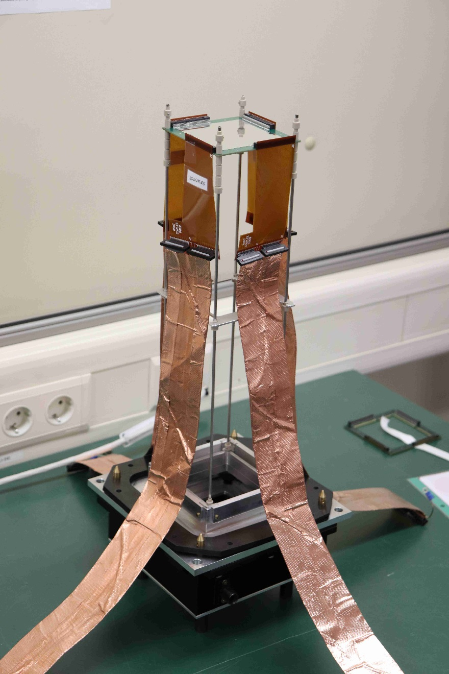
AIDA DSSSD: cabling
Kapton PCB +
3M 1245 wrapped Samtec ribbon cables

Slide 9
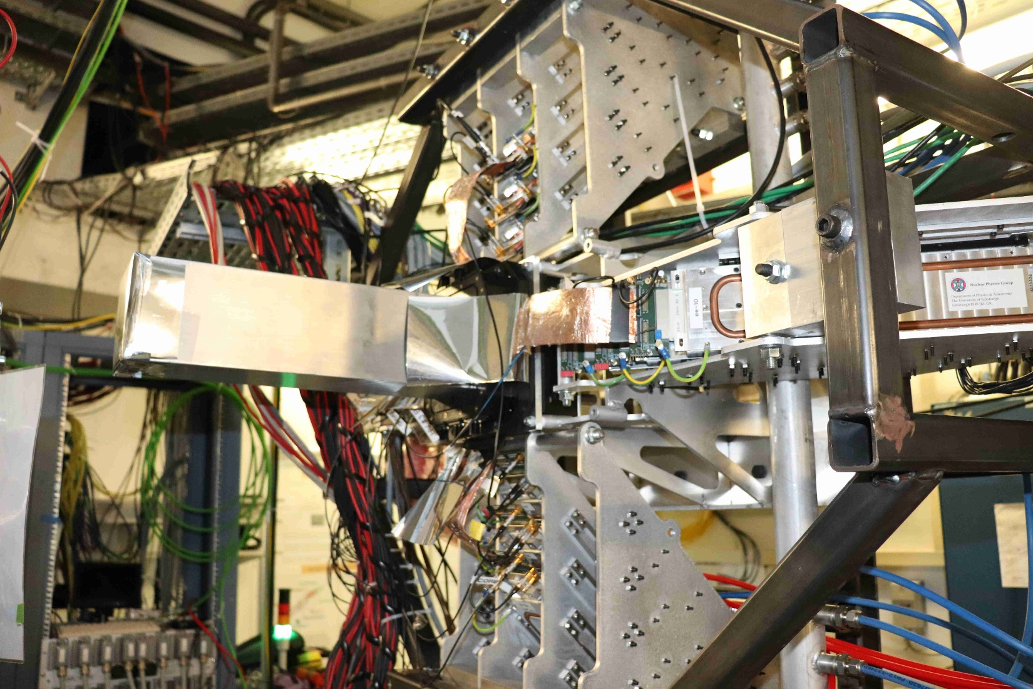
AIDA: snout and FEE64s

Slide 10
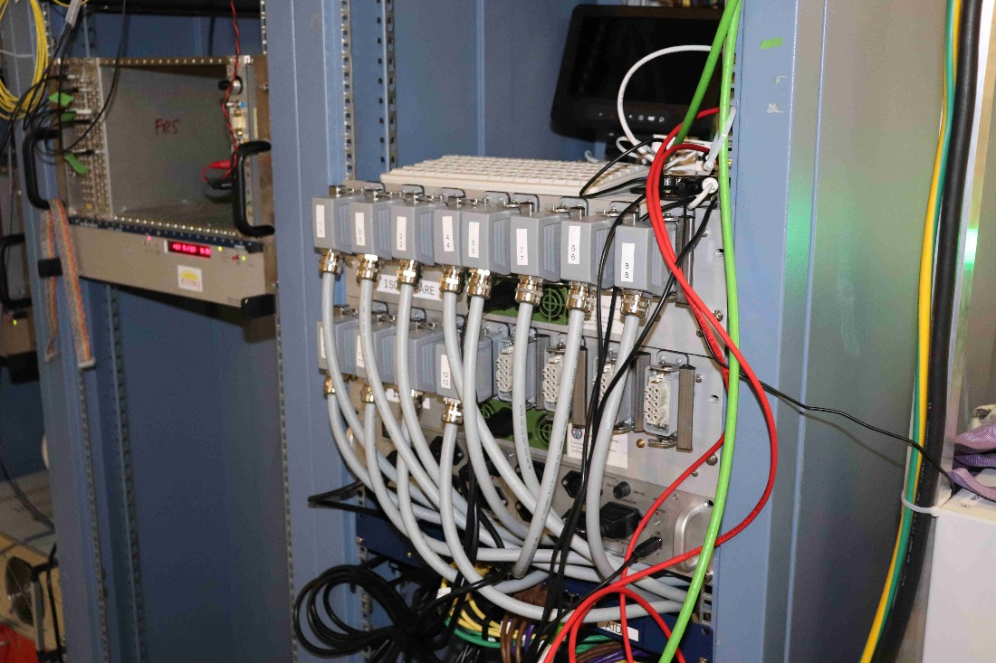
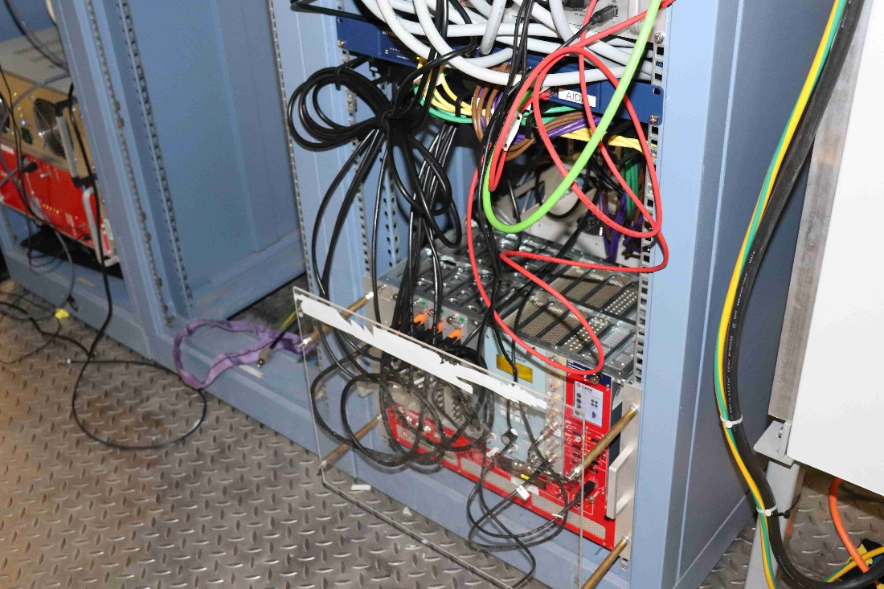
AIDA: 19” rack hardware
For 4x 8cm x 8cm DSSSDs
(1024 channels)
USB-controlled ac mains relay
FEE64 PSUs
Gbit network switch
MACB WR timestamp distribution
Pulser
Detector bias

