Slide 1
Advanced Implantation Detector Array (AIDA)
HISPEC/DESPEC meeting 26 September 2017
presented by
Tom Davinson
on behalf of the AIDA collaboration
(Edinburgh – Liverpool – STFC DL & RAL)
Tom Davinson
School of Physics & Astronomy
The University of Edinburgh

Slide 2
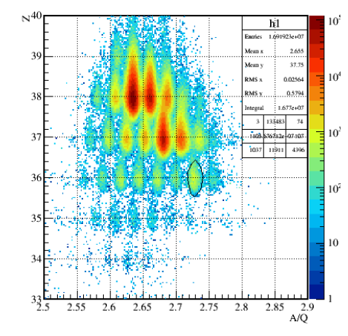
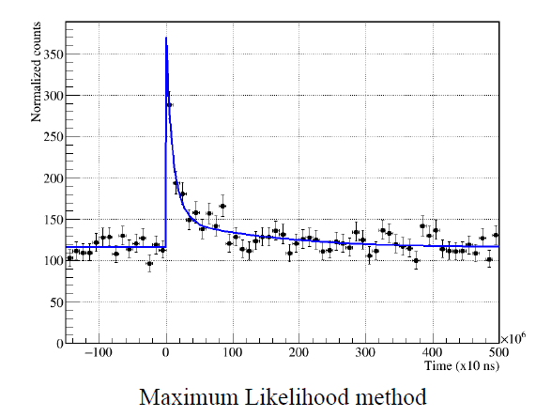
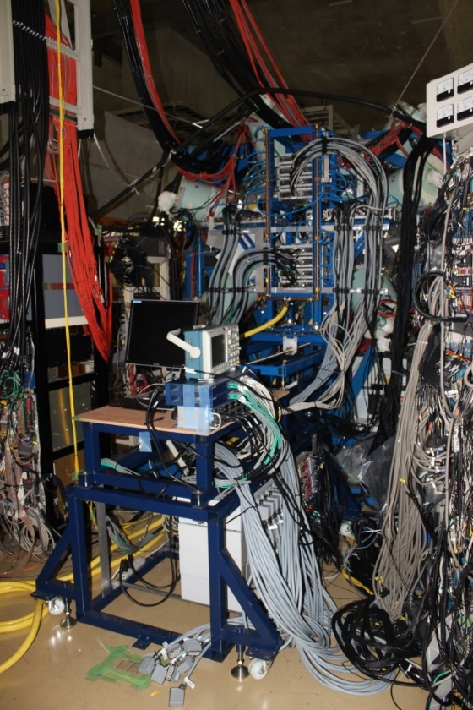
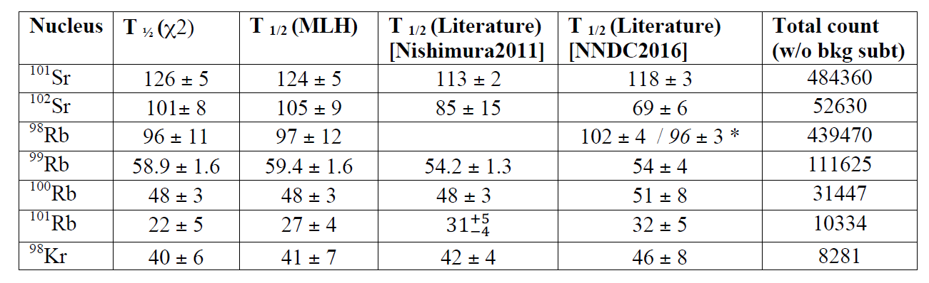
AIDA: Current Status
Operational
Commissioning tests (3x MSL type BB18-1000 DSSSDs) May 2015
First experiments (6x DSSSDs) June 2016
NP1306 Estrade et al., NP1512 Recchia et al.
⁹⁸Kr
Preliminary analysis courtesy Phong Vi

Slide 3
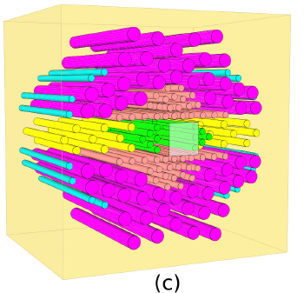
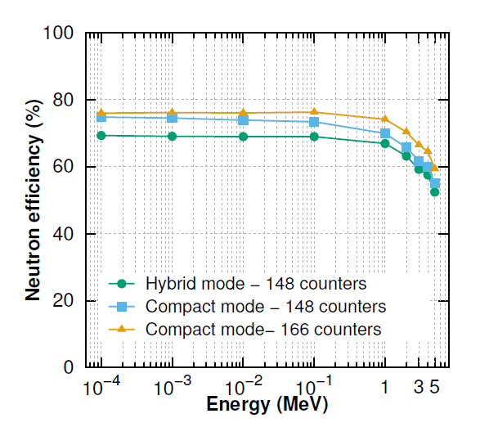
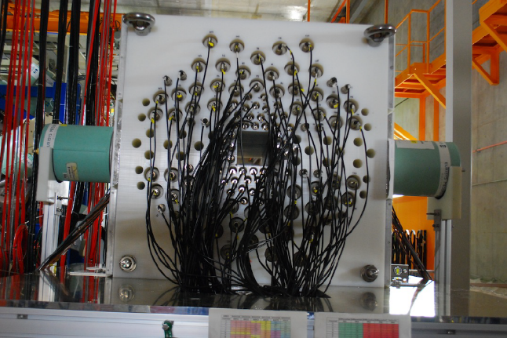
BRIKEN: Current Status
High efficiency detector design (A. Tarifeno et al)
Polyethylene moderator with ~160 ³He counters
Optionally include 2x HPGe clover detectors in close geometry
Successfully installed July 2016
First commissioning tests 1-6, 7-8 and 24-30 November 2016
Experimental program commenced May-June 2017
30+ days approved beamtime (including AIDA+dTAS)

Slide 4
AIDA @ GSI
AIDA hardware to be used for an internal spectrometer for storage ring
32+ AIDA FEE64 and support infrastructure delivered
In discussion with CRYRING collaboration to develop multi-purpose,
modular XUHV chamber for silicon detectors and gas jet target
Possible to use this AIDA hardware for a DESPEC programme from 2018 (say)
AIDA will provide 4x MSL type BB18(DS)-1000 DSSSDs (8cm x 8cm) to support
FATIMA and dTAS experiments
AIDA already has 2x MSL type BB18(DS)-1000 (24cm x 8cm)
To Do
Purchase AIDA DSSSDs
Purchase DSSSD-FEE64 cabling and adaptors
Design and fabricate new AIDA mechanical support assembly
Upgrade AIDA MACB firmware to white rabbit – hardware tests at GSI in prep
Timestamping & online analysis
S4 layout

Slide 5
Timestamping
DAQ Correlation – October 2016
AIDA
Master MACB
TRIGGER
RIBF
DAQ Trigger @ B3F
TRIGGER
50MHz
RESET
RIBF
LUPO @ F11
RIBF
ADC @ F11
RESET
25MHz
TRIGGER
BRIKEN
SIS3316 Digitizer
BRIKEN
SIS3820 Scaler
BRIKEN
SIS3100 VME Sequencer
BRIKEN
NIM clock
BRIKEN
BNC PB-5
Real-time DAQ synchronisation monitor developed

Slide 6
Online Data Analysis
BRIKEN Data Analysis Pipeline
AIDA RAW DATA
AIDA
LuckyDoll (RIKEN; Phong)
AIDAsort (Edin./CMU; Chris/Oscar, Neerajan)
AIDA
Root TTree
Valencian
Merger Tool
(J.Agramunt et al.)
BigRIPS RAW DATA
BigRIPS
Root TTree
BigRIPS
Anaroot (RIKEN; Matsui)
BRIKEN RAW DATA
BRIKEN
Root TTree
BRIKEN
BRIKEN sort(?) (Valencia; Jorge, Alvaro)
AIDA/BigRIPS/BRIKEN time-ordered data streams → merged, time-ordered
derived data
Courtesy Alfredo Estrade Vaz & Jorge Agramunt

Slide 7
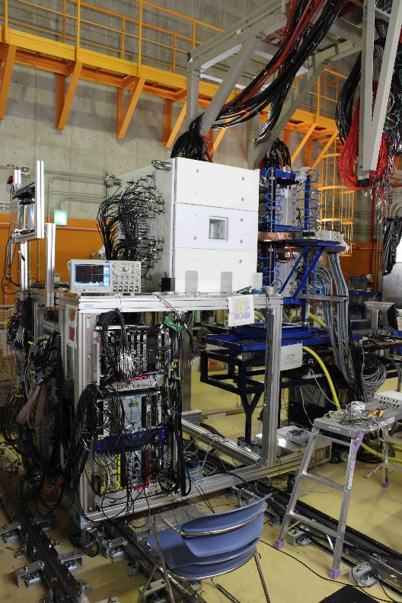
Acknowledgements
AIDA collaboration
http://www2.ph.ed.ac.uk/~td/AIDA/welcome.html
BRIKEN collaboration
https://www.wiki.ed.ac.uk/display/BRIKEN/Home
RIKEN Nishina Centre for Accelerator-Based Science
S.Nishimura, G.Kiss, K.Matsui, P.Vi et al.

Slide 8
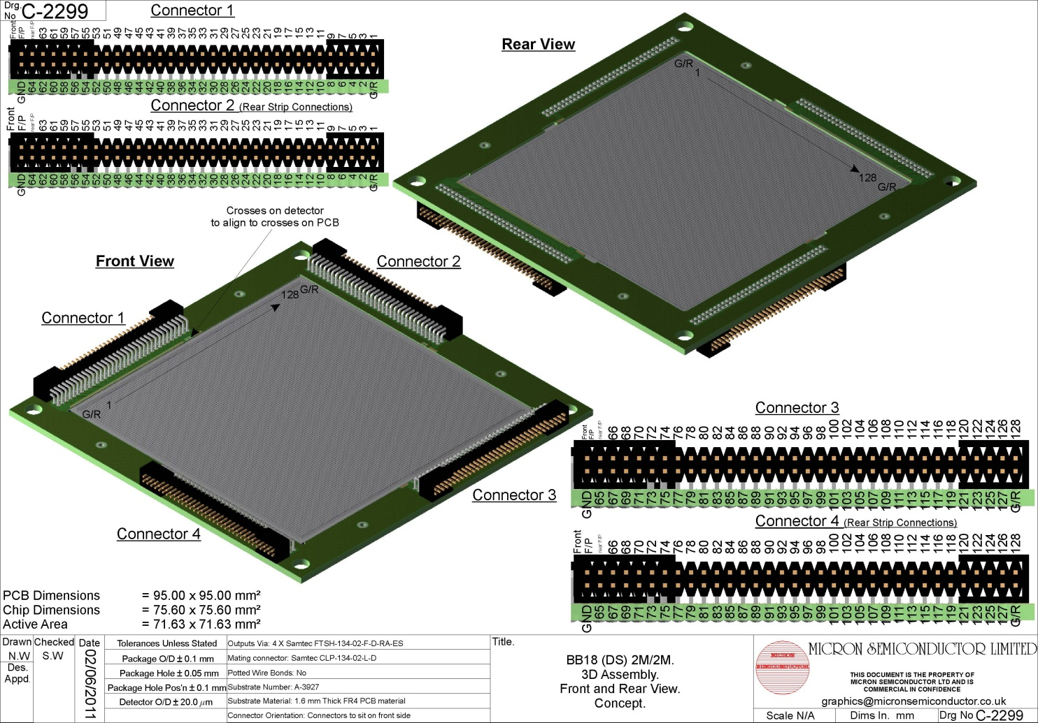
MSL type BB18
128 x 128 strips (16384 pixels)
multi-guard ring
0.560mm strip pitch
1mm wafer thickness

Slide 9
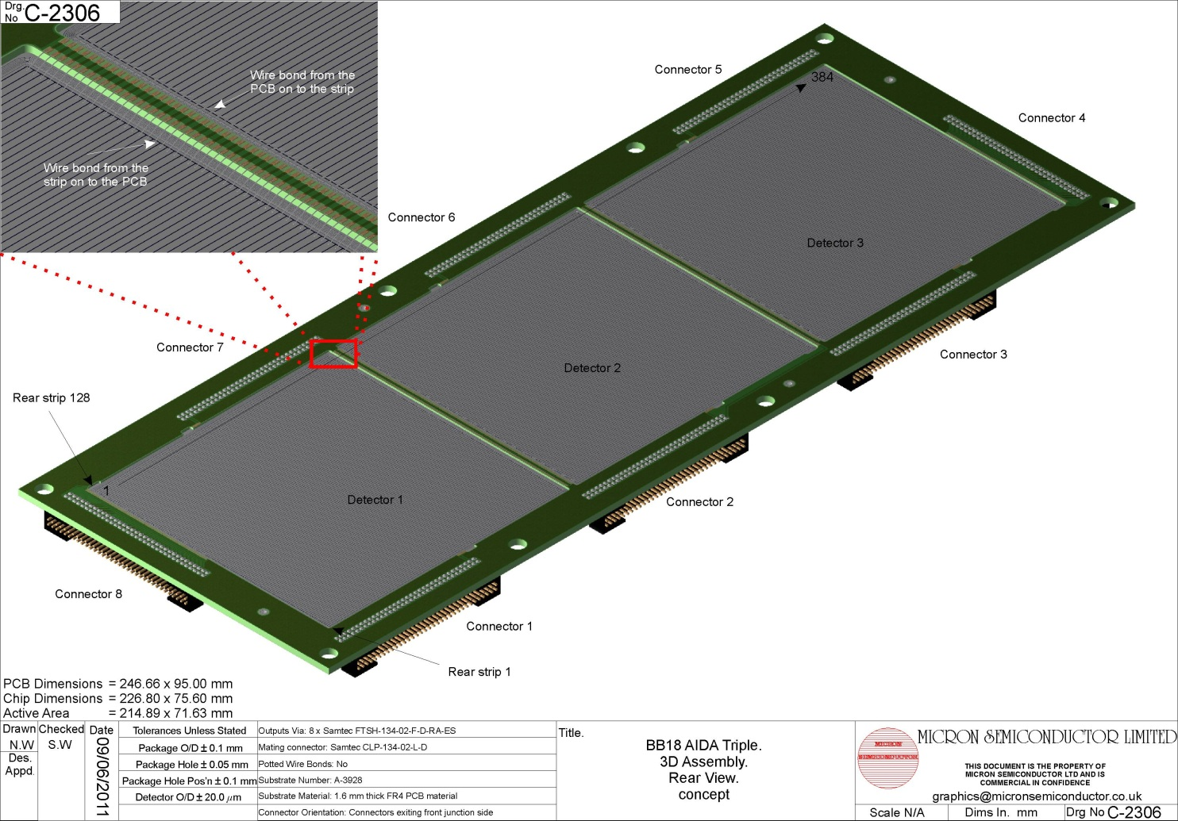
MSL type BB18
384 x 128 strips (49152 pixels)
multi-guard ring
0.560mm strip pitch
1mm wafer thickness

Slide 10
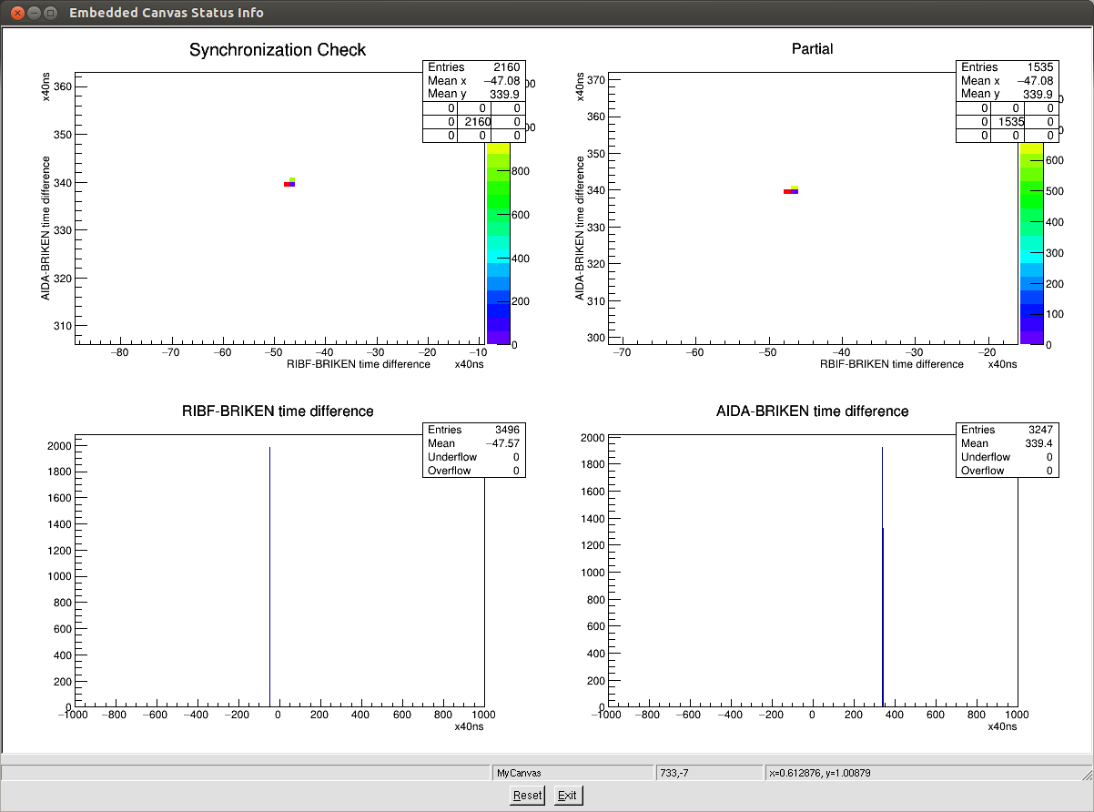
May 2015 Test: online DAQ synchronisation test
Courtesy J.Agramunt, J.L.Tain

Slide 11
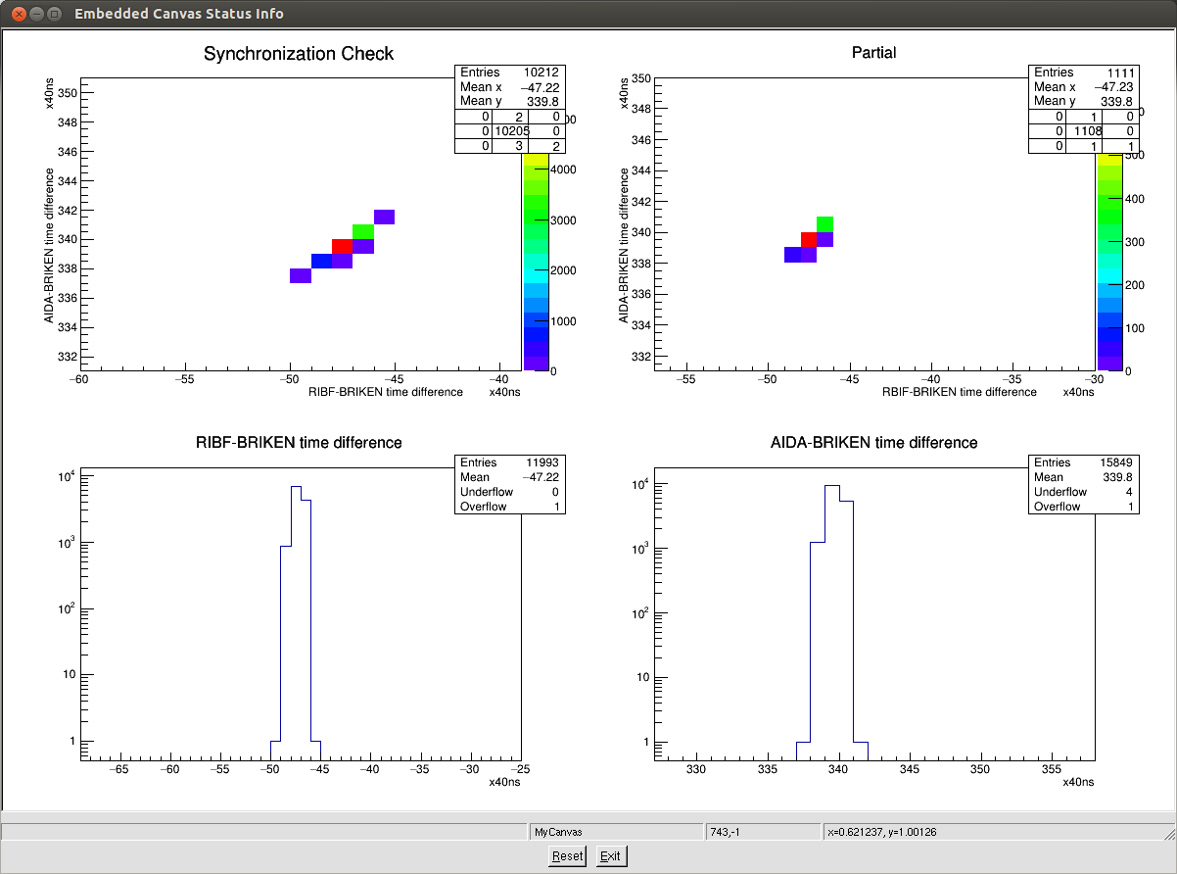
May 2015 Test: online DAQ synchronisation test
Courtesy J.Agramunt, J.L.Tain

Slide 12
Accepted RIKEN Proposals
Masses and β-decay properties of r-process nuclei around N=56
Estrade Vaz et al.
Measurements of new beta-delayed neutron emission properties around
doubly-magic ⁷⁸Ni
Rykaczewski, Tain, Grywacz, Dillman et al.
BRIKEN Neutron Detector – Detector Construction Proposal
BRIKEN collaboration
Studies of r-process nuclei around A~100
BRIKEN collaboration
Measurement of β-delayed neutron emission probabilities relevant to
the A=130 r-process abundance peak
Estrade Vaz, Lorusso, Montes et al.

