Slide 1
Advanced Implantation Detector Array (AIDA)
HISPEC/DESPEC meeting 24 September 2018
presented by
Tom Davinson
on behalf of the AIDA collaboration
(Edinburgh – Liverpool – STFC DL & RAL)
Tom Davinson
School of Physics & Astronomy
The University of Edinburgh

Slide 2
AIDA Support Stand – the plan
AIDA support stand
8cm x 8cm & 8cm x 24cm DSSSDs
Overhead services routing
ac mains power
2x Gbit Ethernet
cooling water
White Rabbit
etc
Temperature controlled cooling water
+20 ºC
https://www2.ph.ed.ac.uk/~td/AIDA/Information/information.html

Slide 3
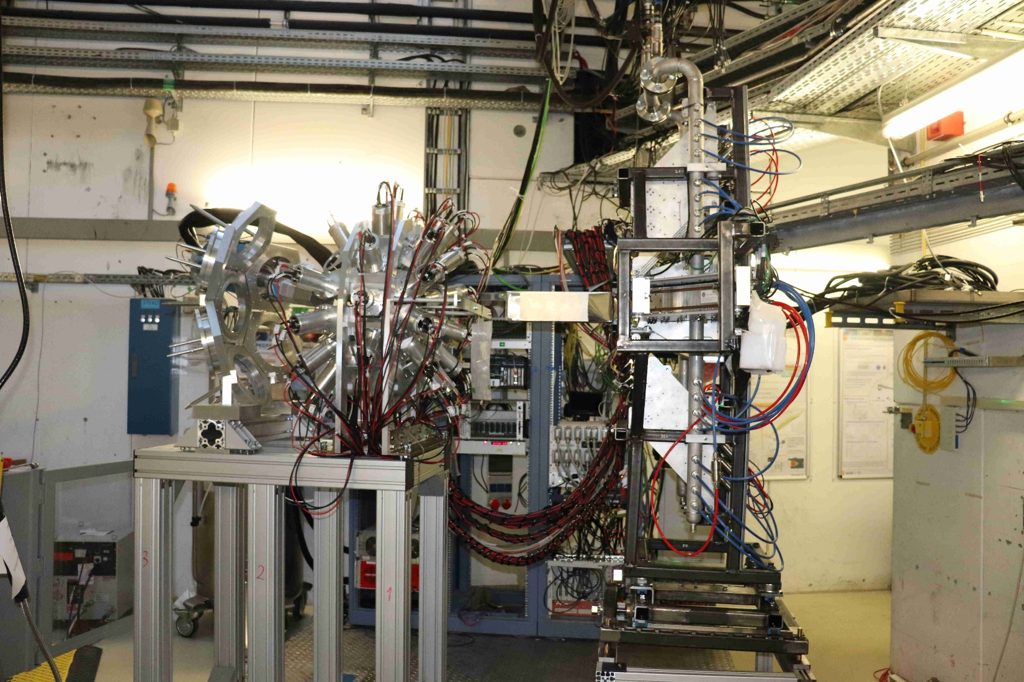
S4: AIDA + FATIMA

Slide 4
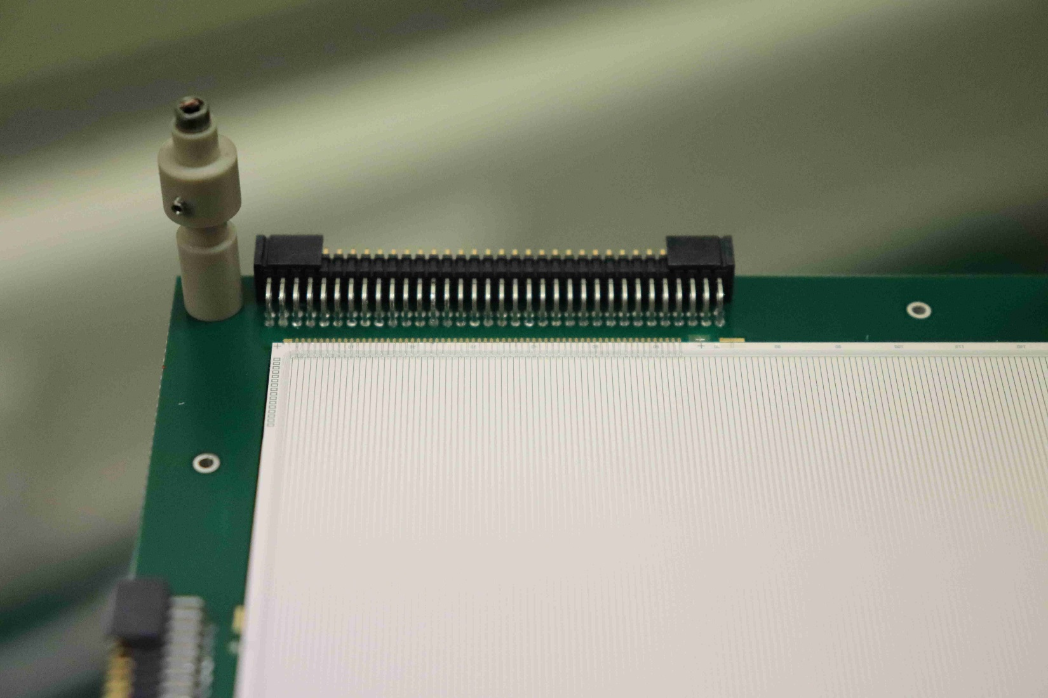
AIDA DSSSD: MSL type BB18(DS)-1000
Detail – 1 (of 4) connectors, strips, bond wires, bias ring, multi-guard ring,
field plate etc

Slide 5
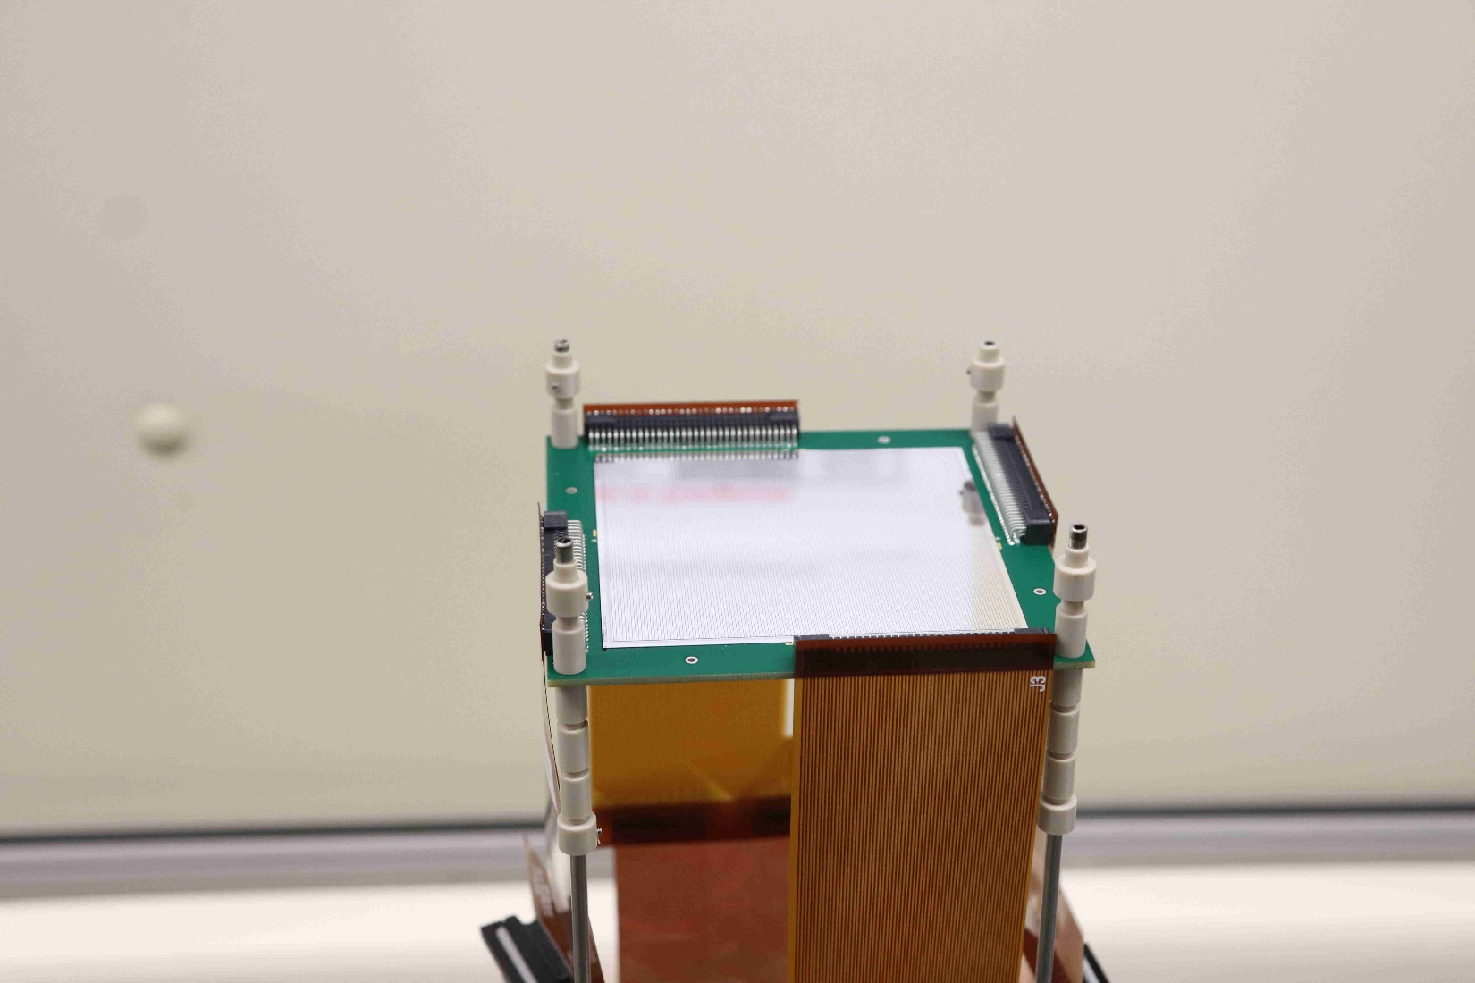
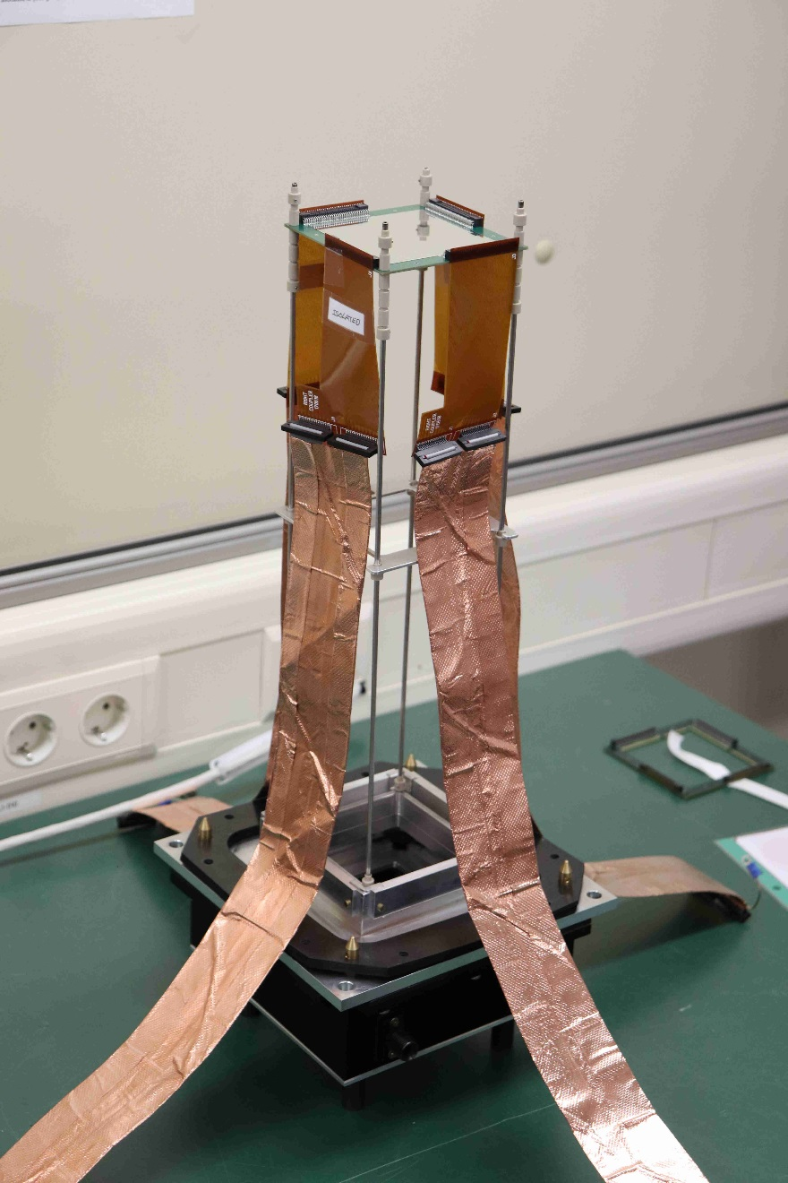
AIDA DSSSD: cabling
Kapton PCB +
3M 1245 wrapped Samtec ribbon cables

Slide 6
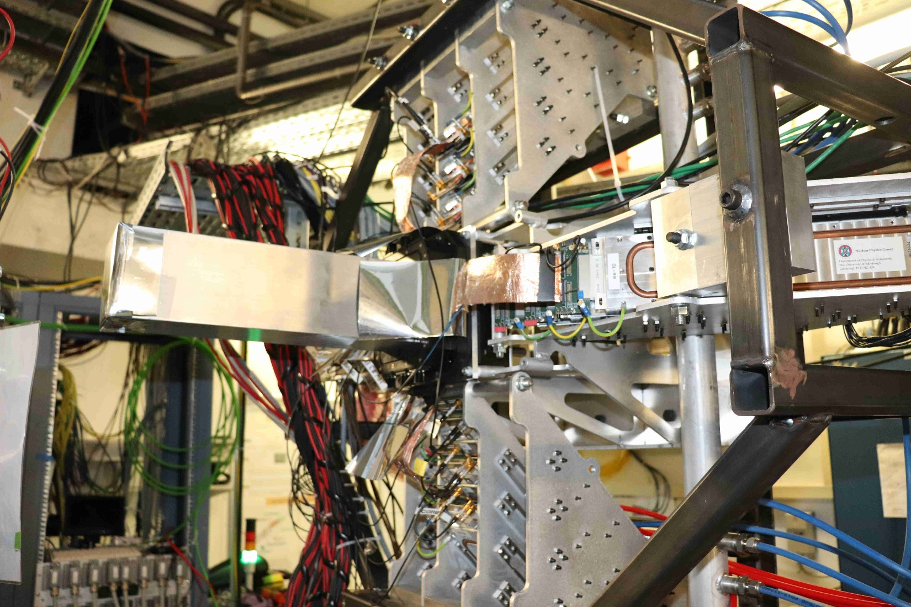
AIDA: snout and FEE64s

Slide 7
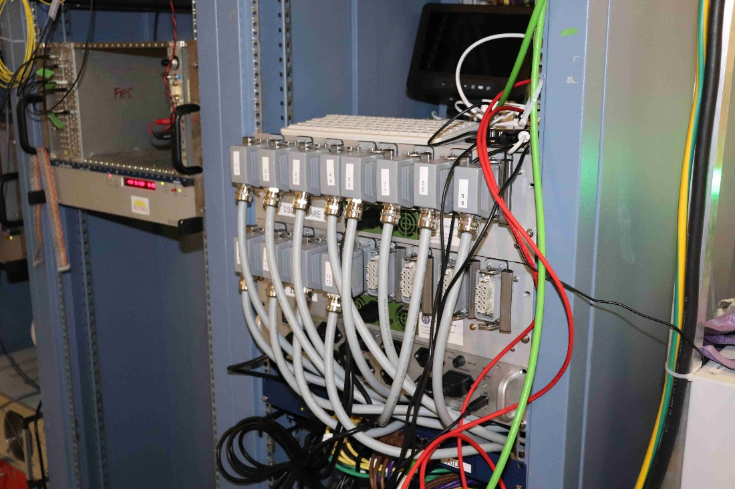
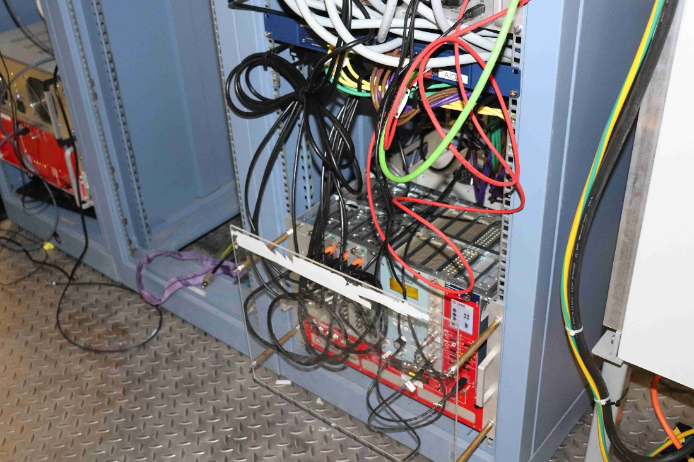
AIDA: 19” rack hardware
For 4x 8cm x 8cm DSSSDs
(1024 channels)
USB-controlled ac mains relay
FEE64 PSUs
Gbit network switch
MACB WR timestamp distribution
Pulser
Detector bias

Slide 8
Done
Remote control
ac mains relay
FEE64 PowerPC system consoles
detector bias
Power interlocks
dew point
water flow
1x MSL type BB18(DS)-1000 installed
day 1 noise ~40-60keV FWHM – to be improved
AIDA operational in standalone mode

Slide 9
To Do
Plastic scintillator
Install 2x plastic scintillator plus 3x DSSSDs
White Rabbit ( ‘Mark 2’ ) merger
Vic Pucknell & Patrick Coleman-Smith debugging
using AIDA test system at STFC DL
Test correlations with FATIMA using pulser and
radioactive sources
Test online analysis software

Slide 10
Acknowledgements
AIDA collaboration
http://www2.ph.ed.ac.uk/~td/AIDA/welcome.html
Edinburgh
Peter Black, Carlo Bruno, Oscar Hall
UKRI STFC Daresbury Laboratory
Ian Burrows, Mike Cordwell, Alan Grant
GSI
Juergen Gerl, Magda Gorska, Nik Kurz, Henning Schaffner,
Karl Heinz ?

