Slide 1
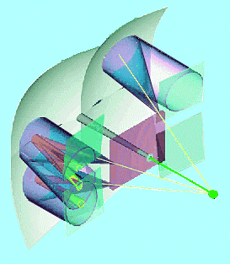
Photon Detectors for a RICH Upgrade with a 40MHz Readout: MaPMT and Flatpanel PMT
manufacturer: Hamamatsu
Metal Channel Detector Types
Quantum Efficiency
Signal Characterisation
Detector Unit Characterisation
System Integration
Cost
Risks
Conclusions: are these photon detector usable for the RICH?
Colour codes for quoted values:
Hamamatsu specs & info
measured or used (in the past or following)
calculated
educated guess
alternative option (not further used here)
to be checked
RICH upgrade meeting, 15.10.2008
Stephan Eisenhardt
University of Edinburgh

Slide 2
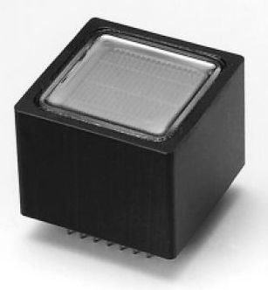
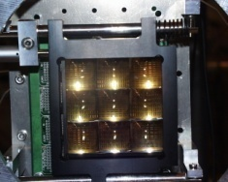
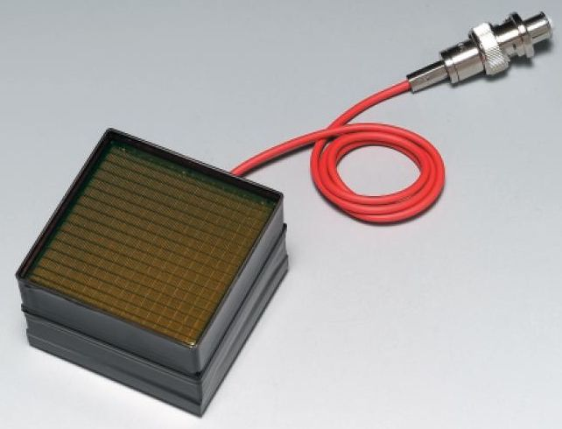
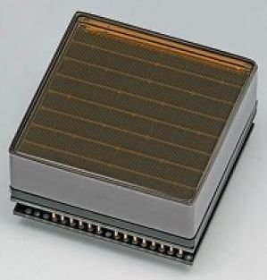
Metal Channel Detector Types
MaPMT: R7600 (H7546B) 2003 MaPMT
25.7x25.7mm, square (w/o housing) evaluation:
18.1x18.1mm active area, 0.3mm gaps (0.2mm gaps)
available as: 1 ch., 4 ch., 16 ch., 64 ch.:
pixel size: 2.0x2.0mm (2.1x2.1mm)
active area fraction: 49.6% (38.7%) (38%,42%)
recovered active area fraction with Quartz lens: 78.1% (85%)
effective pixel size: 2.8x2.8mm (3.0x3.0mm)
available Flatpanel PMT: R8400 (H8500, H9500)
52.0x52.0mm, square
49.0x49.0mm active area, 0.2mm gaps
64 ch., 256 ch.:
pixel size: 3.04x3.04mm (edge: 3.04x3.22mm, corner: 3.22x3.22mm)
active area fraction: 89% (78.3%)
HV:
pin or
cable
contacts

Slide 3
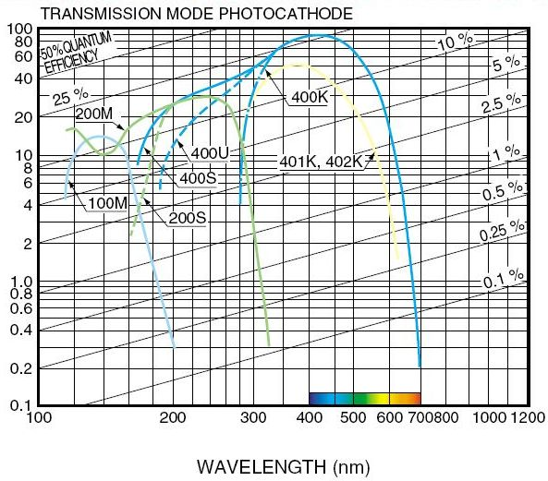
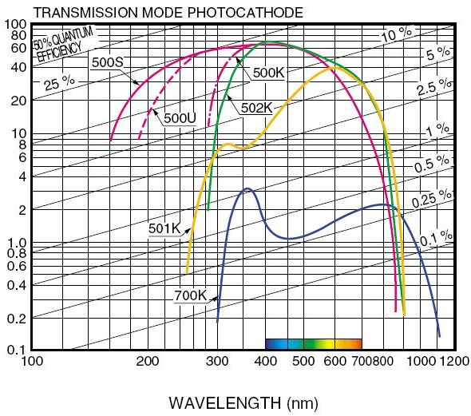
Quantum Efficiency I
Bialkali photo cathodes
Multialkali photo cathodes
Hamamatsu data

Slide 4
Quantum Efficiency II
available standard bialkali/mulitialkali photo cathodes:
standard, bialkali: 400X (X=K,U,S)
windows: K → borosilicate U → UV-glass S → fused silica
QE@200/250/300nm 0/ 0/18% 8/14/18% 18/18/18%
peak QE @ λ[nm] ~26% @ 400nm ~26% @ 400nm ~26% @ 400nm
1%[0%] red cut-off 650[700]nm 650[700]nm 650[700]nm
QE dE (from graph) 0.505 (-29%) 0.706 0.932 (+32%)
high UV and red, multialkali: 500X (X=K,U,S)
windows: K → borosilicate U → UV-glass S → fused silica
QE@200/250/300nm 0/ 0/12% 10/24/25% 10/24/25%
peak QE @ λ[nm] ~18% @ 400nm ~25% @ 260nm ~25% @ 260nm
1%[0%] red cut-off 760[860]nm 760[860]nm 760[860]nm
QE dE (from graph) 0.380 (-54%) 0.813 (+15%) 1.047 (+48%)
400U with UV window still seems to be a reasonable choice from this traditional range
(price/QEdE, ease of handling)
only other contender: 500U, but: additional cost, additional noise from red sensitivity

Slide 5
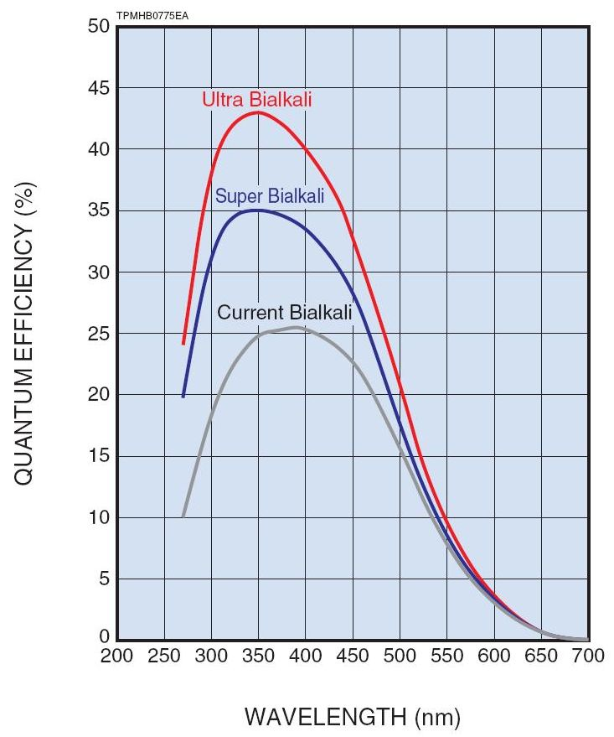
Quantum Efficiency III
new development of Super- and Ultra-Bialkali photocathodes:
questions to Hamamatsu:
Q: as long-term stable as standard bialkali?
A: probably yes – check with factory
Q: tube to tube variations?
A: check with factory
Q: variations across surface?
A: should be small - check with factory
Q: gradual improvement of same process?
A: no, three different processes

Slide 6
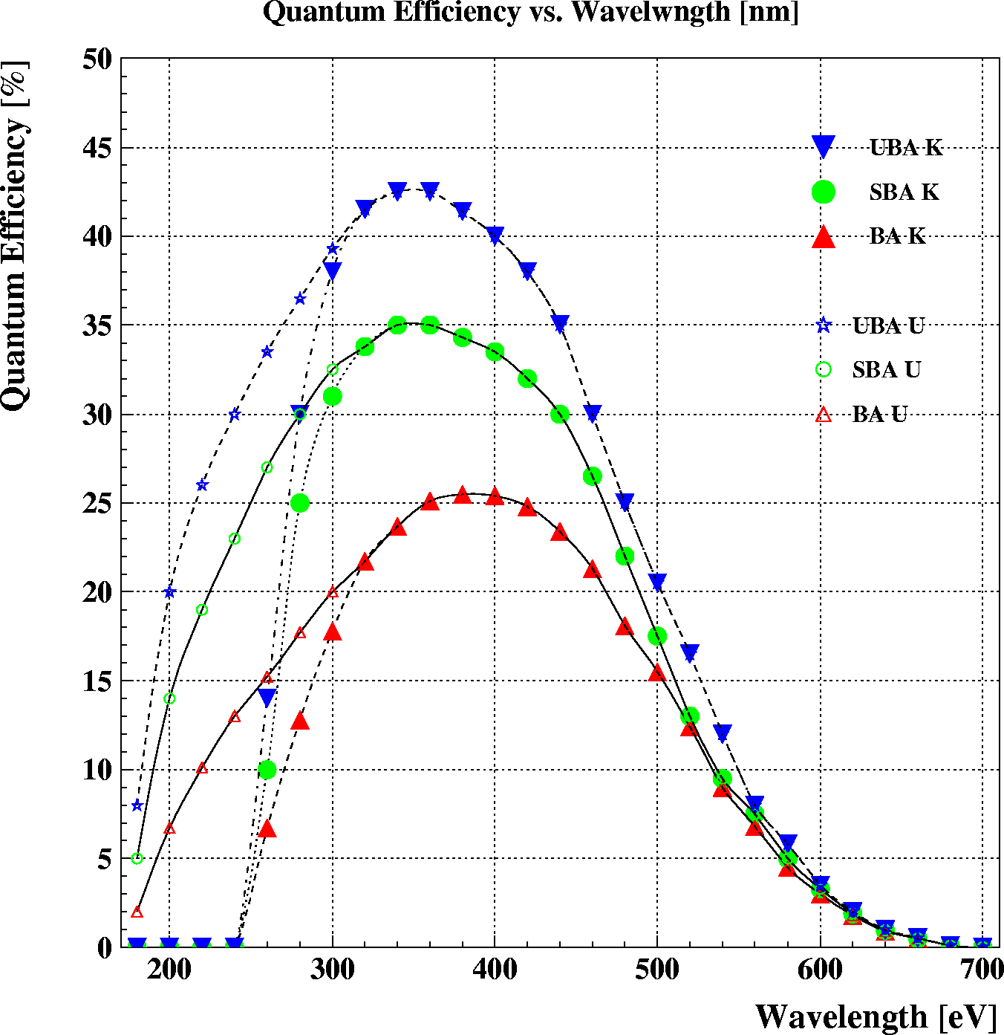
Quantum Efficiency IV
new development of Super- and Ultra-bialkali photocathodes:
all curves apparently measured with borosilicate window (K)
windows: Bilalkali (400K) Super Bialkali (SBA) Ultra Bialkali (UBA)
QE@200/250/300nm 0/ 0/18% 0/ 0/32% 0/ 0/37%
peak QE @ λ[nm] ~26% @ 400nm ~35% @ 350nm ~43% @ 350nm
1%[0%] red cut-off 650[700]nm 650[700]nm 650[700]nm
QE dE (from graph) 0.505 (-29%) 0.726 (+3%) 0.879 (+25%)
SBA and UBA so far marketed only for R7600 with borosilicate
window, not with UV glass or for R8400
no visible obstacle to manufacture these combinations
room for further significant improvement with UV glass window:
QEdE: if shapes of SBA and UBA behave as for standard bialkali
BA(400U) =0.706, SBA =1.130 (+60%), UBA =1.423 (+102%)
i.e. we could double the QEdE wrt. the 2003 MaPMT evaluation
… to be confirmed …

Slide 7
Signal Characterisation I
electron multiplication: 2003 MaPMT R7600(M64) R8400(M256)
dynode chain: 12 (8) dynodes 12 dynodes 12 dynodes
maximum HV: -1000V -1000V -1100V
typical HV: -800V -800V -1000V
gain @ typical HV: 0.3 (0.05) x10⁶ 0.3x10⁶ 1.5x10⁶
i.e. charge of single-γ pulse: 48fC 48fC 240fC
gain doubles every: 50-60V same similar
default divider ratios: 3-2-2-1…1-2-5 3-2-2-1…1-2-5 1-1-1…1-0.9-0.1
tuning of divider chain: done possible not so easy
medium gain divider chain: 4-2-2-1…
low gain divider chain: 4-3-3-1…

Slide 8
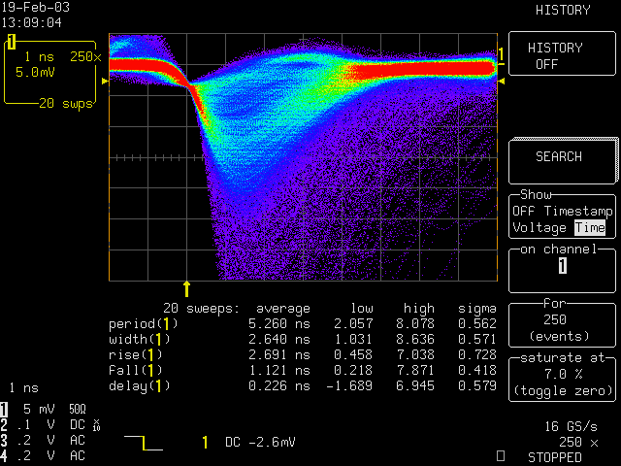
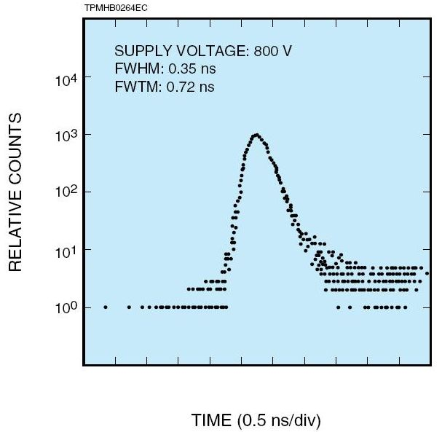
Signal Characterisation II
charge pulses: 2003 MaPMT R7600(M64) R8400(M256)
rise time: 1.1ns 1.0ns 0.8ns
fall time: 2.7ns same ~same
pulse width: 2.6ns same ~same
transit time: 12.0ns 6ns
transit time spread: 0.38ns 0.4ns
remember, single-γ pulse: 48fC 48fC 240fC
amplitude, in 50Ω @ typ.HV: ~1mV(10mV@HV=-1000V) ~1mV ~5mV
MaPMT
single photon pulses
HV = -1000V, input: 50Ω
display: 5mV/div, 1ns/div
transition time spread

Slide 9
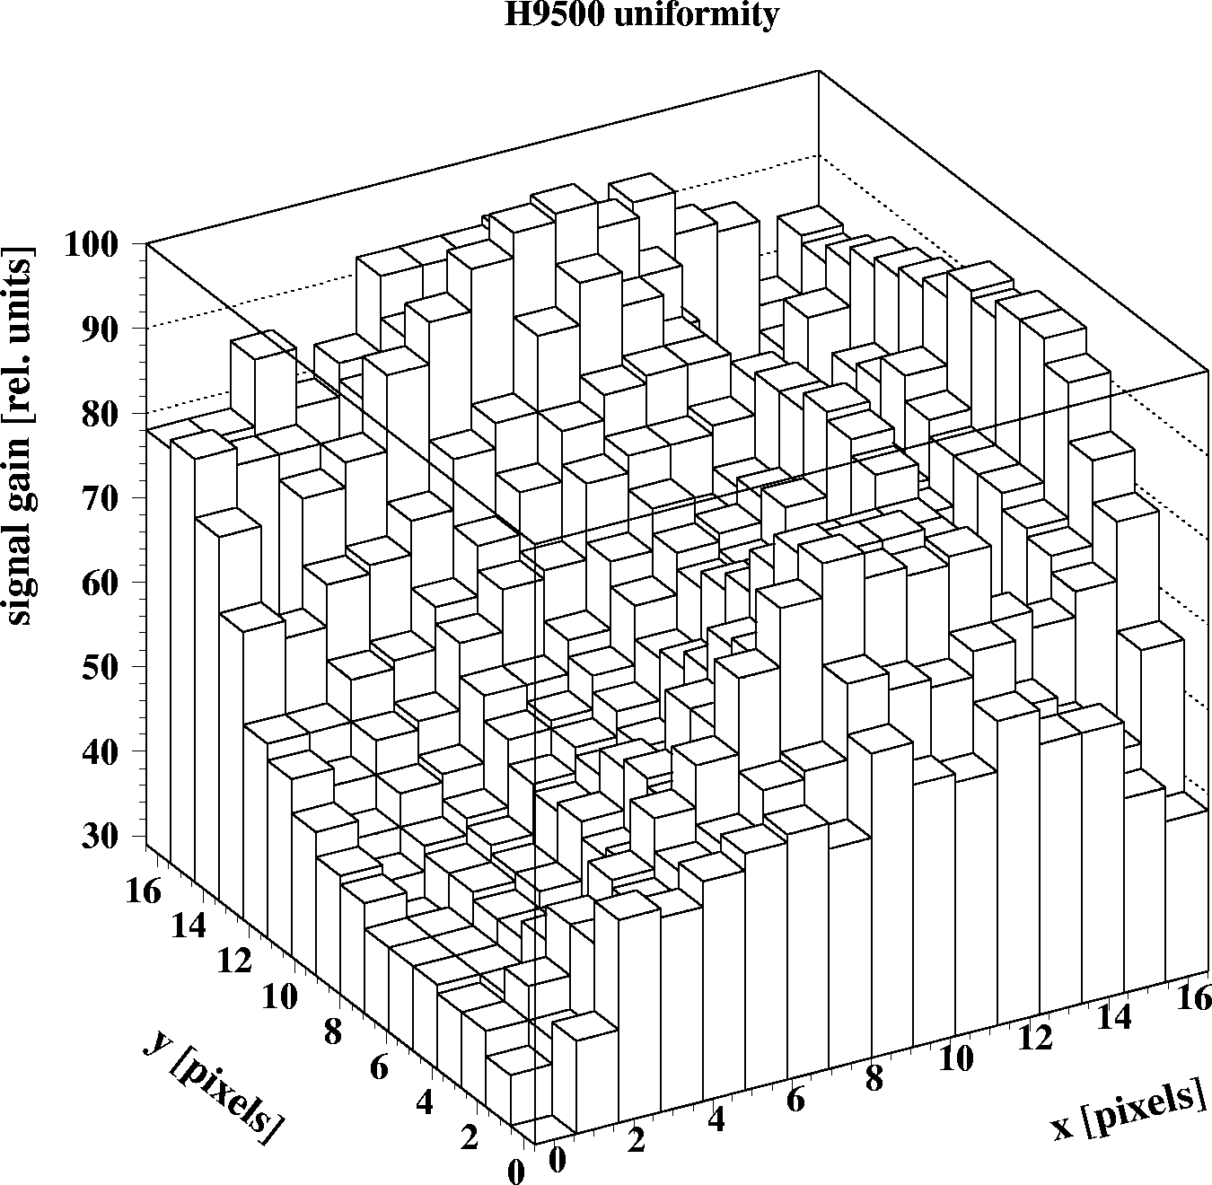
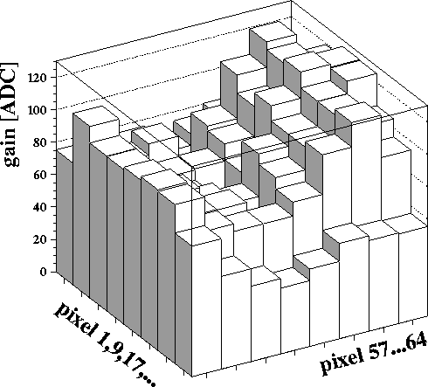
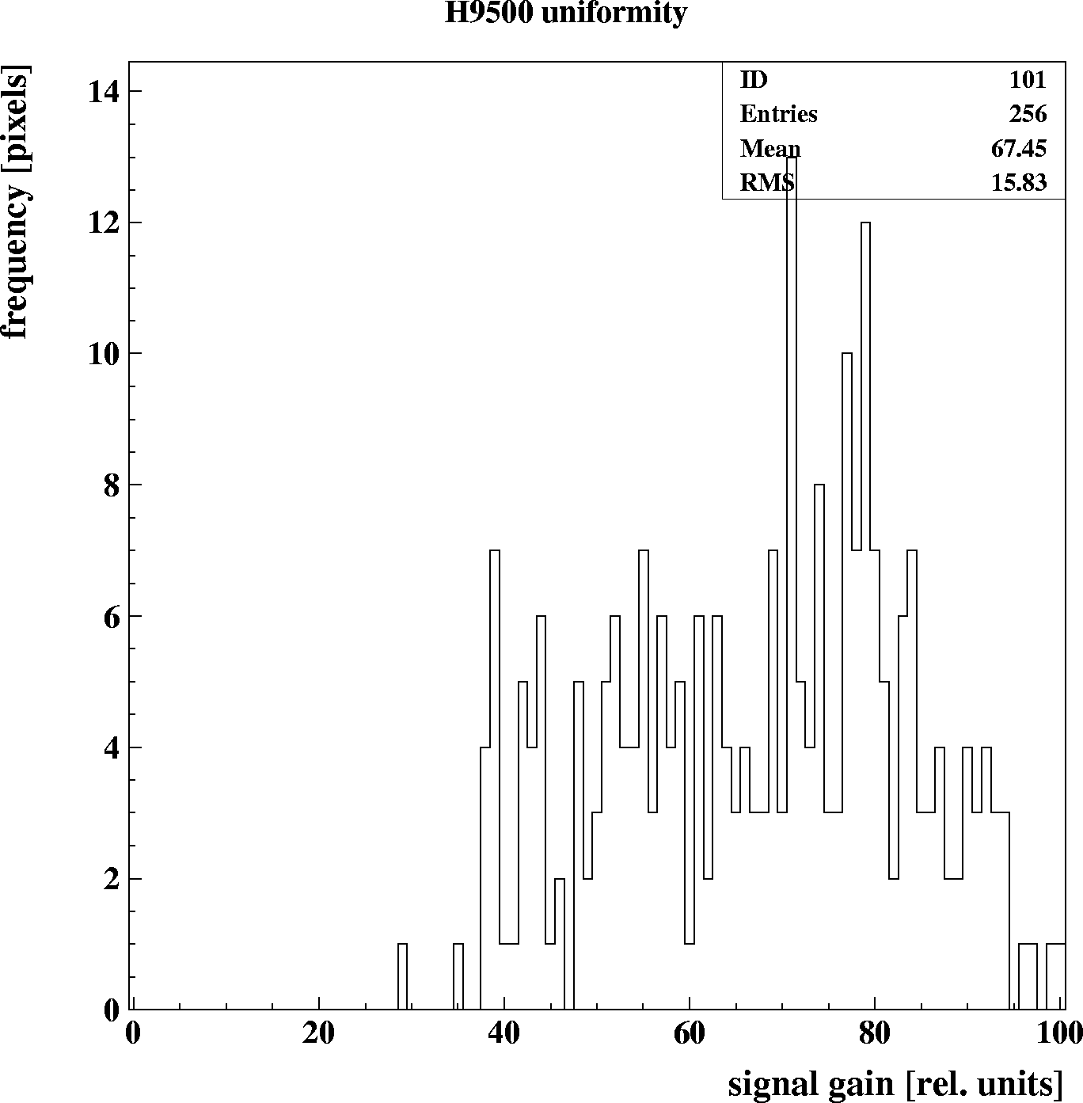
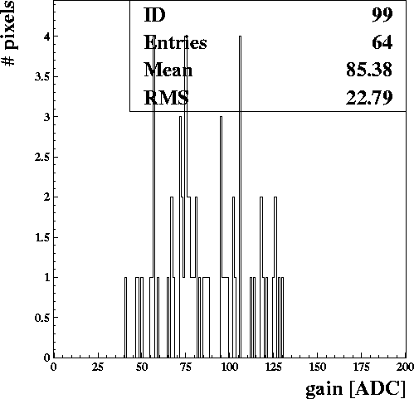
Detector Unit Character. I
electron multiplication: 2003 MaPMT R7600(M64) R8400(M256)
typ./max. gain uniformity: 1:2.5 / 1:4 1:2.5 / 1:4 1:4 / 1:6
uniformity selection:
channel-to-channel: possible 1:2 possible possible
tube-to-tube: possible 1:2 possible possible
total: possible 1:3
prototype 1:3
example 1:3

Slide 10
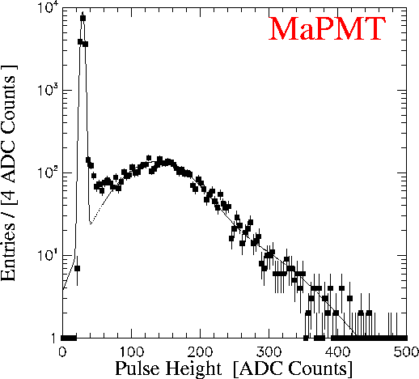
Detector Unit Character. II
cross talk: 2003 MaPMT R7600(M64) R8400(M256)
opt. & elec. to 1 neighbour: consistent 0.7% 0.6%
opt. & elec. to 8 neighbours: with 5% 5.6% 5%
signal noise & signal loss:
mean signal/pedestal width: 40:1 same as 2003 same or better
signal loss below 5σ cut: 11.5% same as 2003 same or better
(as the gain is
larger…)
noise & background sources, per channel:
pedestal: electronic noise Beetle1.3 1000e⁻
typical BG: dark counts 0.2nA (4.2kHz) 0.05nA (0.2kHz)
-900 V
scan across pixel
with 0.1mm LED spot
5σ cut
single photon spectrum

Slide 11
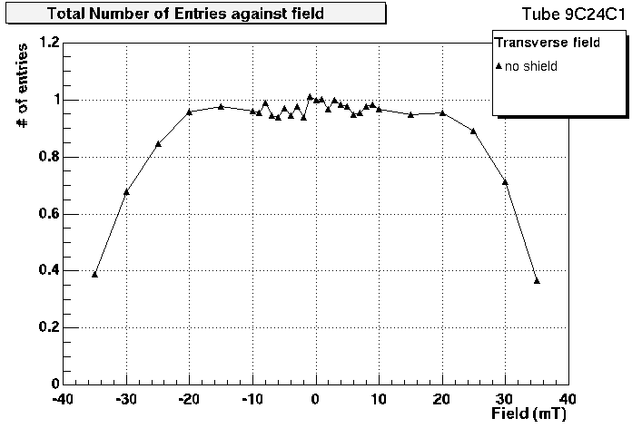
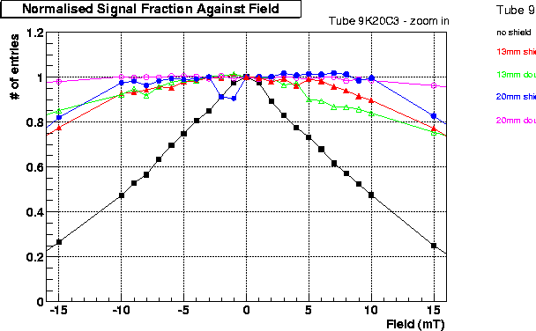
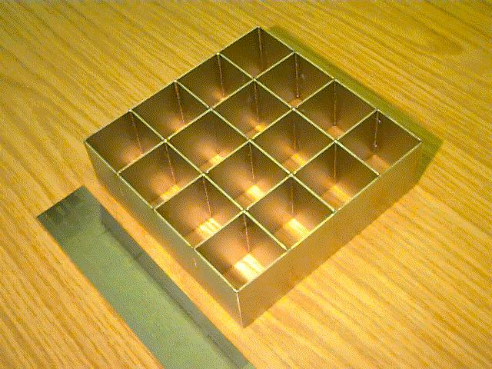
Detector Unit Character. III
magnetic field performance: 2003 MaPMT R7600(M64) R8400(M256)
loss of gain: no same similar
distortion of pattern: no same similar
loss of photons: yes same similar
region of strongest lost edge rows same unclear
unshielded, loss <10%
transverse field >200G (>20mT) same unclear
longitudinal field >20G (>2mT) same unclear
0.9mm shield, 13mm protrusion
longitudinal field >80G (>8mT) same unclear (larger size)
90%
precision: 0.2mm
light yield in MaPMT with transverse field & longitudinal field 4x4 mu-metal shield

Slide 12
Detector Unit Character. IV
durability: 2003 MaPMT R7600(M64) R8400(M256)
typical lifetimes of standard bialkali photocathodes:
charge delivery, lifetime: 10C, >>10yrs same similar
typical lifetime of new super- & ultra-bialkali photocathodes:
same as standard
ageing, gain loss: 2/O(5yrs) same similar
can be cured by O(50V) HV adjustment
radiation damage: negligible negligible negligible

Slide 13
System Integration I
scaling to system: 2003 MaPMT R7600(M64) R8400(M256)
bare unit
size 25.7±0.5mm 25.7±0.5mm 52.0±0.3mm
active area fraction 85% 85% 78%
module configuration 4x4 4x4 2x2, 2x4, 4x4
integrated device
mu-metal shield thickness 0.9mm 0.9mm 0.9mm
margin 0.8mm 0.8mm 0.8mm
device pitch 28.2mm 28.2mm 54.0mm
module size 113.8mm 113.8mm 108.9mm
active area fraction 72% 72% 72%
units needed for 3.3m² 4064(3504,2.8m²) 4064 1112
number of modules 254 (232) 254 278
number of electronic ch. 261k (237k) 261k 285k

Slide 14
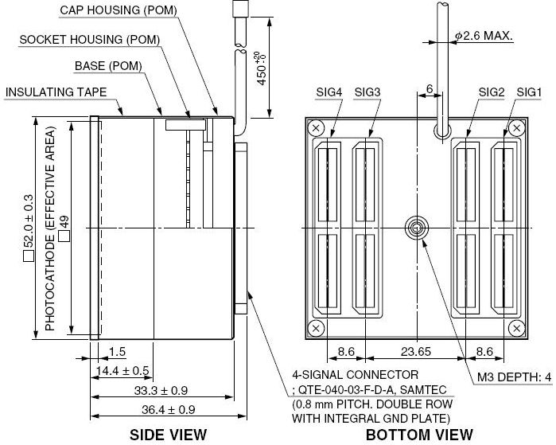
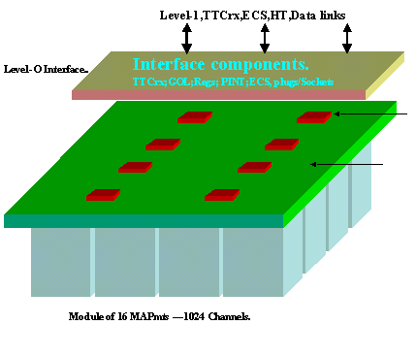
System Integration II
interfaces: 2003 MaPMT R7600(M64) R8400(M256)
HV divider 4x4 board 4x4 board integrated
signal channel connection feed-through direct plug-in Samtec cable
(included)
L0 board: 8 Beetle1.3, need “Beetle2.x” need “Beetle2.x”
HV,LV, TTCrx, need adapted ditto,
PINT, GOL, ECS PINT, GOL, … but no HV
2003 Cambridge
bleeder board
H9500 package
divider chain included
Samtec cables included
option D: HV&GND pins
2003 L0 board outline
4x4 module: 1024 ch.
direct plug-in

Slide 15
System Integration III
readout chip, 40MHz output: 2003 MaPMT R7600(M64)/R8400(M256)
raw analogue signal charge pulse charge pulse
readout chip Beetle1.2MA0 (testbeam)
Beetle1.3MA0 (proposed) “Beetle2.xMAx”
readout type analogue or binary (analogue??? or) binary
provides preamp (300k e⁻) preamp(300k/1.5M e⁻)
shaper shaper
comparator: 3-bit (Beetle1.2:marginal)
5-bit (Beetle1.3:comfortable) 5-bit
pipeline 160 cells (4μs) 0 cells
multiplexing (channels:links) 128:4@40MHz 128:128(256:256)@40MHz
signal transmission to L1: 1Gbit GOL 6Gbit (FPGA+)GOL
buffering 0 cells O(50-100) cells (1…2.5μs)
multiplexing (electr.:optical) 32:1 1024:1
ch./unit/modul per opt. link 1024 / 16 / 1 1024 / 4 / 1
max. triggered evt. fraction O(1%)=(~2/160 cells) O(10%)=(10/100 cells)

Slide 16
Cost I
scalings: 2003 2008
Yen/GBP/CHF/Euro Y190/£1.00/C2.20/E1.40 Y200/£1.00/C1.90/E1.25
scaling of Quartz cost 1.00 1.16
(assumes: 3% inflation/year)
photon detectors: 2003 MaPMT R7600(M64) R8400(M256)
small volume, package cost, including base: (quote, 10/2008)
standard unit £1100 / CHF2090
standard unit, UV glass £1200 / CHF2640 £1200 / CHF2375 £5200 / CHF 9880
+ SBA + UV glass n.a. £1600 / CHF3040 £5600 / CHF10640
+ UBA + UV glass n.a. £1800 / CHF3420 £5800 / CHF11020
bare unity cost
large volume, best PC: no base no base base included
standard unit, UV glass £ 423 / CHF 931 £ 700 / CHF1330 £2200 / CHF4180
cost of lens £ 32 / CHF 70 £ 43 / CHF 81 n.a.
number of units needed 4064 4064 1112
total photon detector cost £1.85M /CHF4.06M £3.01 /CHF5.74M £2.45M/CHF4.65M
2003 proposal £1.59M /CHF3.50M

Slide 17
Cost II
scalings: 2003 2008
scaling of electronics cost 1.00 1.00
(assumes: in average technical gain beats inflation)
L0 boards (all CHF): 2003 MaPMT R7600(M64) R8400(M256)
detector-L0 interface 254x2000 =508k 254x2000 =508k included
F/E board/pitch adapters 2032x70 =142k 2032x2x70=285k 2224x2x70=312k
F/E chip (“Beetle”) 2032x130 =264k 2032x130 =264k 2224x130 =290k
FPGA n.a. 2032x130 =264k 2224x130 =290k
TCC/DCS 254x100 = 26k 254x100 = 26k 278x100 = 28k
Trigger/Clock 254x180 = 46k 254x180 = 46k 278x180 = 50k
optical links to L1/per board 1 (1Gbit) 1 (6Gbit) 1 (6Gbit)
number of boards/links 254 254 278
cost per link/total 220 = 56k 220 = 56k 220 = 62k
number of L1 boards 30 30 30
cost per board/total 5k =150k 5k =150k 5k =150k
totals: L0+L1 system 1192k 1599k 1182k
per module/unit/channel 4700 / 293 / 4.6 6295 / 393 / 6.2 4251 / 1063 / 4.15

Slide 18
Risks
system risks: 2003 MaPMT R7600(M64) R8400(M256)
photon detectors
high QE photocathode n.a. variance & stability variance & stability
cost of gain selection ??? to be determined to be determined
performance in mag. field ok, with shield ok, with shield to be confirmed
exchange rate Yen/£ was rather stable in 2003…2008 (not true for the last 2 weeks)
L0 electronics
analog vs. digital readout
common mode noise issue with test system needs design care needs design care
signal loss (comparator ) 5-bit was comfortable 5-bit should be OK 5-bit should be OK
design of L0 board
cross-talk issue with test system needs design care needs design care
F/E chip was been developed needs new R&D needs new R&D
cooling was on critical path can be cared for can be cared for
FPGA n.a. to be developed to be developed
GOL was available will be available will be available

Slide 19
Conclusions
MaPMT were fully evaluated in 2003: dropped in cost/risk decision
matched the current RICH specification, no fundamental problem
were on par with pixel HPDs concerning the PID performance
development of F/E board was on the critical path
2008 MaPMT: viable option, even with binary readout
photon detectors: same as 2003, but significant gain in QE (UBA)
needs R&D for F/E electronics: detector-L0 interface, low noise/cross-talk board
readout chip, FPGA, 6Gbit optical link
2008 Flatpanel PMT: viable option, with binary readout
preferable to MaPMT and less costly
photon detectors: higher integration than MaPMT
(256 ch., divider, interface)
significant gain in QE possible (UBA)
needs R&D for F/E electronics: no detector-L0 interface, low noise/cross-talk board
readout chip, FPGA, 6Gbit optical link
R&D timescale to 2013: doable, but should start now

Slide 20
Spare Slides

Slide 21
Items to Cover
Sensitivity to Cherenkov light: MaPMT Flatpanel
efficiency of Cherenkov light detection: QE or QEdE covered covered
wavelength range of sensitivity covered covered
Signal characterisation:
raw signal size, rise (fall) time, signal width (pileup?) covered covered
output signal type (analogue: charge, voltage, digital, binary) covered covered
Detector unit characterisation:
any noise issues: sources, size, frequency covered covered
signal to noise ratio, efficiency of separation covered covered
channel granularity covered covered
channel-to-channel variation of the signal covered covered
channel-to-channel cross-talk covered covered
active area fraction covered covered
magnetic field performance covered covered
lifetime, ageing and radiation damage covered covered
if not an off-the shelf-device (e.g HPD): what new steps would be involved in the manufacture process not applicable not applicable
System integration:
binary, digital or analogue readout covered covered
possibility of scalability to a large system covered covered
ease of integration with internal or internal electronics covered covered
any problem areas with previous experiences covered covered
Cost:
detector unit (R&D) covered covered
electronics covered covered
services covered covered
scaling to full system covered covered
Verdict: is this photon detector usable for the RICH in principle?

Slide 22
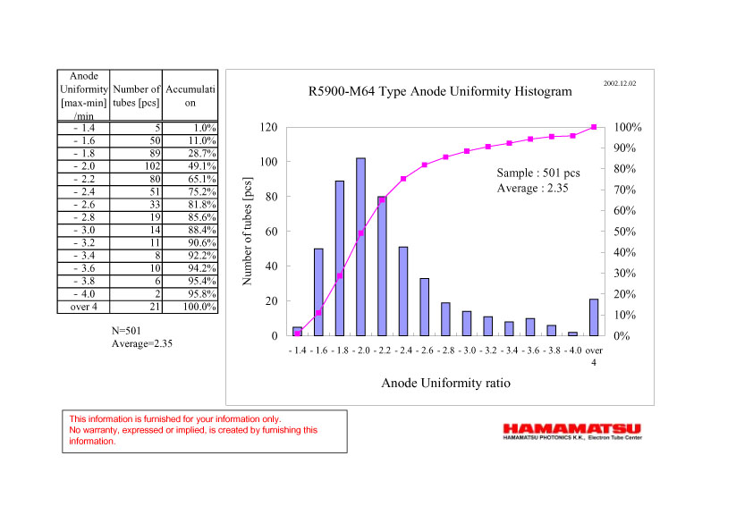
MaPMT Gain Uniformity
private communication from Hamamatsu, 12/2002:
gain variation over production sample of 501 R5900-M64 (predecessor of R7600)
total variation:
factor 5
90% within
factor 3.2
60% within
factor 2

