Slide 1
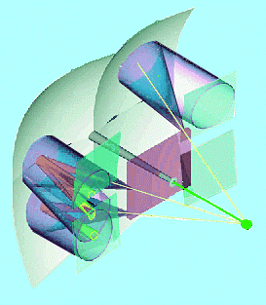
Bootstrap for the Flat-Panel PMT R&D Project
Attempt to compile & order questions & tasks for FP-PMT R&D project
test programme
tool set
key questions
towards a system integration
Edi test setup for Flat-Panel PMT
Edi test setup for QE measurements
Note:
this is a working document,
unfinished and evolving with time…
… comments from the meeting
were included
Flat-Panel meeting, 24.02.2009
Stephan Eisenhardt
University of Edinburgh

Slide 2
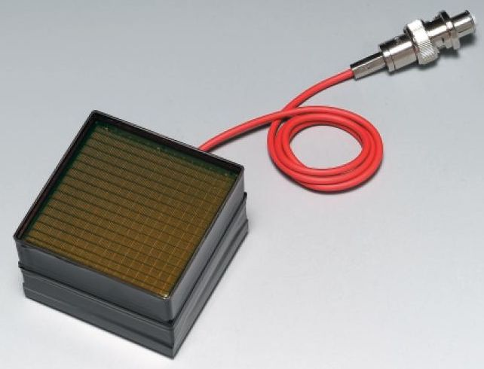
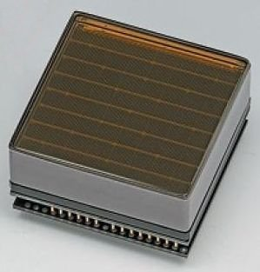
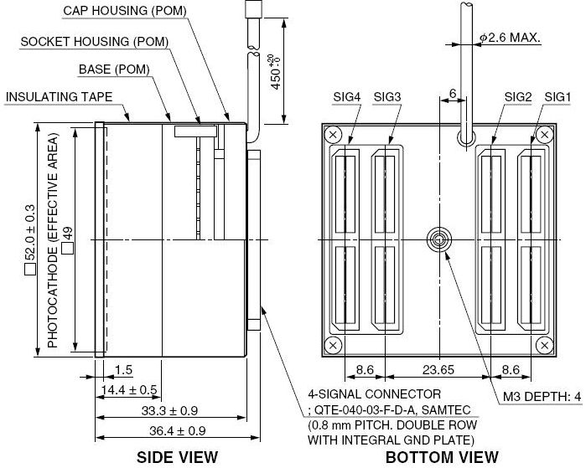
DUT – Device Under Test
Flatpanel PMT: R8400 (package H9500)
256 optical/electrical channels
52.0x52.0mm, square package
49.0x49.0mm active area, 0.2mm gaps
pixel size: 3.04x3.04mm (edge: 3.04x3.22mm, corner: 3.22x3.22mm)
active area fraction: 89% (78.3%)
includes:
HV connection (cable or pin)
HV distribution (bleeder chain)
256 ch. interface:
4x Samtec QTE-040-03-F-D-A connector
4x Samtec STE-040-03 shielded 50Ω signal cable
i.e. direct plug-in to PCB or via cable
needs:
charge integrating read-out
single HV supply
HV:
pin or
cable
contacts

Slide 3
FP-PMT Test Programme I
core programme:
conclude from as many as possible FP-PMT devices, test at several sites
single photoelectron spectrum, separation from pedestal
S/N vs. gain(HV) (700...1100), i.e. posterior gain equalisation possible?
single photoelectron loss below threshold vs. gain(HV)
channel-to-channel gain variation in single FP-PMT
global gain variation between FP-PMTs
system common mode
needs:
common definition of gain, S/N, signal loss below threshold, …
common fit function to signal spectrum, to talk the same language…
proposal: use algorithm developed for MaPMT: LHCb-2004-016
(inter-)calibration of used readouts: gain/charge, (electronic) system noise

Slide 4
FP-PMT Test Programme II
specialised measurements / tasks:
crosstalk to neighbouring pixels
disentangle crosstalk in FP-PMT, Samtec cable, adapter/FE electronics
behaviour on B-field (signal loss, gain loss, crosstalk)
signal gain margin for ageing and B-field loss (need for gain matching of tubes?)
signal (gain?) loss at edges and corners of FP-PMT
profile across pixel (inefficiency at centre?, shape of edge & corner?)
active area fraction (actual sensitive area, gaps between pixels)
QE, signal gain & signal efficiency for bialkali, SBA & UBA photocathode
QE variations across window surface
(QE for borosilicate & UV-glass window)
time profile of signals (any spill-over in subsequent electronics?)
stand-alone MC study of signal efficiency with increased pixel size wrt. HPD

Slide 5
FP-PMT Test Tools
for core programme:
common language: algorithm to describe signal shape/gain/loss
→ existing algorithm: used for MaPMT
(current implementation in Fortran, port to C++ needed?)
controlled (pulsed), single photon light source (per pixel, per event)
→ existing scheme: low cost pulsed LED system used at PDTF
(470nm, 10-15ns FWHM, no afterpulses)
charge injection for charge/gain calibration & cross-talk of readout/cables
automated(?) HV control
for special measurements:
focused light source & xy-stage
magnetic field
calibrated QE measurement
readout with channel-individual gain adaptation:
(e.g. MAROC chip, or discrete)

Slide 6
Key Questions
Key questions to answer for FE electronics (all inter-linked):
dynamic range of signals put into FE chip (any clipping of large input signals?)
signal shaping in preamp: rise time, recovery time, any spill-over to next cycle (e.g. for large signals, depending on characteristics of FE-chip…)
resolution (bits) of channel-by-channel pre-amp gain adjustment (configurable)
digital vs. binary output signal? (analogue signal transmission is out, isn’t it?)
if digital: number of ADC bits?
consequences for links/bandwidth
need/desire online common mode correction?
if online CM-correction where - in FPGA on FE board or at L1?
which resolution needed?
zero suppression before transfer to L1?
pro: saving in bandwidth
contra: need to understand signal very well, otherwise source of bias (countermeasures?)
needed bandwidth and number of GBT links to L1?
(any need to discuss anything other than optical, i.e. copper? e.g. due to cost?)

Slide 7
System Integration
System integration:
module size: e.g.
2x2 FP-PMT = 1024 channels, like for MaPMT, similar to HPD
any reason for other grouping?
arrangement of modules to a plane
to cover the current detector plane
any changes needed/desired?
needed supplies and support:
understand changes to HPD system
evaluate mag. shielding needs and consequences on layout
evaluate possible re-usage of current infrastructure: e.g.
magnetic shielding, photon funnel, quartz windows, MDMS system …
total power consumption and cooling needs
compile/build solution for physical layout of components
need to start thinking now… the 2015 time scale might change a lot…

Slide 8
Case for On-board FPGA
Zero Suppression (now back on the table…)
application after discrimination
… but on-board before transmission to L1 to save bandwidth
caveat: need to understand signals very well to not introduce bias
Cross-talk correction
needs access to all channels of a FP-PMT (i.e. across several FE-chips)
correction needs to be done before discrimination
Common Mode correction
same requirements as cross-talk correction
needed unless:
final system is guaranteed to not have common mode
FE-chips have common mode correction built in
(not whole FP-PMT: would that be sufficient?)

Slide 9
Edi Flat-Panel Setup (default)
planned default Edi setup for Flat-Panel PMT tests: using commercial QDC
☺: fully automated, low crosstalk
😐: 64 channels as a time, needs linear amplification, kHz
ordered:
FP-PMT
VME: CAEN V972 32xQDC (x2)
VME: CAEN V1495 IO
VME: CAEN V288 CAENET
to build:
64x video amp PCB (x2 + adapter for crossing)
(LED trigger box)
DAQ programme:
adapt for new HW & tests
LED
trigger
box
trigger
LED
470nm
enable
power switch
x
y
stepper driver
x
4x 16ch
Qx100
y
RS232
or USB
VME
Q
single
ended
64x
Q
single
ended
GRIN
lens
Video amp
PCB
x1 (x4)
Samtec
x4 SxC
50Ω coax
(optional)
FP-PMT
CAEN
N470 HV
focused
pulsed (CW)
light source
defocused
pulsed (CW)
light source
NI 8012
interlock
PCI
dark box,
DUT, amp PCB,
GRIN on xy-stage
PC
Labview
NI 8012 controller
CEAN V972 32xQDC
CAEN V1495 IO
CEAN V972 32xQDC
CES RCB 8047 CORBO
CAEN V288 CAENET

Slide 10
Edi Flat-Panel Setup (option)
optional Edi setup for Flat-Panel PMT tests: using 4x BoardBeetle1.2MA0
☺: fully automated, 256 channels as a time, 40MHz
☹: crosstalk and dynamic range issue, extra C
ordered:
FP-PMT
to build:
4x adapter Samtec-PGA (PCB?)
(LED trigger box)
DAQ programme:
adapt for tests
LED
trigger
box
trigger
LED
470nm
enable
power switch
x
4x 64ch
of
(4x 128ch)
y
stepper driver
4x 64ch (of 128 ch)
x
y
RS232
or USB
VME
V
128x LVDS
multiplex
Q
single
ended
GRIN
lens
BoardBeetle
1.2MA0
x4
Samtec
x4 SxC
50Ω coax
(optional)
FP-PMT
CAEN
N470 HV
focused
pulsed (CW)
light source
defocused
pulsed (CW)
light source
NI 8012
interlock
PCI
dark box,
DUT, amp PCB,
GRIN on xy-stage
PC
Labview
adapter
Samtec-
PGA
(extra C!)
SEQSI
NI 8012 controller
MIDAS20 + FLIC
CAEN V1495 IO
CES RCB 8047 CORBO
CAEN V288 CAENET

Slide 11
Edi Flat-Panel Setup (w. B-field)
optional Edi setup for Flat-Panel PMT tests: using 4x BoardBeetle1.2MA0 (or QDCs)
☺: fully automated
😐: 256 (64) channels as a time, crosstalk and dynamic range issue
units still to organise/borrow/buy:
new current source
(may have access to borrowed source)
to build:
special dark box
current source interface
LED
trigger
box
trigger
LED
470nm
enable
4x 64ch
of
(4x 128ch)
stepper driver
4x 64ch (of 128 ch)
RS232
or USB
VME
V
128x LVDS
multiplex
Q
single
ended
BoardBeetle
1.2MA0
x4
Samtec
x4 SxC
50Ω coax
FP-PMT
CAEN
N470 HV
defocused
pulsed (CW)
light source
NI 8012
interlock
PCI
dark box,
DUT, amp PCB,
GRIN on xy-stage
PC
Labview
adapter
Samtec-
PGA
(extra C!)
SEQSI
or USB
NI 8012 controller
MIDAS20 + FLIC
CAEN V1495 IO
CES RCB 8047 CORBO
CAEN V288 CAENET
0-10V
30A
source
magnet 0-35mT (0-350Gauss)
12cm opening

Slide 12
new Edi QE setup
Edi setup for QE measurement:
fully automated
established measurement procedure
units still to order:
ND filter set
quartz lens
xy-stages & stepper driver
(NI 6036E to SC2042 interface)
(solenoid for PD)
to build:
(dark box)
new distr. box
mounts for
xy-stage
PD
new power switch
Labview program
NI SC2042
power switch
NI 6036E
PCI
quartz lens
(optional)
x
y
stepper driver
RS232
or USB
φ
x
y
PD
DUT
GPIB
Xe lamp &
ND filters
monochromator,
switch (& chopper)
dark box,
calib. Si-PD
on φ-arm,
DUT on xy-stage
distr. &
switch box
PCI
I in
PC
Labview
V out
interlock
GPIB
pA meter
6487
USB

Slide 13
Conclusions?
… not really
we have a mountain of work before us
… and little time

Slide 14
Spare Slides

