Slide 1
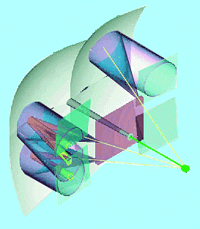
Flat-Panel PMT Front-End Requirements
Bootstrapping: where from?
Gain adaptation for large signals and variations
Dynamic range and spill-over
ADC layout
On-board FPGA
Conclusions
RICH Upgrade meeting, 16.04.2009
Stephan Eisenhardt
University of Edinburgh

Slide 2
Bootstrapping: where from?
We have to formulate our needs and wishes to feed our view into plans to develop dedicated L0 front-end electronics
This talk tries to start the discussion on the L0 electronics parameters for the Flatpanel-PMT as would be suitable for the RICH
The information/ideas here are drawn from:
fall transit anode gain
time time spr. dark I variation
the FP-PMT spec sheet 0.8 ns 0.4 ns 0.05 nA 1:4
(to be updated from evaluation data)
the 2003 evaluation of the MAPMT 1.1 ns 0.3 ns 0.2 nA 1:4
(assumed to yield very similar pulse shapes and spectra)
discussions with Jan Buytaert, Ken Wyllie, …

Slide 3
Beetle1.2MA0 – Front End
… look back: what did we have…
‘input-attenuation’ Front-End: gain adapted to MaPMT signal: 300k e⁻
coming from preamp optimised for Silicon signal (2x MIP a 22k e⁻)
larger C_{FB} was needed for same output from larger input signal
posed a problem in Beetle1.2 as boundaries of FE-design were fixed already
i.e. only limited real estate available for the feed-back capacities of the preamp
nevertheless, Nigel’s cramped solution (above) worked very well:
noise: ~0.5 ADC channels (~4.3k e⁻); signal: ~35 ADC channels (~300k e⁻)
in FED with issues: 7-bit effective, limited dynamic range
V
V
C_{FB, preamp}
~300kΩ
~100kΩ
Beetle 1.2MA0:
Nigel Smale, 2003
~800fF
~200fF
line-in
C =O(10pF)
&
R=50Ω
V
MaPMT
preamp
shaper
buffer
output to ADC
input
~200fF
bias
bias
bias

Slide 4
Gain Adaptation in MAROC 2
MAROC 2 chip provides gain adaptation for 64 MaPMT channels:
(super common base) pre-amplifier with successive scaled mirror (i.e. variable gain unit)
low input impedance → low current in mirrors → reduced cross-talk
6 bits to steer 6 parallel scales
gain value 0 = signal inhibited
gain value 16 = unity gain
input signal variation 4:1 equalised to ~6% of nominal signal (300k e⁻)
input range: 75k…300k e⁻ → to: 295.3k…314.0k e⁻, i.e. width: 18.75k e⁻
preamp

Slide 5
FP-PMT Preamp Options
Capacitive gain adaptation:
real estate not yet defined
→ chance to find optimal solution
configurable capacities for each channel provide gain adaptation
simple approach (Jan Buytaert):
minimum fixed capacity: C_{BF,min}
(for minimum signal)
6 bit configuration for additional C
(i,.e. 64 higher C levels for larger signals)
→ input gain variation 4:1 equalised to <5% of minimum signal
Serves both:
proper treatment of large input signals (low cross-talk!)
equalisation of 4:1 gain variations
V
???kΩ
32x C
16x C
8x C
4x C
2x C
1x C
C_{FB,min}
???fF
preamp
input
bias

Slide 6
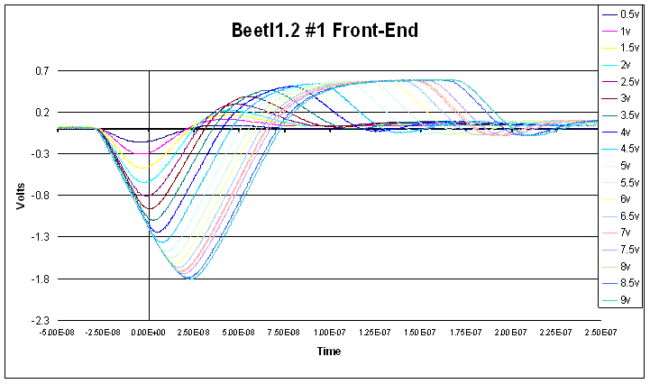
Dynamic Range Adaptation
signals larger than linear dynamic range lead to spill-over:
pulse clamping at or in pre-amp: (several options)
e.g. current limiting diode before pre-amp
or non-linear feed-back parallel to integrating capacity
both leading to:
Beetle 1.2 with 8-dynode MaPMT:
1 photoelectron ~ 58 ke⁻
= 150 mV after pre-amp
Nigel Smale, 2003
1 phe ~ 58 ke⁻
= 150 mV
25 ns
preamp
current
limiter
non-linear impedance
V
C_{FB}
t
effective pre-amp output
preamp
input

Slide 7
ADC Binning
options of ADC binning, if resolution is limited:
aim: minimise signal loss while suppressing noise
problem: need high ADC resolution at pedestal and threshold position
example ADC binnings (here illustrated for 5-bit ADC):
linear layout, full dynamic range
pro: well understood
con: limited resolution where needed
linear layout, limited dynamic range
pro: significantly increased resolution
in pedestal and threshold region
con: blind to medium and larger signals,
measurement of gain and calibration of signal loss from data not possible,
cross-talk correction jeopardised (how strongly?)
non-linear layout, optimised dynamic range
pro: increased resolution where needed, some sensitivity to full range kept
con: calibration/interpretation of data non-trivial, problems of 2) eased but not gone
➔ best option: linear layout, high resolution, full dynamic range…
idealised FP-PMT
signal spectrum
pedestal
optimal
threshold cut
signal loss
example
ADC
binnings:
1)
2)
3)
1 and 2 photon
spectra

Slide 8
ADC Resolution I
What is the effect of a resolution limit on the signal loss?
example data spectrum: 2003 12-dynode MaPMT data
1 photoelectron ~ 300ke⁻, ADC: 7-bit effective (FED with dynamic range limit)
deducted signal loss of example data:
11%, due to photo-conversion at 1st dynode
for reduced resolution the signal loss
increases as one cannot cut as precise
in example spectrum the loss increases
by factor 2 for reduction 7-bit → 4-bit
➔ requirement for ‘high resolution’ means: 7-bit or more
2003 MaPMT example data:
example
ADC
binnings:
7-bit: 128 ch.
6-bit: 64 ch.
5-bit: 32 ch.
4-bit: 16 ch.
4-bit: signal loss: 21.8%
5-bit: signal loss: 16.5%
6-bit: signal loss: 12.8%
7-bit: signal loss: 11%

Slide 9
ADC Resolution II
Example layout of ADC:
system design usually aims for:
system noise σ: O(1 ADC)
common mode: O(<1 ADC)
Beetle1.2MA0 + FED (best values achieved), MaPMT typical size 300ke⁻:
ADC bin resol. range 1 phe @ noise σ S/N threshold sensitivity/loss
7-bit_{eff} 8.6ke⁻ 550 ke⁻ ped. + 35 ch. 4.3ke⁻ 70 high / low
new ADC layout: FP-PMT typical signal size: 1.5Me⁻
8-bit 10 ke⁻ 2560 ke⁻ ped. + 150 ch. 10 ke⁻ 150 very high / lowest
8-bit 20 ke⁻ 5120 ke⁻ ped. + 75 ch. 20 ke⁻ 75 high / low, sensitivity to 2nd ph.el.
7-bit 20 ke⁻ 2560 ke⁻ ped. + 75 ch. 20 ke⁻ 75 good / low
6-bit 30 ke⁻ 1920 ke⁻ ped. + 50 ch. 30 ke⁻ 50 satisfying / bearable
5-bit 60 ke⁻ 1920 ke⁻ ped. + 25 ch. 60 ke⁻ 25 marginal / high
4-bit 120 ke⁻ 1920 ke⁻ ped. + 12.5 ch. 120 ke⁻ 12.5 inadequate / very high
High-res ADC are only a concern for bandwidth reasons, but our requirements are:
high-res threshold, with data reduction to hit information (possibly 2-hit info)
reliable calibration of our data processing ➔ solution: on-board FPGA

Slide 10
On-board FPGA
On-board FPGA serves the following purposes:
during data acquisition:
1st step: common mode correction, if neccessary:
use ADC data of full tube to find pedestal position (if not yet done by FE-chip)
2nd step: cross-talk correction:
use ADC data for neighbouring pixels to correct for cross talk before discrimination
3rd step: zero suppression / digital discrimination
select data to send to L1
4th step (optional): data reduction:
convert ADC values (n-bits) → hit-map (1 bit) or
convert ADC values (n-bits) → multi-hit probability (m<n bits)
needs significant computational power of the FPGA
but can live with relatively low bandwidth requirements
in calibration run:
unchanged feed-through of all ADC data to L1
this introduces dead time
but allows for checks/calibration of the algorithms for step 1-4

Slide 11
Conclusions
We need to formulate *our* needs to negotiate with collaborators
Aim for the best system and see what we can realise:
Front-End adapted by design for large charge pulses
6-bit gain adaptation to equalise FP-PMT internal gain variations
dynamic range limitation designed into pre-amp
to avoid spill over from large signals
high resolution ADC for:
high S/N
high threshold sensitivity
low signal loss
on-board FPGA to process data and reduce volume, but allow for checks and calibration
Open to discussion and evolution
… especially needed when FP-PMT data comes in

Slide 12
Spare Slides

Slide 13
draw-page: do not use

