Slide 1
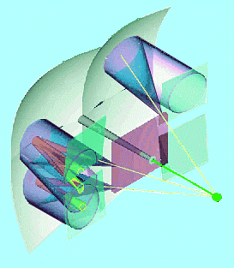
Flat-Panel PMT Status of Readout at Edinburgh
Development of amplifier for FP-PMT signals
First FP-PMT signal traces (with a 2-channel readout…)
Conclusions
RICH Upgrade meeting, 26.08.2009
Stephan Eisenhardt
University of Edinburgh

Slide 2
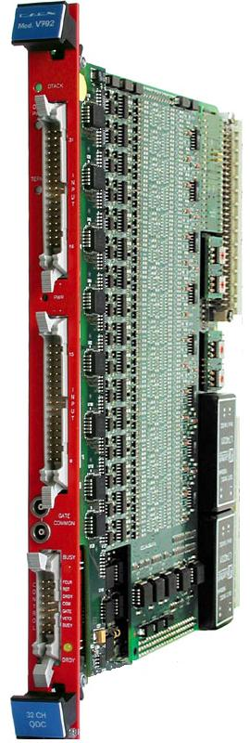
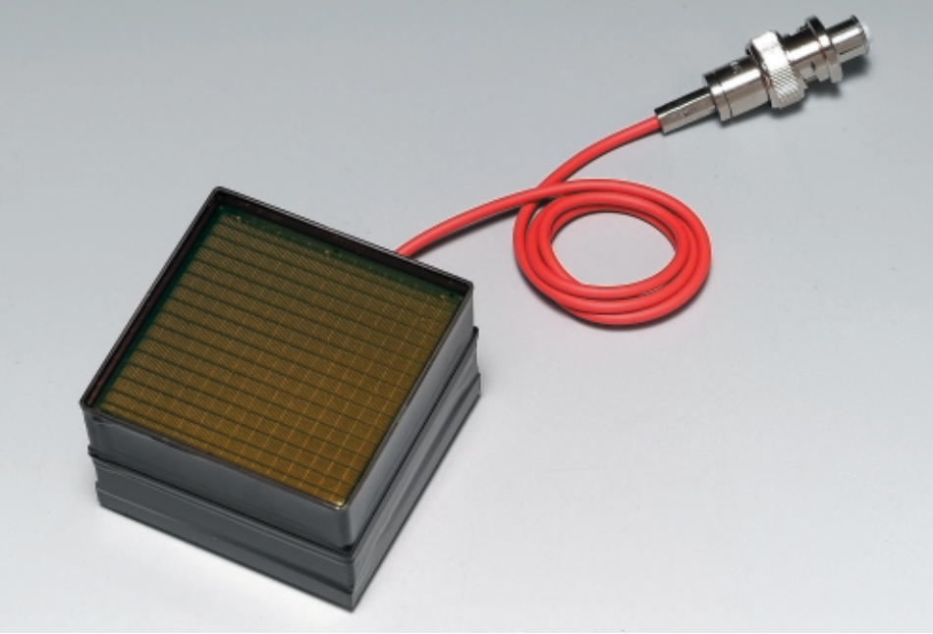
Task: Build a Reference Readout .
Adapt signal output of FP-PMT to charge sensitive ADCs
need 64x amp:
gain ~100
PMT signal: 0.06 – 0.24pC (0.375 – 1.5 Me⁻)
256 channels
ADC Range: 0 – 400pC
Resolution: 0.10pC
2x32 channels

Slide 3
How to …
Commercial fast amps too expensive for 64 channels:
channel gain: 10
e.g. 16 channels for ~ £ 3000.-
OK for 8 channels, as done for MaPMT
too expensive for 64 channels (Σ = £ 24000.-)
Alternative : build your own…
large gain
low noise
linear in charge amplification
fast (base of pulse shape <15ns)

Slide 4
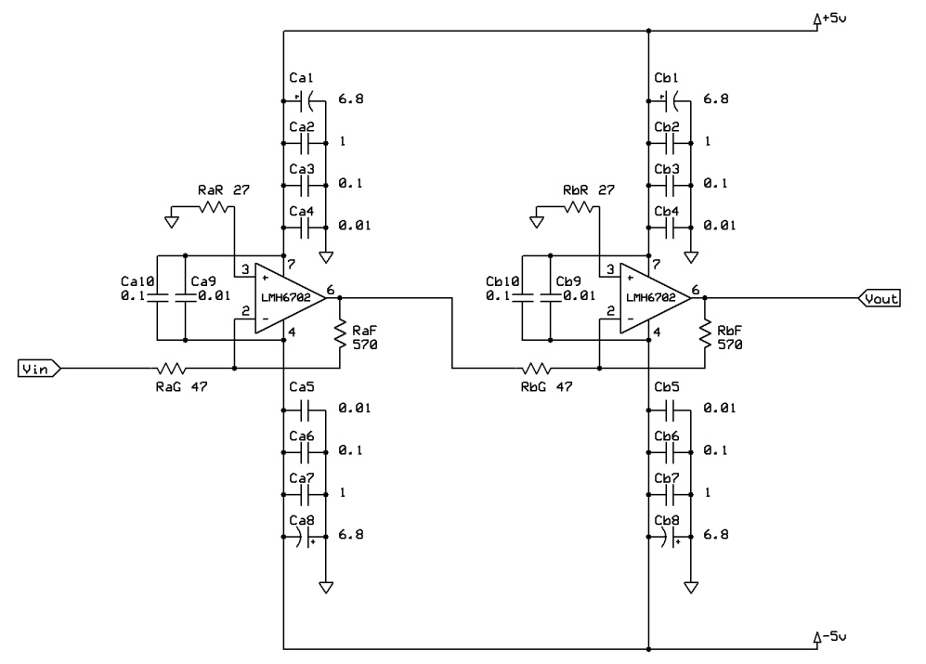
Our Solution
Base: op-amp LMH 6702
non-differential, wideband op-amp
ultra low distortion
bandwidth at gain 2: 1.7GHz (output signal <0.5Vpp)
bandwidth at gain 10: 370MHz
operated in inverting mode
fast slew rate: 3100V/μs
low noise: 1.83nV/ √Hz
Our layout:
two-stage amplifier
50Ω input and output termination
each stage with gain 10
→ operation outside recommended range…
strong noise filtering
signal GND and power GND separated

Slide 5
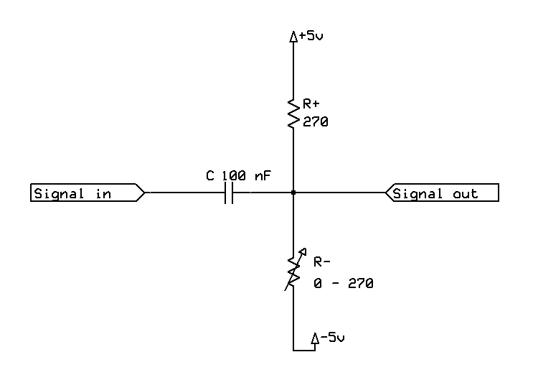
Biasing
Restriction by the input circuit of the V792: may not exceed +15mV
risk of damage to the input circuit
i.e. positive overshoots may kill the expensive devices…
Solution:
adjustable bias circuit in the output
capacitive decoupling (100nF)
bias adjustable (0…-5V)
use low noise trimmer (500Ω, 25 turn)
Operation:
mandatory study of output signals before connecting to V792
set biases for all channels individually to a safe value…

Slide 6
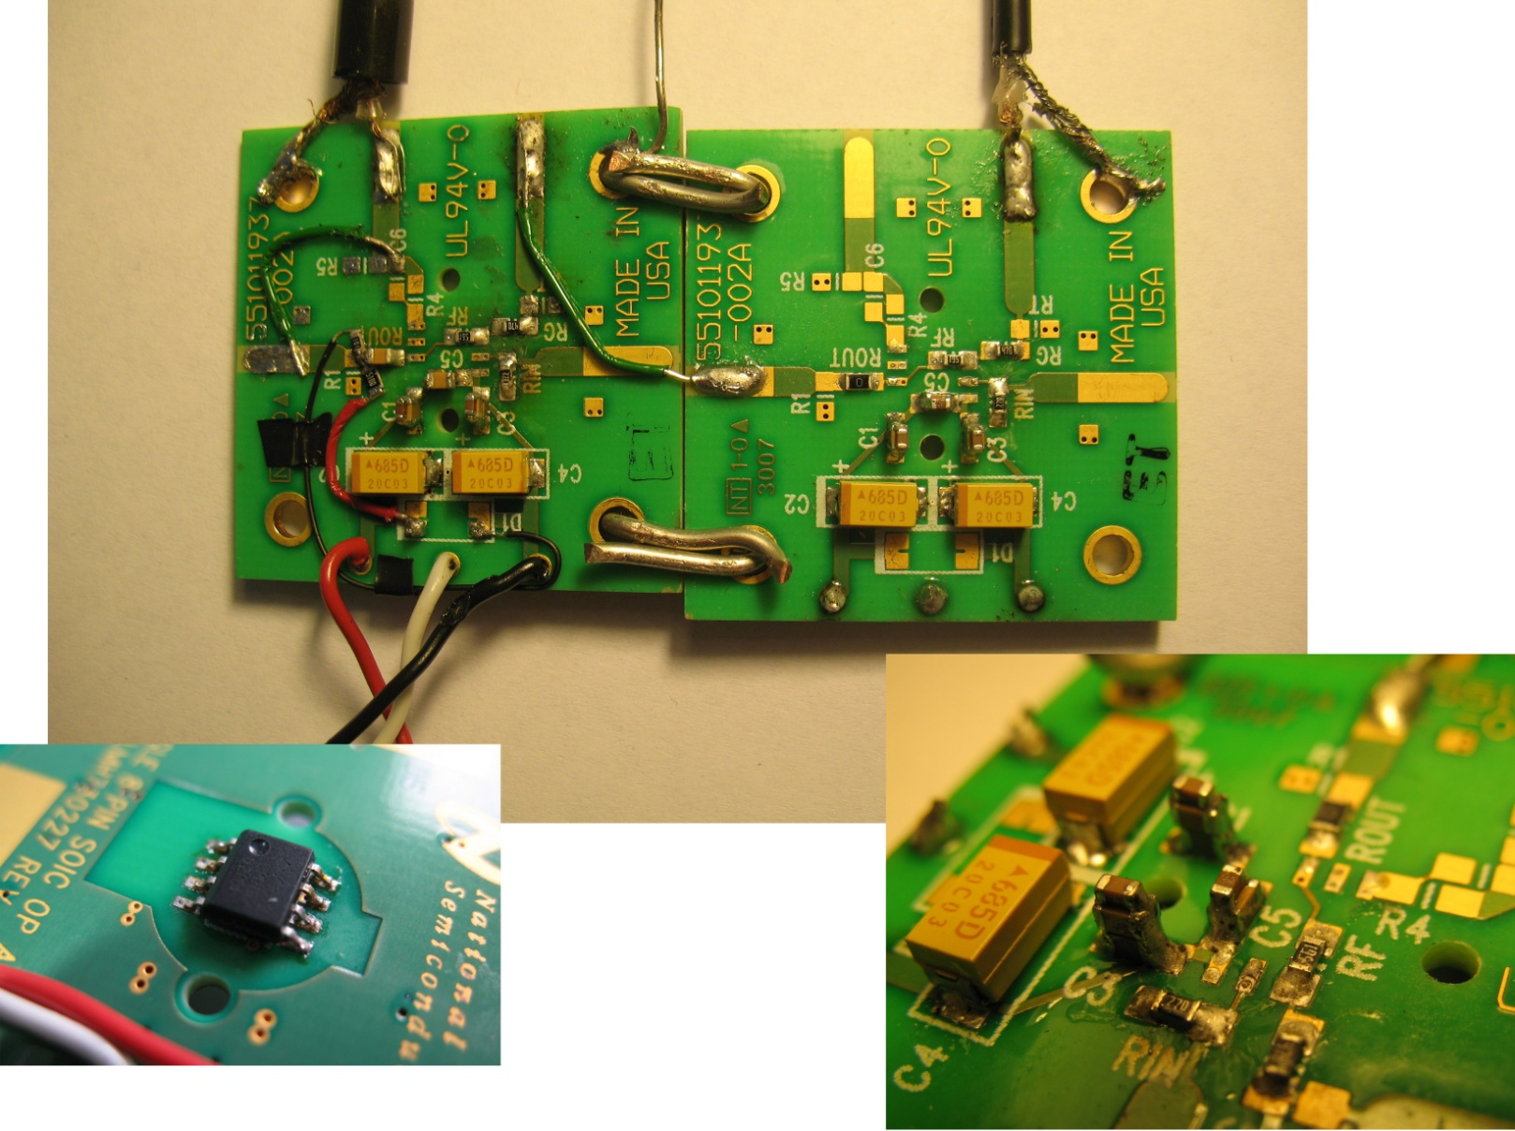
The Prototype
Built and studies by Iain Longstaff (summer student):
using two
evaluation PCBs
signal source:
MaPMT@1000V
gain ~1.2Me⁻
(centre channel)
use dark counts =
single photoelectrons
signal split to:
- amp input
- oscilloscope
readout:
oscilloscope
50Ω input

Slide 7
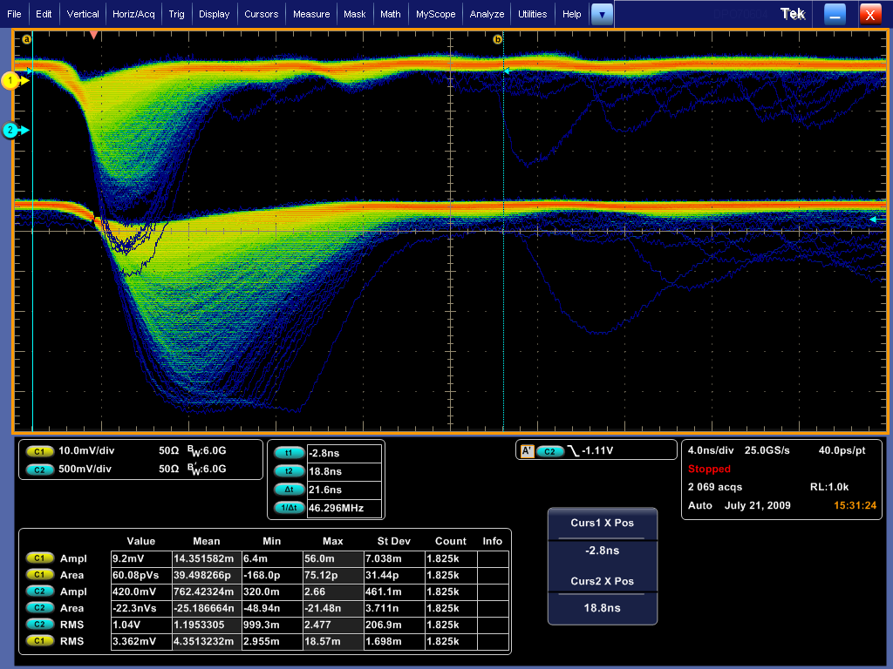
MaPMT Signal Trace
MaPMT pulses
10mV/div
amp pulses
500mV/div
time scale
4ns/div
>2000 pulses

Slide 8
Prototype Results
Voltage gain:
saturates: at 4V - bias
due to output current limit of 80mA & 50Ω termination
Charge gain:
effective gain: expected: 142, found: 132±3
linear over the whole spectrum, if integrated over 16ns
Noise:
measured standard deviation of pedestal
(HV of MaPMT off)
std dev @ input: 0.58mV
std dev @ output: 19mV
ratio: 33 << gain
noise at input limited by measurement,
not by amplifier
400pC
1pC

Slide 9
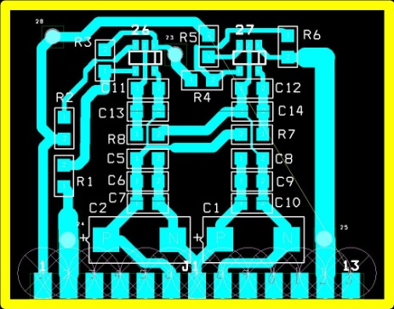
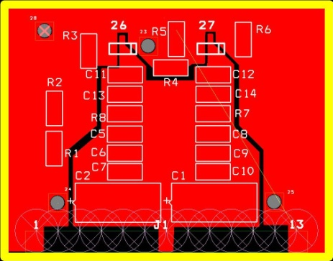
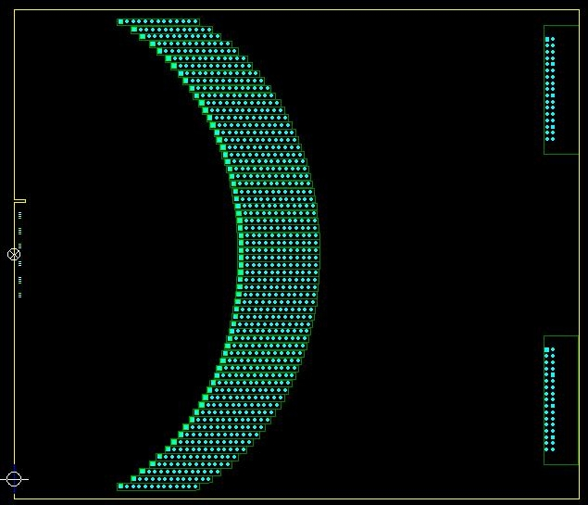
Amplifier Status
Single Channel amplifier PCB:
PCB designed
130 PCBs produced
first PCB populated and under test
Motherboard:
currently in PCB design
64 amplifier PCBs plug vertically in
alternating from front and back side
same input track length (capacity!)
impedance match where possible
power bus bars
64 biasing circuits
complication: high density input connector
2x40 pins, 0.75 mm pitch
connecting to both sides of the PCB
connecting to GND on the edge
amp circuit
GND planes
4 output
connectors
a 16 ch
64 ch
input
connector
room for
bias circuits

Slide 10
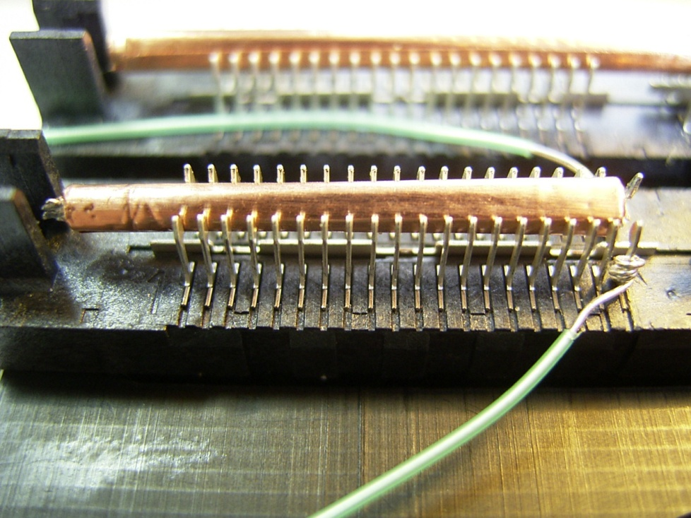
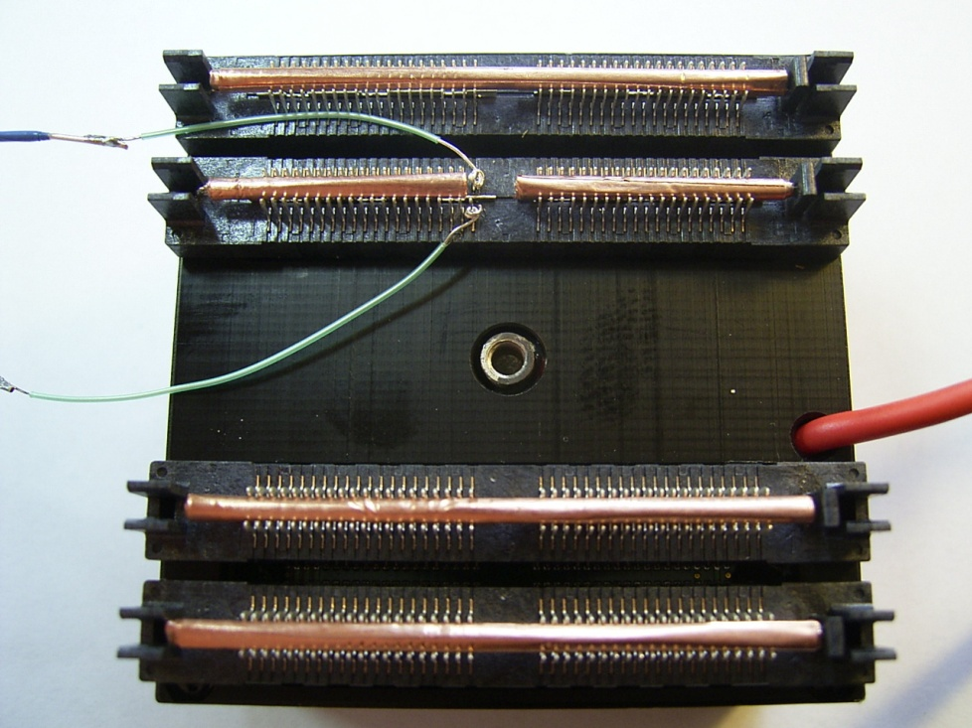
Two-Channel Readout
How to read out single FP-PMT channels? (without a proper setup…)
need proper grounding of other channels…
Recipee:
use 4 PCB mount connectors
roll copper foil
squeeze between solder pins
(shorts 16 GND to 64 signal pins)
leave gap to feed out 2 channels…

Slide 11
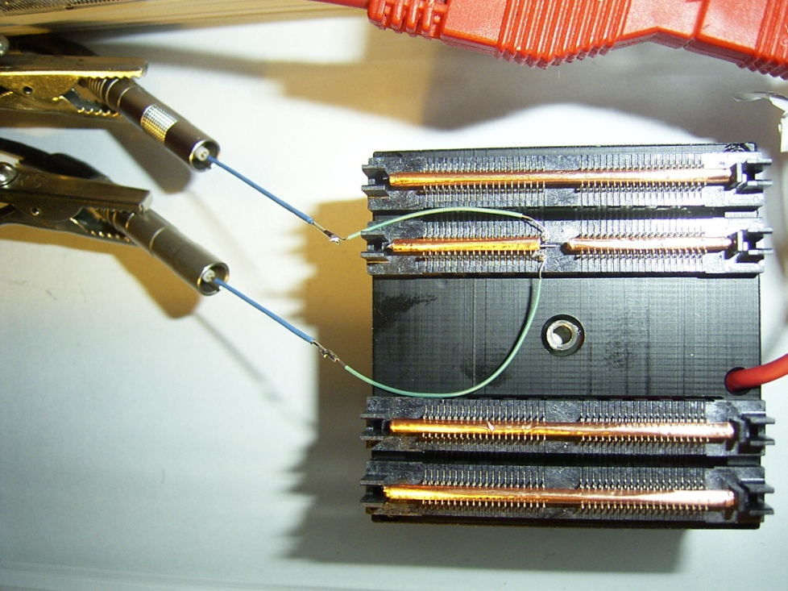
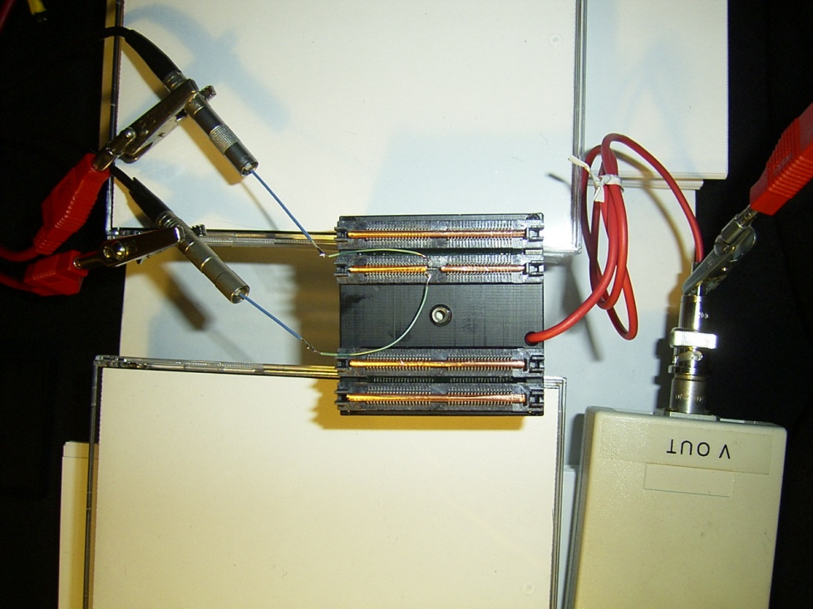
Two-Channel Readout
feed lines directly into LEMO cables…
and ground well (aehm, sort off…)
prop up FP-PMT in dark box
and look for dark counts
caveat: no cross-talk study possible yet
(not neighbouring channels)

Slide 12
FP-PMT Signal Trace
FP-PMT pulse
10mV/div
amp pulse
500mV/div
time scale
4ns/div
τ_{rise}~0.8ns
1 pulse

Slide 13
MaPMT Signal Trace
known reflection from Y-split
MaPMT pulse
10mV/div
amp pulse
500mV/div
time scale
4ns/div
τ_{rise}~1.2ns
1 pulse

Slide 14
FP-PMT Signal Trace
FP-PMT pulses
10mV/div
amp pulses
500mV/div
time scale
4ns/div
>1000 pulses

Slide 15
FP-PMT Signal Trace
FP-PMT pulses
10mV/div
amp pulses
500mV/div
time scale
10ns/div
>1000 pulses

Slide 16
FP-PMT Signal Trace
FP-PMT pulses
10mV/div
amp pulses
500mV/div
time scale
40ns/div
>1000 pulses

Slide 17
Conclusions
Amplifier development took longer than expected
(not aided by me being ill for >1 month…)
Prototype amplifier works very well
linear in charge amplification
large gain
low noise
PCB status
amplifier PCB just back from production
motherboard PCB on the drawing board
FP-PMT signal trace
fast signal indeed: τ_{rise} ~0.8ns as in data sheet
ringing on the trace: not yet understood

Slide 18
Spare Slides

